Slide 1
PREPARING FOR SUCCESS
SELF-MANAGEMENT & GOAL SETTING
Notes:
In previous classes, we’ve talked about potential changes you can make to be successful in managing your chronic disease. These include changes to nutrition and physical activity. Today we are going to discuss HOW to make the changes that we’d like to make and/or implement the strategies you’ve learned into your daily life. We will also touch on the mind-body connection, including how stress and emotions can impact blood sugars, blood pressure, and other aspects of your physical health.

Slide 2
ONLINE CLASS ETIQUETTE
Minimize distractions
Turn off the TV, radio, cell phone ringer
Privacy & security
Asking questions
Chat box
Zoom tips
Notes:
1) Minimize distractions on the participants’ end. Presenter: Ensure your background is appropriate/not distracting.​
​
2) Privacy & security sample script:​
-Just like online shopping or email, Virtual Care has some inherent privacy and security risks that your health information may be intercepted or unintentionally disclosed.​
-Feel free to share your personal experiences or questions during our group discussion time, but please be aware that your personal information will be shared with anyone accessing this webinar.​
​
3) Participant questions.​
-Please let me know when you have a question by typing it into the chat box (explain where to find the chat box). I will be monitoring the chat throughout the session.​
-Or you can un-mute your microphone and ask your question out loud, if you prefer.​
​
4) Zoom tips. Turning off participants’ webcams saves bandwidth and reduces freezing/glitches.​
-On the next slide, show clients how to turn their microphone and webcam on & off.​
​
Does anyone have any questions before we get started?​

Slide 3
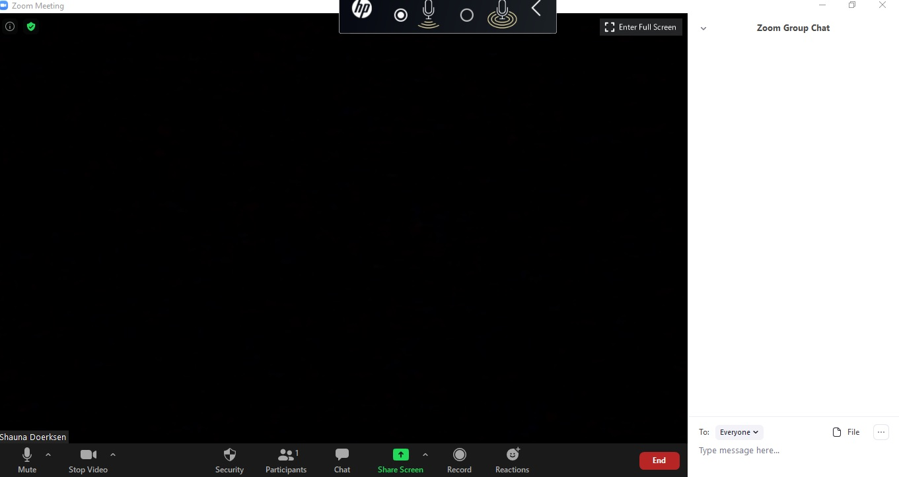
Notes:
1st animation: Arrows pointing to chat icon in taskbar and the chat box on the right side of the screen.
2nd animation: Arrows pointing to mute and stop video in the taskbar.

Slide 4
TODAY WE WILL TALK ABOUT …
Wellness & Chronic Disease Self-Management
Preparing for Change
Motivators & Barriers
Goal Setting
Action plan for change
Problem solving
Notes:
So today we are going to talk about:
1) Wellness and chronic disease self-management.
2) Preparing for change, identifying: a) the change we would like to make, b) what is motivating us and c) identifying barriers and how to overcome them.
3) Goal setting: Creating an action plan for change, and identifying the steps we need to make to carry forward with the change.
Please ask questions – this session is designed to be interactive and to support you in reaching your goals.

Slide 5
Icebreaker
What is an accomplishment that you are proud of?

Slide 6
Chronic Disease
“Conditions that last 1 year or more and require ongoing medical attention, or limit activities of daily living, or both.”
- Centers for Disease Control and Prevention

Slide 7
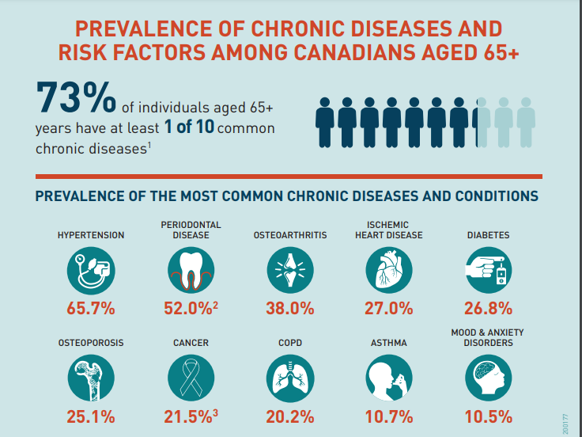
Chronic Disease
Notes:
If you hear the words “chronic disease” you may think of heart disease, diabetes or cancer. But there are many more chronic conditions that affect millions of Canadians. You might be living with one or more of the following conditions:
High blood pressure, Arthritis, Osteoporosis, COPD, Asthma, Chronic pain, Chronic fatigue syndrome, Fibromyalgia, Depression & anxiety, Lupus, Parkinson’s disease, or Dental/Periodontal disease. All of these conditions, among others, can have an impact on our mental or physical health.

Slide 8
Individuals living with a chronic condition may experience:
Fatigue
Loss of physical strength & endurance
Emotional distress (e.g. frustration, anger)
Sense of helplessness
Feeling overwhelmed by health demands
Notes:
If you have a chronic condition, you may experience: Fatigue, Loss of strength or endurance, Emotional distress, or A sense of helplessness.
It is normal to feel overwhelmed when you have a chronic condition. Stress is normal when receiving a new medical diagnosis or learning how to manage your health.

Slide 9
Stress
Notes:
Stress is the body’s physical response to something in your environment. Stress could be caused by having a fight with a friend or family member, if you have an important deadline or test coming up, if you’re having a busy time at work, or have a lot going on with life outside of work.
There are many things that can cause stress, but what differs from one individual to the next is: 1) The amount of stress that each of us experience, and 2) Our skills and ability to cope with stress. Prolonged stress can have serious, long-term consequences on our body and our overall health.

Slide 10
Stress: The body’s physical response to environmental factors
Prolonged stress can cause:
Cardiovascular disease
Weight gain
Digestive issues
Decreased concentration
Irritability
Shortened lifespan
Impact of stress on the body
Learning to manage stress is an important part of living a healthy life
Notes:
Health concerns that can arise from prolonged stress include: cardiovascular disease, weight gain, digestive issues, decreased concentration and irritability, and even a shortened lifespan. By learning how to manage stress in a positive way, you can reduce the negative impact of stress on your body and improve your overall health.

Slide 11
MANAGING STRESS
If you are feeling overwhelmed, hopeless, or like you can’t get through your daily routine …
Speak with your primary care provider
Consult with a licensed mental health professional (e.g. psychologist or counsellor)
Notes:
When thinking about managing a chronic disease, reducing stress is an extremely important part of managing our health. Different people may need different degrees of support to help manage stress. For some people, attending this class and learning new coping strategies, may give you the tools you need to improve your health.
If you feel hopeless, overwhelmed, or you have trouble just making it through the day, you may need more formal support. Please talk to your primary care provider or another health care professional, like a counsellor. They can connect you to resources to support your mental health and manage stress. We will talk about many strategies throughout today’s class and provide you with a list of resources at the end.

Slide 12
TRUE OR FALSE? “You can have a chronic condition and still live a healthy life”
TRUE
Notes:
Zoom poll question: You can have a chronic condition and still live a healthy life.
a) True b) False

Slide 13
THE FACTS
Being healthy in all aspects of our life helps us to:
Take control of our own health
Cope with challenges (chronic illness or other concerns)
Live life to the fullest
Improve our quality of life

Slide 14
Health: “A state of complete physical, mental and social well-being, and not merely the absence of disease” -World Health Organization
Wellness
“Includes the presence of positive emotions and moods, satisfaction with life, fulfillment and positive functioning”
-Centers for Disease Control and Prevention

Slide 15
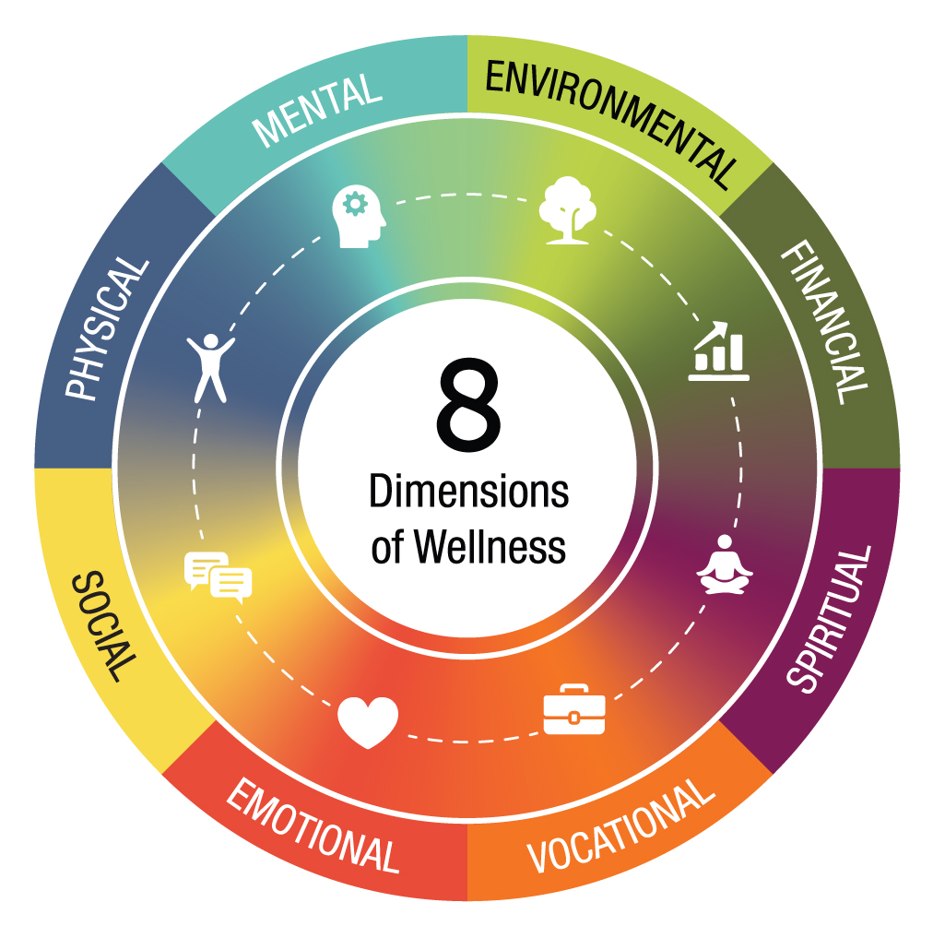
Notes:
There are 8 dimensions that make up wellness. These are emotional, spiritual, intellectual, physical, environmental, financial, occupational, and social wellness. We often think of ‘wellness’ in terms of our physical health, however in order to be truly healthy, we need to pay attention to all 8 dimensions of wellness.

Slide 16
Physical Activity
Enjoyment
Professional Help
Healthy coping strategies for wellness
Sleep
Social Support
Mental Wellness
Notes:
These coping strategies can be applied to all 8 dimensions of wellness.

Slide 17
TRUE OR FALSE? “I am dependent on health care professionals to manage my chronic condition”
FALSE
Notes:
POLL QUESTION.

Slide 18
HEALTH SELF-MANAGEMENT
We can live a healthy life with a chronic condition by working to overcome the problems caused by the condition, which may be:
Physical
Mental
Emotional
Social

Slide 19
Health self-management skills
Managing common symptoms and problem solving
Maintaining a healthy lifestyle
Decision making
Safe use of medication
Community resources
Effective communication with family and health care team
Adapting social activities
Notes:
-Managing common symptoms and problem solving: Responding to changes in symptoms as your chronic disease gets better or worse.
-Maintaining a healthy lifestyle: Regular exercise, healthy eating, good sleep habits, and stress management.
-Decision making: Deciding when to seek medical help, what treatments to try.
-Safe use of medication: Using medication safely and effectively, while minimizing side effects.
-Community resources: Finding and using community resources (social, financial, etc.)
-Communication: Communicating effectively with your health care team and with family/friends.
-Adapting social activities: Pacing yourself, Creating time for social connections that can fit within your chronic disease management goals.
Reference: Living a Healthy Life with Chronic Conditions, p. 6 (Participant guide for Get Better Together)

Slide 20
Educate yourself
Fight fear with knowledge
Stay informed
Give up the guilt
Ask for support from those around you
Practice self-care
Develop a realistic plan
Take action
Set clear, specific, short-term goals for action
Take Back Control:
Steps to
self-management

Slide 21
get ready to change
GET READY TO CHANGE

Slide 22
TRUE OR FALSE? “To make a change, all I need is willpower”
FALSE
Notes:
POLL QUESTION

Slide 23
Change is not that simple
THE FACTS
If only we could just wish we could change, and we did!
Change is hard for many reasons …

Slide 24
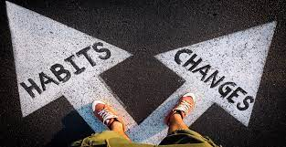
Why is change so hard?
We are creatures of habit
Path of least resistance
Disease management is demanding
“Pleasure principle”
Culture
High stress
Over-consumption of high fat, high sugar, and high salt foods
Notes:
-Creatures of habit: It takes a long time to develop new habits. It can be easy to change our behaviour in the short term but difficult to maintain for the long haul.
-Path of least resistance: This is a natural survival mechanism we take in order to conserve our energy.
-Disease management: Is demanding and requires a lot of work.
-Pleasure principle: For safety and survival reasons, we are motivated to prefer pleasure and avoid pain.
-Culture: We live in a culture filled with high stress, that promotes sedentary behaviours and overconsumption of calorie-dense food, which is readily available. Foods high in fat, salt and sugar activate the reward centres in our brains and bring us pleasure.
-All of these factors can undermine our attempts to change. You have probably experienced some or all of these challenges!

Slide 25
GETTING MOTIVATED TO MAKE A CHANGE

Slide 26
Changing our behaviour requires practice and a desire to change
Ask yourself:
What is the behaviour that I’d like to change and WHY?
What are 3 benefits to this change right now?
What are the long-term benefits?
Notes:
Changing our behaviour takes practice. Any behaviour that you try to change, is something that you should be able to maintain for the long term. The behaviour should be something that will benefit you and enhance your life. But change takes time and a lot of effort. In order to be successful, you must consider all the factors involved and PLAN for how you will make the change.
Some questions to help you start with a behaviour change:
What are 3 benefits to this new behaviour right now?
What benefits will you get today from making this change?
What benefits will you notice if you stick with the change?

Slide 27
Break down the change into small pieces
Notes:
Think of this apple as the change you want to make. You shouldn’t eat an apple in one bite. It’s easier and more manageable to cut the apple into pieces and eat it piece by piece. Your life changes work in the same way. You are more likely to stick to a change that is easier to manage. Small attainable changes result in better long-term results.

Slide 28
Behavior change….Where do I start?
Step 1
Identify the change you would like to make and complete a change plan worksheet
Step 2
Identify barriers and brainstorm strategies to overcome barriers
Step 3
Set a goal
Step 4
Create an action plan
Behaviour change: Where do I start?

Slide 29
GROUP ACTIVITY
Let’s identify a behaviour you would like to change
Notes:
Ask the group to brainstorm possible behaviours to change. If they are comfortable, ask one participant to volunteer their desired behaviour change, and work through that change together as a group, using the steps on the next slides.

Slide 30
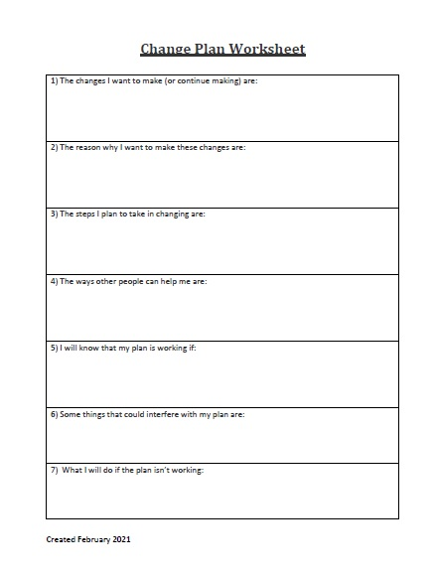
CHANGE PLAN WORKSHEET
Check your email
(sent with the link to today’s class)
Notes:
Here is the Change Plan Worksheet. This was emailed to you with the Zoom link for today’s class. If you have not received this worksheet, it will be emailed to you again after today’s class.
This worksheet can be an effective tool to help you identify: 1) Your motivation to change, 2) Identify barriers & supports in making a change, and 3) Create a plan.
Go through the steps of the Change Plan Worksheet as a group, using the example behaviour change that your group identified.

Slide 31
CHANGE PLAN WORKSHEET
Step 1
The change(s) that I want to make (or continue making) are:
The reasons why I want to make this change are:
The steps I plan to take in changing are:
The ways other people can help me are:
I will know that my plan is working if:
Some things that could interfere with my plan are:
What I will do if the plan isn’t working:

Slide 32
BARRIERS TO CHANGE
Step 2
Change is hard
It takes practice to change old habits
What could prevent you from achieving your goal?
What can you do to overcome these barriers?
Notes:
(Work through provided example from Group Activity). Example behaviour: Walk for 10 minutes every day.
Potential barriers: Lack of time; Lack of energy; Lack of motivation; Lack of/cost of transportation; Cost of a physical activity program; Cost of equipment, clothing, etc; Lack of a partner and/or support person; Other more important priorities in life; I’ve tried before and it didn’t work; I don’t feel comfortable being active; Fear of progression of diabetes or other health complication; Fear of injury or re-injury; Fear of low blood sugar during or after physical activity; Poor self image; I don’t like to exercise; I would like to change but I’m not ready.
Overcoming barriers: Have friends do the activity with you; Choose a small reward for every time you meet your goal for the day; Be creative.

Slide 33
OVERCOMING BARRIERS
Step 2
The change you want to make: “Eat healthier” (for example)
Barriers:
Difficult to choose better foods at the grocery store
Don’t know which foods are healthy
Your partner also eats unhealthy foods
Overcome the barriers:
Make a grocery list before going to the store
Research healthy foods online
Ask your partner to agree to the same meal plan

Slide 34
GOAL SETTING
Step 3
Goals are the new skills and behaviors we want to achieve
Goals can help us improve our physical and mental quality of life
With the right tools, our goals can become easier to achieve
Goals must be realistic and specific

Slide 35
Types of Goals
Emotional Goals
Outcome Goals
Action Goals
Notes:
There are 3 types of goals. It’s important to recognize the difference between these types of goals.
1) Emotional goal: These are goals about how we want to feel, e.g. “I want to feel happier”.
2) Outcome goals: Things that we want to have in life. Outcome goals are helpful motivators to our behavior, but we cannot necessarily control the outcome of a situation. There is never a guarantee that we will get the outcome that we are hoping for. In order to increase our chance of success, we want to convert an outcome goal into an action goal or behavioural goal.
3) Action goal/behavioural goal: This is something that you can change and that you do have control over. These actions or behaviours are the things we say and do in order to pursue outcome or emotional goals. For example:
-What do you want to do differently
-What do you want to start or stop doing
-What do you want to do more or less of
-How do you want to treat yourself, others, the world
The action goals are our focus for today.
Example: People often choose weight loss as a goal. This is an example of an outcome goal. However “losing weight” is NOT an action.
-Instead, we need to convert or break down the outcome goal into one or more actions, or action goals.
-What are the actions or behaviours that we need to “do” in order to lose weight? e.g. Incorporate exercise into our daily life, increase intake of vegetables, etc.
-Our long term outcome may be weight loss, but we need to break it into small, manageable behaviours.

Slide 36
Example
Steps to create
a goal
1) Start with the change you want to make
2) Break it down into small, actionable pieces
3) Identify a goal
4) Create an action plan
Notes:
Here are 4 easy steps to create and achieve the change you want to make in your life.
1) Think about the change you want to make. Write it down on paper – this makes it more concrete.
2) Break down the change into small actionable pieces.
3) Identify a goal you would like to work on – something that is important to you and that you feel motivated to accomplish.
4) Create an action plan - See next slides.

Slide 37
Example
1) Your change: “More physical activity”
2) Break it down: Dancing, walking, biking . . .
3) Choose a goal:
“I will dance”
4) Create an action plan: This week I will do a dance workout (what) for 10 min (how much) after lunch (when), 2 times per week (how often)
Example
Notes:
1) First, start with the big picture idea of what you want to achieve (often the emotional or outcome goals).
In our example, we want to “Do more physical activity”. However, physical activity is a broad category.
2) We can break it down by choosing one type of physical activity – in this example, dancing. This makes our goal more actionable.
3) Next we identify/choose a goal. “I will dance.”
4) Create an Action Plan and work towards your goal. This means doing the activity specified in your Action Plan.
Before you start working towards this goal, ensure you have the proper tools in place. For dancing, make sure you have enjoyable music or a workout video, a room with enough space so you can dance without bumping into things, and comfortable clothing and shoes.
Any questions about this?

Slide 38
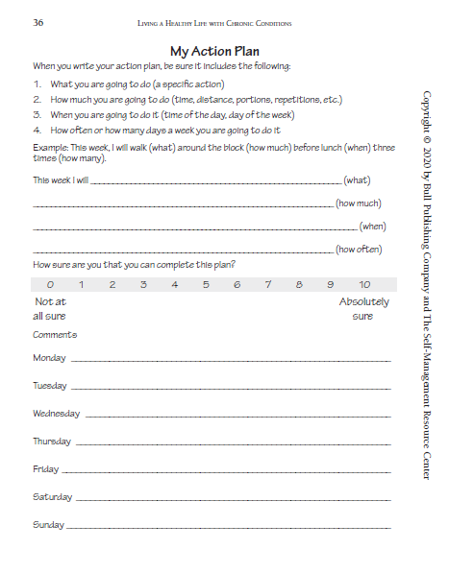
ACTION PLANNING
Step 4
An ‘action plan’ is a tool you can use to help you accomplish your goal. It asks:
Exactly what are you going to do?
How much will you do?
When will you do this?
How often will you do the activity?
On a scale of 1-10, how confident are you that you can complete your plan?
In your email ↑
Notes:
You also received this Action Plan worksheet with the email for today’s class. Please pull it out now. If you don’t have this worksheet, it will be emailed again after today’s class.
When rating your confidence about achieving your plan:
-If your confidence is 7 out of 10 or higher, this is probably a realistic action plan.
-If you scored below 7, you should look at your action plan again. Ask yourself why you are unsure in your confidence. What problems do you anticipate, how could you overcome these problems, and how can you change your action plan so that it is more realistic?
Reference: Living a Healthy Life with Chronic Conditions, p. 26 (Participant guide for Get Better Together)

Slide 39
YOUR TURN
1) Start with the change you want to make
2) Identify a goal
4) Rate your confidence level
3) Create an action plan
This week I will _____ (what) _____ (how much) _____ (when),
___ times per week (how often)
Notes:
Give participants 3 minutes to identify a goal, create an action plan, and fill in their worksheet. Then participants can share and discuss their action plans, if they feel comfortable.
What did you come up with? If you feel comfortable, please share your goal by speaking out loud or type it in the chat box.

Slide 40
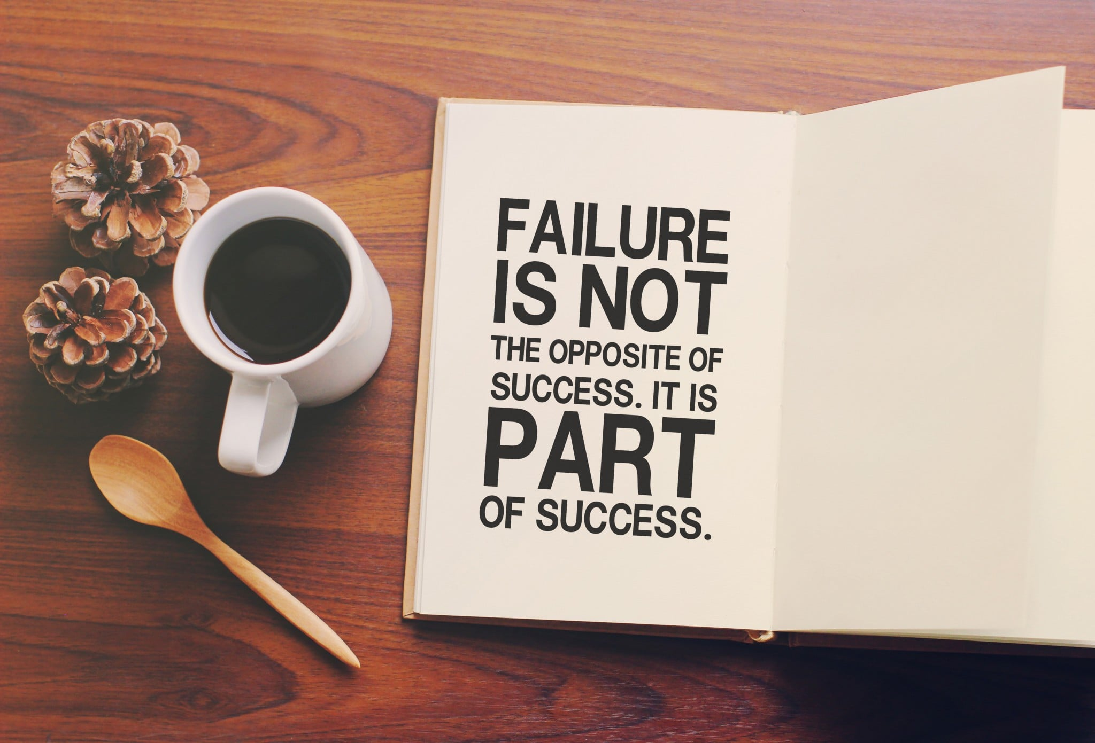
TIPS FOR SUCCESS TO ACHIEVE YOUR GOAL
Start small
Only work on 1 or 2 goals at a time
Re-evaluate your goals regularly
If at first you don’t succeed, try again
Celebrate your successes
This Photo by Unknown Author is licensed under CC BY-NC-ND
Notes:
Start small: Start with a change that is easy to achieve. This will help to motivate you to stay on track. If you start with a change that is too big, it can feel too overwhelming and discouraging, and you are less likely to be successful.
Only work on 1-2 goals at a time: If you have too many goals you want to achieve at the same time, this can be stressful, and it will be harder to manage.
Re-evaluate: It’s important to keep re-evaluating your goal. You may find that new barriers arise. Instead of giving up on the goal, re-evaluate and make changes to your goal. Maybe your goal was not realistic or achievable, given the changes that have happened in your life.
If at first you don’t succeed, try again: It takes time to learn what goals are manageable for us and what goals may be too big. -If you feel like your goal is getting very hard to meet, change your goal and try again. -Changing your life is a big deal, and we need to let ourselves feel some success before we challenge ourselves too much. This is an important learning opportunity that will help you learn how to accomplish goals better in the future.
Celebrate your successes: It is important to reward yourself for making steps to accomplish your goals to help motivate you. This will keep your motivation level high.

Slide 41
RECOVERING FROM SLIP-UPS
Everyone slips up or “falls off the wagon” once in a while
Change is hard and it requires practice
Don’t blame yourself or cast judgment
Problem solve: What caused you to slip up?
There is no such thing as failure, just feedback!
Notes:
Everyone slips up: Most people experience ups and downs when they try to implement a healthy habit.
-You may have had a busy day and skipped your exercise routine. Or maybe you went on vacation and stopped following your healthy diet.
-Once you fall off the wagon, it can be difficult to get back on track. But why?
-Often, we are very critical of ourselves. We fall into all-or-nothing thinking, and believe that if we do not achieve our goal 100%, then we have failed. When we feel like we’ve failed, we get discouraged, and it becomes more challenging to try again.
Change is hard: However, setbacks are normal and are very likely to occur. It would be unusual for you not to slip up with your new habits at least once in a while!
-Have you ever learned to play a musical instrument or learned a new sport? Were you perfect on your first or second try? It took practice before you mastered the skill.
-The same applies to any behaviour change you are trying to make. It is normal to make mistakes, and it’s important to learn from those mistakes.
Don’t blame: When you slip up, don’t blame yourself or feel that you just need to have more willpower. There is almost always a reason why you fell off track.
-Be curious with yourself, not judgmental. What caused you to slip up? Did you have an extra stressful day? Or maybe you ran out of time to grocery shop, so you didn’t have healthy food in the house, and went to the drive-thru instead.
Problem solve: Think about what was the problem, and how could you respond differently next time? Or how could you plan ahead so you don’t run into the same situation again? Next time, try out your new plan and see how it works. If it still causes you to slip up, try something else until you find a solution that works.
No such thing as failure: Try not to get frustrated and view your slip ups as failure. Instead, use that feedback to do better the next time.

Slide 42
STRESS / MENTAL HEALTH RESOURCES
Mental Health & Wellness Resource Finder
https://sharedhealthmb.ca/health-providers/mental-health-and-addictions/ mental-health-and-wellness-resource-finder/
Body Scan (4 minute meditation)
https://www.youtube.com/watch?v=ZM3eYRODNbc
Breathing Exercise & Deep Muscle Relaxation Exercise
http://www.adam.mb.ca/audio-relaxation
Notes:
Body Scan meditation: YouTube video that guides you through mindfulness exercises and can help you feel more relaxed in the moment.
Breathing & relaxation exercise: A 3 minute audio that guides you through breathing exercises which can help to reduce feelings of stress and anxiety.

Slide 43
STRESS / MENTAL HEALTH RESOURCES
Anxiety Canada resources: AnxietyCanada.com
Smartphone app: MindShift CBT
Free online counselling (AbilitiCBT): myicbt.com/home
Counselling: Check if your benefits include EAP (Employee Assistance Plan) or cover other mental health services
Notes:
Anxiety Canada’s website contains many articles and other mental health resources.
Mind Shift: A free smartphone app that provides guided breathing exercises and helpful coping strategies if you are feeling stressed or anxious.
AbilitiCBT: Free, virtual therapy for people experiencing anxiety, depression and anxiety related to the COVID-19 pandemic. (Service offered to Manitobans age 16+).

Slide 44
FREE CLASS SERIES
Cognitive Behavioural Therapy with Mindfulness (CBTm)
Changing your thought patterns to improve your mental health
Get Better Together
Coping with a chronic physical or mental health condition
Powerful Tools for Caregivers
Managing your own wellbeing while caring for a loved one
wrha.mb.ca/groups/

Slide 45
Thank you! Any questions?
Any questions?
Use the chat function or un-mute your microphone
Please complete an evaluation
Notes:
Evaluation: https://www.surveymonkey.com/r/WPYYNRZ
Put the Survey Monkey link into the chat box so that participants can complete the survey immediately.
Survey link should also be included in the email sent to participants after today’s session.

Slide 46
REFERENCES
Blair, S. N., Sallis, R. E., Hutber, A., & Archer, E. (2012). Exercise therapy – The public health message. Scandinavian Journal of Medicine and Science in Sports, 22, e24-e28. https://doi.org/10.1111/j.1600-0838.2012.01462.x
Clockify. (2021). How to set SMART goals: 10 helpful templates. Retrieved October 4, 2021, from: https://clockify.me/blog/productivity/smart-goals/
Colberg, S. R., Albright, A. L., Blissmer, B. J., Braun, B,, Chasan-Taber, L., Fernhall, B., Regensteiner, J. G., Rubin, R, R,, Sigal, R. J., American College of Sports Medicine, & American Diabetes Association. (2010). Exercise and type 2 diabetes: American College of Sports Medicine and the American Diabetes Association: Joint position statement. Medicine and Science in Sports and Exercise, 42(12), 2282-2303. https://doi.org/10.1249/mss.0b013e3181eeb61c
Dietitians of Canada. (2021). 10 SMART healthy eating goals. Retrieved October 4, 2021, from: https://www.unlockfood.ca/en/Articles/Weight-and-Health/10-SMART%E2%80%9D-Healthy-Eating-Goals.aspx
Gulve, E. A. (2008). Exercise and glycemic control in diabetes: Benefits, challenges, and adjustments to pharmacotherapy. Physical Therapy, 88(11), 1297-1321. https://doi.org/10.2522/ptj.20080114
Hughes, J. (2018, November 17). How to set SMART goals (with 5 examples). Retrieved October 4, 2021, from https://www.elegantthemes.com/blog/business/smart-goals
Knowler, W. C., Barrett-Connor, E., Fowler, S. E., Hamman, R. F., Lachin, J. M., Walker, E. A., & Nathan, D. M. (2002). Reduction in the incidence of type 2 diabetes with lifestyle intervention or metformin. New England Journal of Medicine, 346(6), 393-403. https://doi.org/10.1056/NEJMoa012512
Lorig, K., Holman, H., Sobel, D., Laurent, D., Gonzalez, V., & Minor, M. (2013). Living a healthy life with chronic conditions (4th ed.). Bull Publishing Company.
Mind Tools. (2021). SMART goals: How to make your goals achievable. Retrieved October 4, 2021, from: https://www.mindtools.com/pages/article/smart-goals.htm
Nathan, D. M., Cleary, P. A., Backlund, J. C., Genuth, S.M., Lachin, J. M., Orchard, T. J., Raskin, P., & Zinman, B. (2005). Intensive diabetes treatment and cardiovascular disease in patients with type 1 diabetes. New England Journal of Medicine, 353(25), 2643-2651. https://doi.org/10.1056/nejmoa052187
National Diabetes Information Clearinghouse. (2013, November 21). DCCT and EDIC: The Diabetes Control and Complications Trial and Follow-up Study. Retrieved May 2, 2014 from http://diabetes.niddk.nih.gov/dm/pubs/control/
NutriProCan. (2020, May 14). SMART nutrition goals guide and worksheet. Retrieved October 4, 2021, from: https://www.nutriprocan.ca/smart-nutrition-goals/
Streit, L. (2018, May 2). SMART goals for healthy eating and weight loss. Retrieved October 4, 2021, from: https://www.healthyforlifemeals.com/blog/smart-goals-for-healthy-eating-and-weight-loss

Slide 47
ACKNOWLEDGMENTS
Development team:
Cindy Campbell, OT Reg (MB) CRE; Laura Durling, OT Reg (MB); Katherine Kehler, OT Reg (MB); Maggie Wallin, BMR-PT CRE
Reviewer team:
Aimee Bowcott, MPH RD CDE CRE; Cindy Campbell, OT Reg (MB) CRE; Shauna Doerksen, RD CDE; Jenna Hart, RD CDE; Sheila Pelagio, BHEcol BN RN CTE; Colin Reeve, BSP CDE CRE CTE; Cindy Sanchez, RN BN CDE; Cheryl Shaver, BScPharm CTE; Maggie Wallin, BMR-PT CRE

