Slide 1
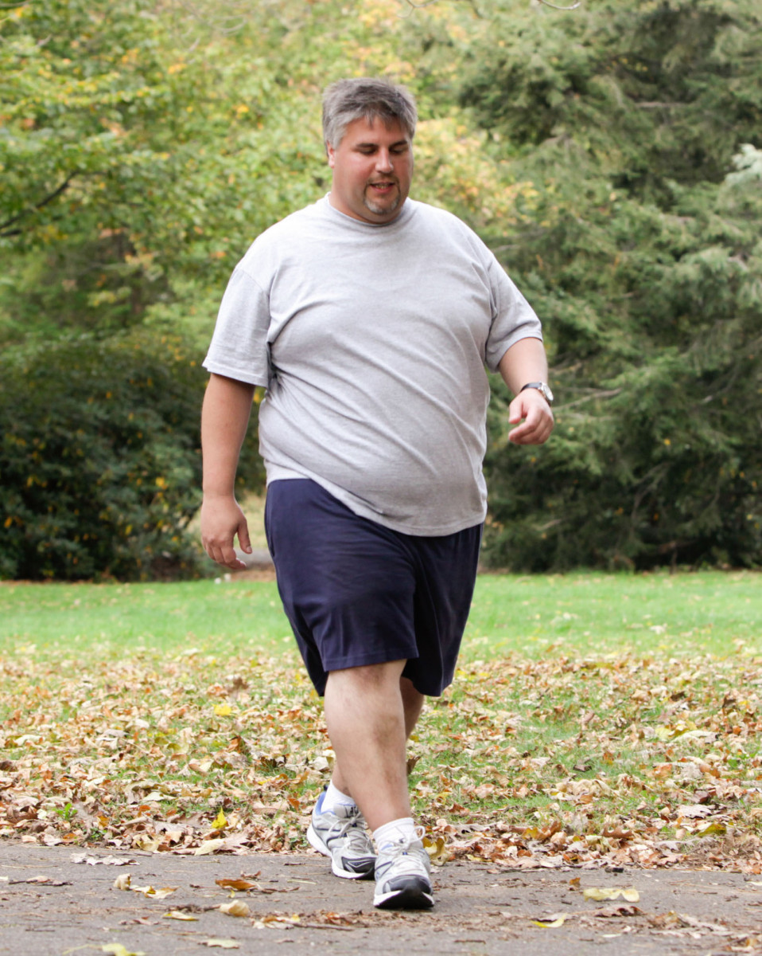
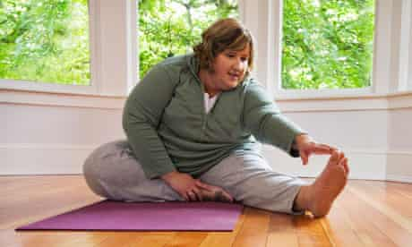
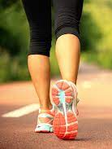
PHYSICAL ACTIVITY ESSENTIALS
Notes:
This class is taught as part of the Diabetes series (class #3), is a recommended but optional part of the Heart Health series (class #3), and is also available as a stand-alone class for any participant, with or without a chronic disease, who is interested in physical activity.
The class content is the same for all of these iterations of the class. Please tailor the material (particularly slides 24-36) to your group of participants.

Slide 2
ONLINE CLASS ETIQUETTE
Minimize distractions
  Turn off the TV, radio, cell phone ringer
Privacy & security
Asking questions
  Chat box
Zoom tips
  Turn off your webcam​
  Mute your microphone​
Notes:
1) Minimize distractions on the participants’ end. Presenter: Ensure your background is appropriate/not distracting.​
​
2) Privacy & security sample script:​
-Just like online shopping or email, Virtual Care has some inherent privacy and security risks that your health information may be intercepted or unintentionally disclosed.​
-Feel free to share your personal experiences or questions during our group discussion time, but please be aware that your personal information will be shared with anyone accessing this webinar.​
​
3) Participant questions.​
-Please let me know when you have a question by typing it into the chat box (explain where to find the chat box). I will be monitoring the chat throughout the session.​
-Or you can un-mute your microphone and ask your question out loud, if you prefer.​
​
4) Zoom tips. Turning off participants’ webcams saves bandwidth and reduces freezing/glitches.​
-On the next slide, show clients how to turn their microphone and webcam on & off.​
​
Does anyone have any questions before we get started?​

Slide 3
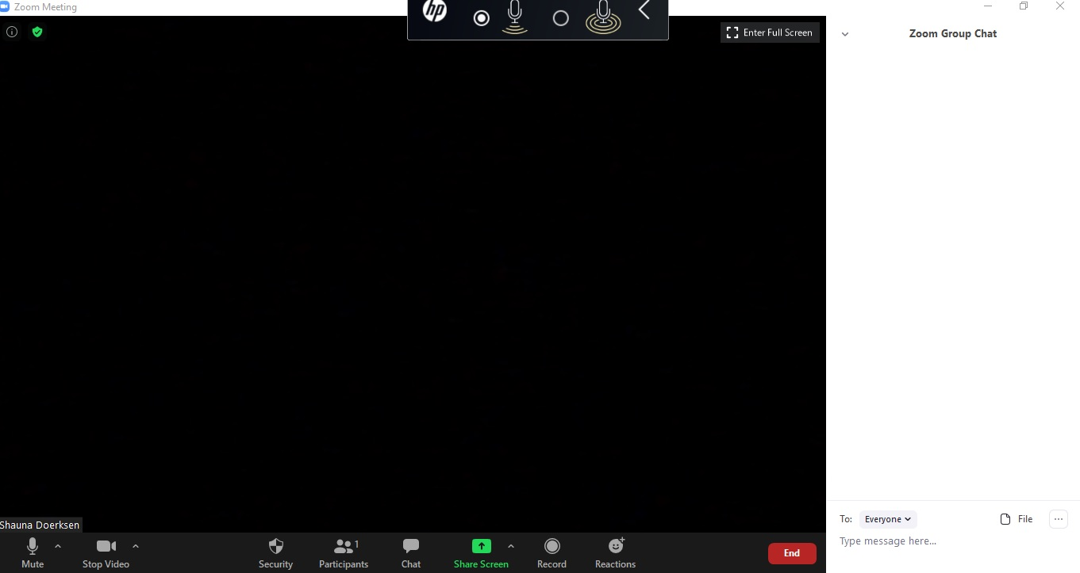
Notes:
1st animation: Arrows pointing to chat icon in taskbar and the chat box on the right side of the screen.
2nd animation: Arrows pointing to mute and stop video in the taskbar.

Slide 4
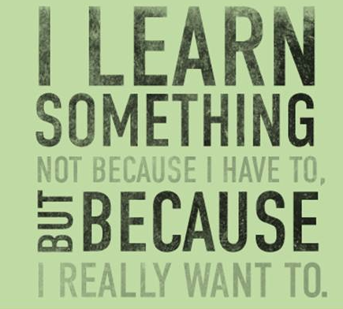
What do you want to
learn today?
Notes:
You can use the Zoom “whiteboard” feature to make a list of topics that participants want to discuss.

Slide 5
objectives
Explore our beliefs about exercise
Benefits of physical activity and exercise
Guidelines for physical activity
How to be active, even with a chronic condition
Helpful strategies
Where to start

Slide 6
PHYSICAL ACTIVITY/EXERCISE: YOUR BELIEFS
What do you think of when you hear the words physical activity or exercise?
What experiences have you had engaging in activity
or exercise programs?
Notes:
We’ve all heard that physical activity or exercise is good for you! Have you exercised before? What was your experience? What stops you from exercising?
Group discussion – possible answers:
-Exercise must be vigorous and painful to obtain any health benefits.
-Exercise always makes my pain worse.
-If I miss a day, I’ve failed and there’s no point in continuing with my exercise program.
-There’s no point in going for a 5 minute walk.
-I’ve tried it before and I failed, or it didn’t help.
-I missed my exercises last week, so I may as well just quit.
-We all have our own beliefs and experiences with activity and exercise, and these can vary throughout our life. Some of our experiences have been positive and some negative.
-If we have negative thoughts about physical activity because of our past experiences, we may need to change how we think about this important strategy to manage our health. It's never too late to start something new.
-I'm hoping that you will keep an open mind and that at the end of this presentation, you will think about physical activity and exercise in a positive manner and realize how important it is for your health and overall well-being.

Slide 7
Good news!
Everyone can MOVE
For most people, it is far more dangerous to continue sedentary living than to begin an activity or exercise program
Finding the right type of activity and the right “dose” is key

Slide 8
Notes:
When exercise is prescribed as a treatment for patients, the results from exercise are often as good as the results from medication.
(Source: https://www.heartandstroke.ca/articles/could-you-use-an-exercise-prescription)
Physical activity is not new or innovative, but it is the most under-prescribed and under-used treatment that we have for any and every health condition! You can choose to take a “small dose” of exercise or a “large dose”, but ANY amount of physical activity provides health benefits.

Slide 9
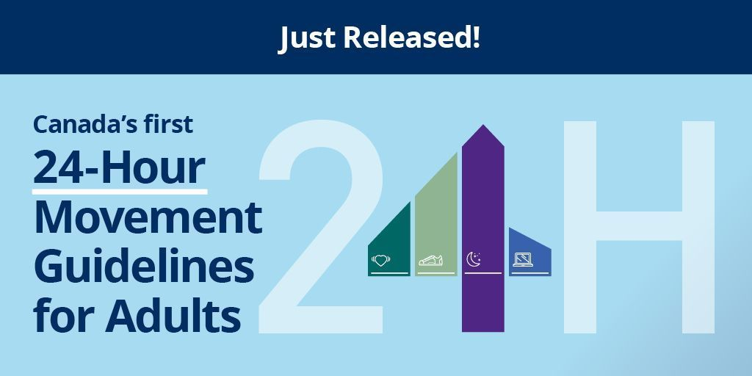
Notes:
Just released: Canada’s 24 hour MOVEMENT guidelines. These guidelines go beyond just “exercise”. They lay out how much physical activity, sleep and screen time we should be getting for good health.

Slide 10
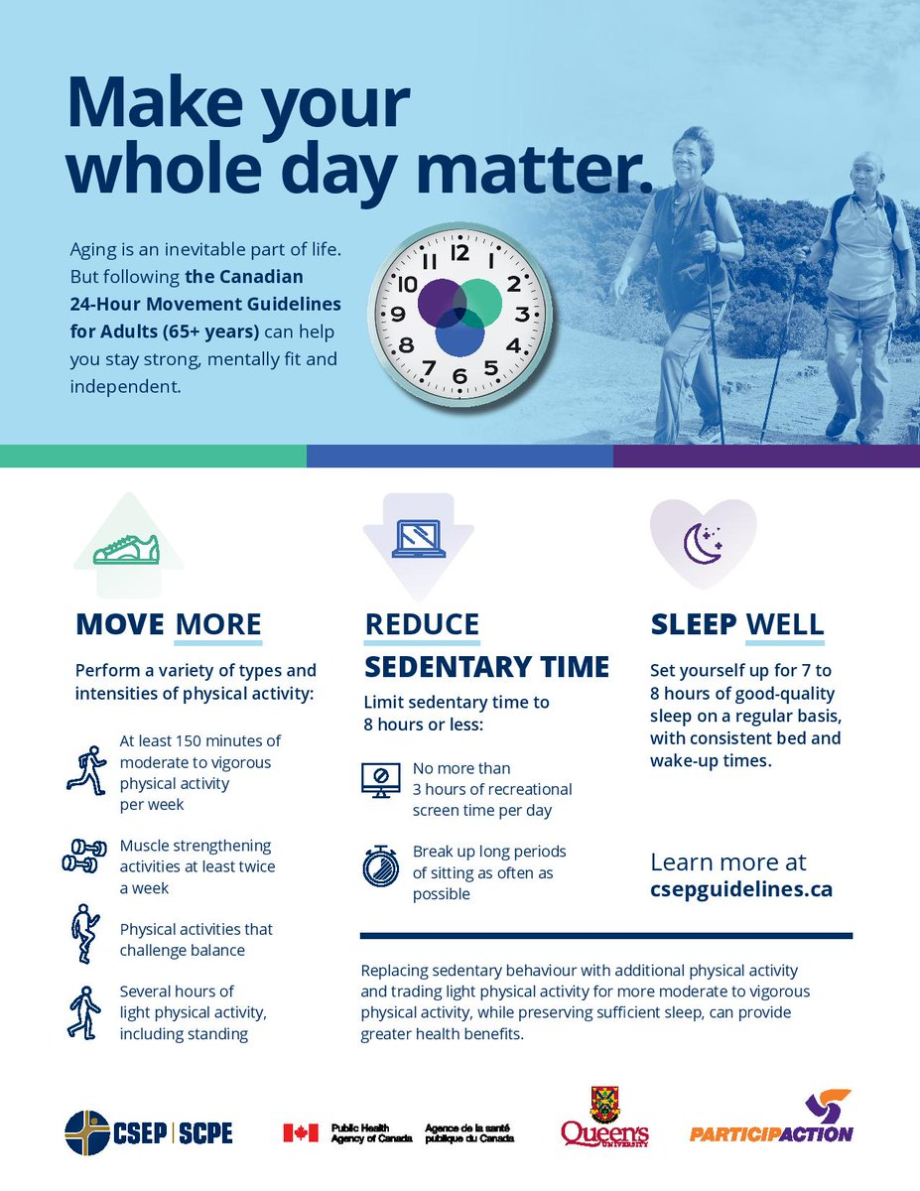
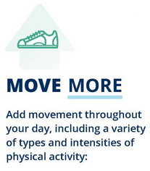
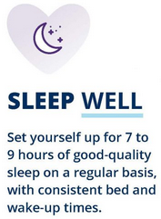
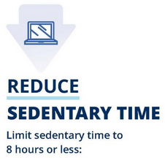
Notes:
Canada’s new movement guidelines focus on how we balance activity and movement, with other important health factors, during a 24-hour period.
The key message: It’s not just about 30 minutes of exercise. Instead, we need to think about all 24 hours - your whole day matters!
There are 3 pillars of movement and health: 1) Move more, 2) Sleep well, and as able, 3) Reduce sedentary time.
-Rather than focusing on specific targets for activity, a better place to start is to think about how we fill a 24-hour window.
-For example, you might consider: How much movement/activity/exercise am I getting? How much time am I spending sitting or lying down? How much time am I spending napping, resting or sleeping? What is the quality of my sleep?
-The goal is not only to start to increase our activity/movement, but also to work towards improving healthy sleep patterns and reducing prolonged sedentary time.
-This will allow you to “make your whole day matter” and provide more tangible benefits to your physical and mental health.
-It’s also helpful to consider that even if we cannot reach our activity/movement goal for the day, there are still other ways to improve the day. For example, focus on simply reducing time sitting, or making a plan to get a good night’s rest.

Slide 11
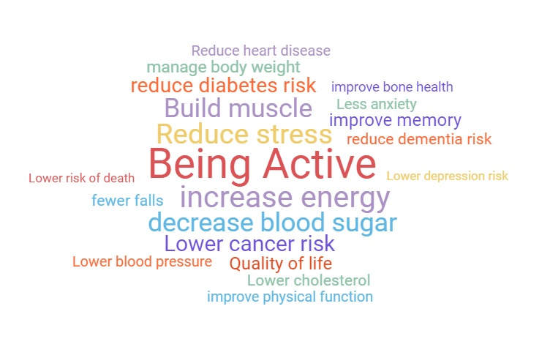

Notes:
Following the 24-hour movement guidelines is associated with all of these health benefits. The best news is that being active provides all these benefits without the side effects of prescription medication.

Slide 12
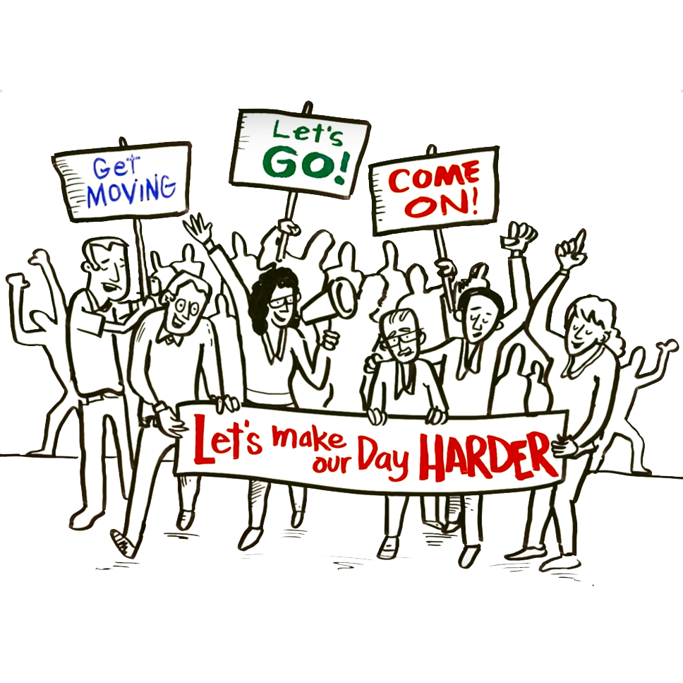
https://www.youtube.com/watch?v=whPuRLil4c0
Notes:
Now we will watch a 4 minute video. This is designed to help change your mindset about physical activity. Since we just discussed reducing sedentary time, you may want to consider standing and/or marching in place, while we watch this video, instead of sitting.
Example of making your day harder: Take the stairs instead of the elevator. Make this a habit – you might forget there is an elevator in your building!
Prior to class: Preload this YouTube link so that it is ready to go when you want to watch it.​
-Click Share Screen.​
-Choose the YouTube video, then at bottom of the window, check off “USE COMPUTER AUDIO” then press OK.​
-Be sure to mute your microphone or at least don't speak over the audio while the video is playing, because participants can hear both you and the video.​

Slide 13

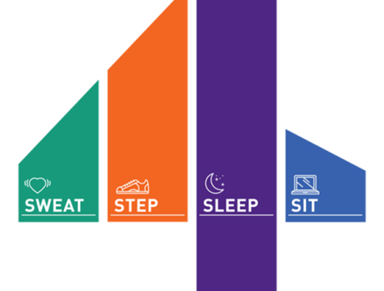
Daily Physical activities: maintain health
Notes:
-The STEP pillar refers to our normal daily activities, like housework or walking from the parking lot to the grocery store.
-We can improve our STEPS by increasing the total amount of activity we do in a day, and by making a point to choose activities that require more physical effort, like Dr. Mike Evans mentioned in the video.
-Examples: Take the stairs, Park further away from the entrance when at the grocery store, Shop in-person at the mall or grocery store rather than shopping online, Rake the leaves instead of using a leaf blower.
-The SWEAT pillar refers to activities at a higher intensity, that make you breathe a little harder and sweat a little. Usually this is a more deliberate activity that we call exercise. We will talk more about exercise and the SWEAT pillar later in this class.

Slide 14
“STEP” - DAILY ACTIVITIES
Examples:
  Walking, counting steps (10,000)
  Shopping
  Gardening
  Dusting
The dose is unlimited!
Notes:
-Examples: Walking between rooms in your house, or walking the aisles of the grocery store. If you wore a FitBit or a pedometer, your daily activity would be the number of steps you accumulated at the end of the day. It doesn’t matter what you did to get those steps.
-To get the greatest health benefits, we should perform several hours of light activity every day. This includes time on your feet (standing).
-The important thing to know is that any increase in activity from what you are doing now, is an improvement to your health.

Slide 15

Activity / exercise: improve your fitness
Notes:
We just discussed STEP or what we typically refer to as physical activity. Now we’re going to talk about SWEAT, or what is typically referred to as exercise.
Exercise is an activity that is planned and sustained, but can be as short as 5 minutes at a time. Exercise will increase your fitness level and in turn improve your health.

Slide 16



“SWEAT” - EXERCISE GUIDELINES
  Aerobic exercise
      Minimum 150 minutes per week
      Intensity (effort) = moderate to vigorous
  Resistance exercise
      2-3 times per week
Notes:
For those of you who are already quite active throughout the day (STEP), think about increasing your activity level by including exercise. SWEAT is the best bang for your buck both for improving your health and for reducing blood sugars.
Aerobic exercise: 150 minutes is a guideline. If you are not currently active at all, start slowly and work up to 150 minutes/week.
Intensity = the amount of effort you exert. You may have to start with a “light” intensity if you are not used to being active.

Slide 17
Activity and/or exercise
More activity or more vigorous activity = More health benefits
Doing something is better than doing nothing
  If you are currently not active – Biggest “return on investment” comes from adding small amounts of physical activity
Be as active as you are able, given the limits of your body
and your life situation!
Notes:
While you do receive greater health benefits with higher levels of activity, don’t be intimidated by the guidelines and let that prevent you from starting to exercise.
-If you feel that you can’t meet these physical activity guidelines, start with less! Either less time (duration) or less intensity.
-If you are not doing any physical activity at the moment, you get the biggest “return on investment” and the greatest improvement in your health by starting even a small amount of exercise.
-Even 5 or 10 minutes a day of exercise provides a significant health benefit, if you are currently not doing any activity!

Slide 18
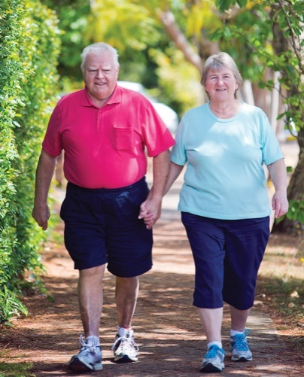
Aerobic Activity
Activity that targets and strengthens the heart & lungs
Examples: Brisk walking, cycling, swimming, cross-country skiing
Dose:
  10 minutes – 3 times per day, 5 days per week
  20 minutes – 7 days per week
  60 minutes – 3 days per week
Blood sugars can be reduced immediately with sustained activity
Notes:
Cardiovascular or aerobic activity is an activity that causes you to breathe harder. Your heart rate increases and is sustained over a period of time.
Requires the use of the larger muscle groups (legs, arms) in a continuous, rhythmic motion.

Slide 19
INTENSITY / EFFORT:
Rate of Perceived Exertion scale (RPE)
0 | Rest
1 | Very Light
2 | Light
3 | Moderate
4 | Somewhat hard
5 | Hard (breathing deeply)
6
7 | Very hard (out of breath)
8
9
10 | Maximal
Can talk and sing
Light (RPE 1-2)
Moderate (RPE 3-6)
Vigorous (RPE 7+)
Can talk but not sing
Sweating and
Increased heart rate
Cannot talk or sing
Notes:
-Example: Walking the dog (daily activity). Increase the intensity by walking faster, adding an arm swing.
-By increasing your heart rate with activity, this helps your heart to get stronger. In the same way that if you lift weights, progressively adding more weight will help to increase your muscle strength.
-If you don’t push yourself a little, you will maintain your current level of fitness, but you won’t improve.

Slide 20
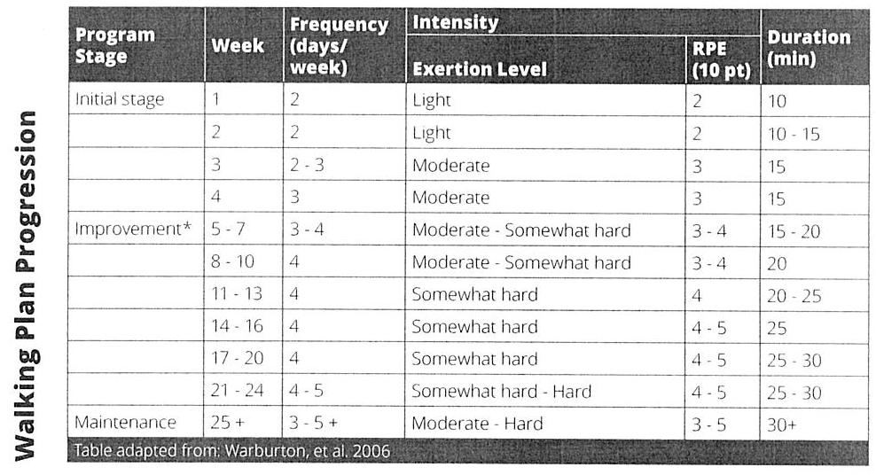
SAMPLE WALKING PROGRAM
Notes:
An example of how to start a walking program. Notice that the initial stages do not meet the guidelines!
It’s absolutely understandable and expected you may not be able to start with a program that meets the guidelines for physical activity.
Over time, you will be able to progress and increase the dose of exercise tolerated, as noted in this example.
However, some people never reach the stage of their exercise program where they meet the guidelines, due to your body’s limitations or other factors.
Even so, you still receive significant benefits to your health and well-being by performing whatever amount of activity that you can, versus being sedentary and not participating in exercise at all.

Slide 21

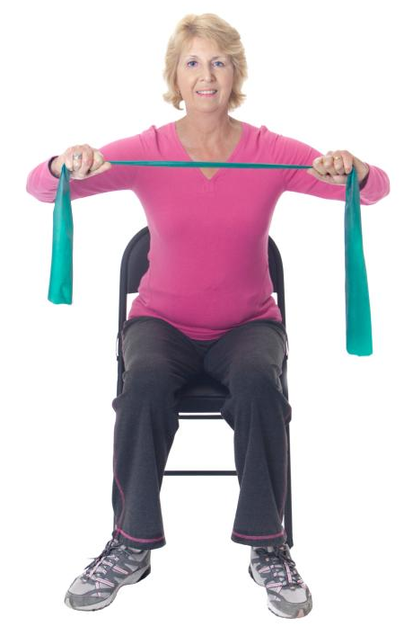
RESISTANCE EXERCISE
Activity that targets and strengthens muscles
Examples: Dumbbells, resistance bands, yoga, body weight, water exercises
Dose: 2-3 times per week (not on consecutive days)
Benefits:
  Increases muscle mass / Increases metabolism
  Improves body composition
  Protects the joints
  Lowers blood pressure / Improves cholesterol levels
  Lowers blood sugars over time
Notes:
Resistance exercise: Activities that use muscle strength to move a weight or work against a resistance load.
---Presenter notes---
Benefits to blood sugar: (Discuss this as part of the diabetes class series)
-When you build muscle, it requires more energy to maintain muscle mass, so you require more glucose for energy. This means that after you eat, more glucose will go into your muscles, instead of turning into fat or staying in the bloodstream.
-Unlike aerobic activity where you may see an immediate decrease in your blood sugar, performing resistance exercise may actually increase your blood sugar for several hours after your workout. That is OK, don’t be alarmed.
-The temporary higher blood sugar is a good sign that you stressed your muscles enough, so that they will rebuild stronger than before and you will start to see the benefits of increased muscle mass. Your blood sugar will come down again.
-As you continue to do resistance exercise over time, it helps to lower your blood sugar in the long term.

Slide 22
SAMPLE RESISTANCE PROGRAMS
Resistance bands
http://guidelines.diabetes.ca/docs/patient-resources/introductory-resistance-program.pdf
Hand weights (dumbbells)
http://guidelines.diabetes.ca/docs/patient-resources/resistance-exercise.pdf

Slide 23
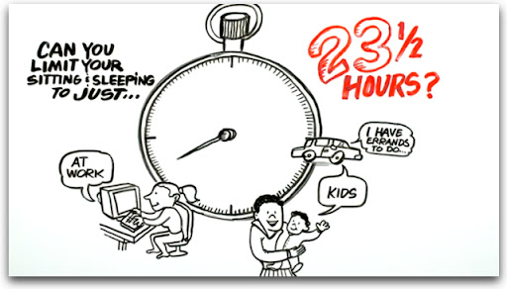
https://www.youtube.com/watch?v=3F5Sly9JQao
Notes:
This video is 5 minutes long. If you don’t have time to watch it during the class, direct participants to click on the link and watch it later. They will receive the slides with the YouTube link after the class.
Prior to class: Preload this YouTube link so that it is ready to go when you want to watch it.​
-Click Share Screen.​
-Choose the YouTube video, then at bottom of the window, check off “USE COMPUTER AUDIO” then press OK.​
-Be sure to mute your microphone or at least don't speak over the audio while the video is playing.​

Slide 24
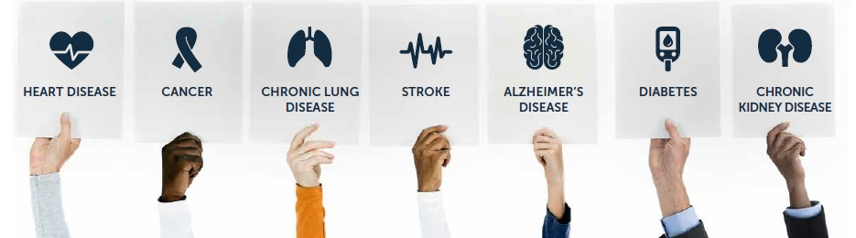
Physical Activity & Chronic conditions
Notes:
QUICKLY REVIEW SLIDES 24-36 OR TAILOR THIS CONTENT TO THE PATIENT POPULATION ATTENDING YOUR CLASS.
Some people with chronic conditions or decreased mobility have more challenges to physical activity. It is important to know how exercise affects your body and how to help yourself be successful with activity.

Slide 25
IS IT SAFE FOR ME TO INCREASE MY ACTIVITY?
Almost everyone is safe to walk, swim, cycle, or use resistance bands
Start off easy and progress slowly
If you’re still concerned, talk to your health care provider and
complete the Get Active Questionnaire: https://csep.ca/wp-content/uploads/
2021/05/GETACTIVEQUESTIONNAIRE_ENG.pdf
If you answer YES to any question, then review: https://csep.ca/wp-content/
uploads/2021/05/GAQREFDOC_ENG.pdf
Notes:
It is safe for almost everyone to do moderate to vigorous intensity activity (e.g. walking, swimming, cycling, resistance bands).

Slide 26



PHYSICAL ACTIVITY WITH: DIABETES
Effects of physical activity:
  Increased insulin sensitivity
  Body’s cells can take up glucose and use it for energy, whether insulin is available or not
→
→
Notes:
DIABETES: Effects of physical activity.
-Your body’s cells require glucose (sugar) for energy. The cells require insulin, in order to take up the glucose. Insulin is like a key that unlocks the door to the cell, so that glucose can enter.
-Physical activity increases insulin sensitivity. This means that your muscle cells can use insulin more efficiently to take up glucose and use it for energy, both during and after activity.
-As well, when your muscles contract during activity, those muscle cells can take up glucose and use it for energy, even if insulin is not available.
-Thus, physical activity is a great way to reduce your blood sugar.

Slide 27
PLANNING FOR ACTIVITY WITH: DIABETES
  Know your medications
    Medications with risk of hypoglycemia: Insulin; Glicazide (Diamicron);
    Glyburide (DiaBeta); Glimepiride (Amaryl); Repaglinide (Gluconorm)
  Monitor your blood sugars before and during activity, if needed
  Carry fast-acting carbohydrate (e.g. glucose tablets, fruit juice, sports drink)
  Ensure you are well hydrated
  Wear proper footwear
  How to treat low blood sugar: https://guidelines.diabetes.ca/docs/patient-resources/hypoglycemia-low-blood-sugar-in-adults.pdf
Notes:
-If you take insulin injections or any of the listed medications (which help the pancreas to make more insulin) then you should monitor your blood sugar before, during, and 2 hours after exercise.
-Because exercise is so effective at lowering blood sugar, you need to be ready in case of a low blood sugar (hypoglycemia).
-It is especially important to monitor your blood sugars when you start a new activity or exercise, increase the length of time you exercise for, or increase the intensity of the exercise.
-Hydration is particularly important if your blood sugar is high.
-Comfortable clothing makes the exercise experience much more pleasant.
-Good footwear is important especially for people with altered nerve sensation or neuropathy. Inspect your shoes before and after activity - look for tiny stones, check if material is loose on the inside or outside of the shoe, look for anything that may cause friction or damage to your foot.

Slide 28
PHYSICAL ACTIVITY WITH: HIGH BLOOD PRESSURE
Effects of physical activity:
  Short term: Blood pressure increases during activity
  (this is normal)
  Long term: Regular physical activity makes your heart stronger
    Heart can pump blood with less effort
    Blood pressure decreases
Notes:
-During exercise, blood pressure increases, in order to push more oxygen-rich blood throughout the body.
-Over time, regular physical activity makes your heart stronger, and a stronger heart can pump more blood with less effort. As a result, the force required to pump blood is lower, which decreases your blood pressure.
Source: https://www.hopkinsmedicine.org/Press_releases/2004/04_06a_04.html

Slide 29
PLANNING FOR ACTIVITY WITH: HIGH BLOOD PRESSURE
  Know your resting blood pressure values
  If resting blood pressure is more than 160/90, talk to your
  health care provider before starting or increasing your activity level
  Ensure you are well hydrated
  Wear proper footwear
  For more information: https://www.heartandstroke.ca/heart-disease/
  risk-and-prevention/condition-risk-factors/high-blood-pressure

Slide 30
PHYSICAL ACTIVITY WITH: HEART DISEASE
Effects of physical activity:
  Unblocks blood vessels and increases blood flow
  Regular physical activity makes your heart stronger
    Heart can pump blood with less effort
    Reduces resting heart rate
    Increases physical activity tolerance
Notes:
Coronary artery disease is the most common form of heart disease. Coronary artery disease blocks the arteries and makes the blood vessels “stiff”, which restricts blood flow to the heart. This can cause a heart attack or angina (chest pain).
Exercise reduces inflammation, and relaxes and opens up the blood vessels. Exercise also keeps the inside of your blood vessels smooth and “slippery” which prevents blood clots from sticking to your arteries. (Source: https://www.health.harvard.edu/heart-health/exercise-and-your-arteries)
After a heart attack or heart surgery: Patients who exercise regularly can improve their survival rates between 25-50%, which is as much as any medication.
(Source: https://www.heartandstroke.ca/articles/could-you-use-an-exercise-prescription)

Slide 31
PLANNING FOR ACTIVITY WITH: HEART DISEASE
  Talk to your health care provider before starting or increasing
  your activity level if:
      You’ve had a heart attack
      Your resting blood pressure is more than 160/90
      You have coronary artery disease and diabetes and are over age 40
  Ensure you are well hydrated
  Wear proper footwear
  For more information: https://www.heartandstroke.ca/articles/exercising-when-you-have-heart-disease

Slide 32
PHYSICAL ACTIVITY WITH: LUNG DISEASE (ASTHMA/COPD)
Effects of physical activity:
  Shortness of breath is better controlled
  Increases strength and activity tolerance
  Improves control of anxiety
  Increases confidence in your abilities

Slide 33
PLANNING FOR ACTIVITY WITH: LUNG DISEASE (ASTHMA/COPD)
  Avoid environmental factors that could aggravate your symptoms
  Choose one activity for each season
  Consider indoor activities
  Coordinate the timing of your medication and activity
  Carry your rescue inhaler
  For more information: https://www.livingwellwithcopd.com/DATA/
  DOCUMENT/58_en~v~integrating-an-exercise-program-into-your-life.pdf

Slide 34
PHYSICAL ACTIVITY WITH: ARTHRITIS
Effects of physical activity:
    Decreases pain and stiffness (especially long-term)
    Improves physical function
  Activities should be “joint friendly” (e.g. walking, swimming)
  Try to stay active even when arthritis symptoms increase
      Modify activities as needed
  For more information: https://www.cdc.gov/arthritis/basics/
  physical-activity-overview.html

Slide 35
PHYSICAL ACTIVITY WITH: CHRONIC PAIN
e.g. Fibromyalgia, Neuropathy
Effects of physical activity:
    Decreases pain over time
    Reduces stress
    Improves physical function and stamina
          Allows you to engage in more activities in all areas of life
    Regain confidence and control of your body

Slide 36
PLANNING FOR ACTIVITY WITH: CHRONIC PAIN
    Find your baseline
    Pace yourself
    Be patient; reducing pain takes time
  Ensure you are well hydrated
  Wear proper footwear
  Education about managing chronic pain: https://wrha.mb.ca/groups/chronic-pain-self-management/

Slide 37
SAFETY PRECAUTIONS FOR EVERYONE
STOP physical activity if you have:
  Chest pain
  Abnormal shortness of breath
  Dizziness or lightheadedness
  Nausea
  Blurry vision
  Pain or numbness in limbs
Notes:
-Stop if you have chest pain or any signs/symptoms of a heart attack.
-Ensure you are fit to exercise. If you have an injury, have it assessed before proceeding with physical activity.

Slide 38

Pain with Activity/exercise
Normal pain response:
Abnormal pain response:
Up to 1-2 hours post-exercise
Delayed onset muscle soreness:
12-48 hours after
  Lasts 2+ hours
  Interferes with ability to continue activity
  Interferes with activities of daily living
  Don’t quit … MODIFY
  Decrease intensity
  Change the movement
  Change the activity
Notes:
-Increased pain for an hour after exercise is normal. Muscle soreness/stiffness after exercise is also normal, at first lasting for up to 48 hours after a new exercise.
-If you have increased pain that lasts for more than 1-2 hours, and it interferes with your ability to continue exercise or daily activities, you may have done too much. You should adjust your exercise plan in the future – but don’t quit, just modify your activity. Either decrease the intensity, change the type of movement you are doing, or change the type of activity (e.g. brisk walking instead of jogging).

Slide 39
How to have success with exercise
Identify
barriers and alternatives
Set goals
(sign up for “Preparing
for Success” Class)
Monitor
your progress
Think positive,
start small,
make it social
Notes:
Identify barriers and find alternatives.
Set goal(s) for yourself.
Monitor your progress towards your goal.
Stay positive. Start with a small change. Make it social (with friends) to increase your enjoyment and ability to “stick with it”.

Slide 40

Barriers to Activity
What’s stopping you?
Ways to start
Low motivation
Cost
Weather
Transportation
Intimidation
Pain
Ask a friend to join you; Do a fun activity;
Attend a group
Find a program on the internet;
Connect to subsidy-supported programs;
Find a simple activity
Mall walking; Home exercise programs
Take the bus or Transit Plus; Call a friend
Talk to an exercise specialist to help you
Ensure the activity is right for you; Attend a class
Notes:
-Cost: Walking, Free smartphone apps with exercise plans, YouTube videos.
-Pain: Take a chronic pain class to learn about coping strategies, Ask an exercise specialist for advice.
-Lack of energy: Start small. Even 5 minutes of activity is better than nothing!
-No time: We never find the time for activity. We have to make time. Schedule physical activity as an appointment on your calendar. Set yourself an alarm reminder to exercise, even when you get busy.
Other possible barriers (problem solve as a group): Don’t like to exercise, Fear of trying something new, Lack of support from family, Don’t like groups, I need to exercise in a group setting, I don’t know how to exercise.

Slide 41
SET A GOAL (ACTION PLAN)
Starting on _______ (date), I will _______ (action)
_______ (when), _______ (number) times per week.
Starting on May 5, I will walk from 12:00-12:15
on Tuesday and Thursday during my lunch hour.
Notes:
Set a goal for yourself. Your goal should be Specific, Measurable, Attainable, Realistic, and Timely. See the example goal of walking twice a week.
We often fail because we set goals that are too ambitious and too vague/broad. Start with a small, easy goal that you are 95% sure you can achieve, and build from there.
Take 3 minutes to create a SMART goal for yourself. Use the above template and fill in the blanks with your personal goal.
Now, let’s share and discuss our goals. If you feel comfortable, please share your goal by speaking out loud or type it in the chat box.

Slide 42
Monitor your progress
Track or log your activity (calendar, smartphone app, diary)
Exercise is not a quick fix, be patient
Be prepared for ups and downs
Perseverance is key
Notes:
-It can be difficult to notice an improvement in your exercise, because often progress is slow, with ups and downs along the way.
-If you keep a log of your activity, you can look back to see your changes and improvements over time.
-Most people have ups and downs with an exercise program. You may have missed a week of exercise due to some life circumstances. Or you had a sore knee that stopped you from walking as far as usual, leading to modifications in your distance and intensity.
-These setbacks are normal and very likely to occur. It would be unusual for you not to slip up with your exercise program at least once in a while! The key is to not let this frustrate you. Over the long term, if you continue with your activity plan, you will continue to progress.

Slide 43
New thoughts about exercise
I don’t have
to be perfect,
just consistent
It might
be enjoyable
The right activity and the right starting point shouldn’t hurt me
I have an
exercise program, so no need to
be intimidated
Several short walks are just
as good as
one long walk
If I don’t meet
my goals, maybe
I need to make new ones
Being active means
being healthy
Walking
with a friend
has helped me
to reconnect
Notes:
After our discussions today, do you have any new thoughts about exercise? I hope that the idea of movement, activity and exercise now seem more doable and realistic for you to try.

Slide 44
PHYSICAL ACTIVITY CHALLENGE
Choose an activity (The best activity is the one that you’ll do)
If you’re already active, increase your intensity
Identify barriers and problem solve
Set a goal
Don’t expect perfection
Ask for help

Slide 45
WHO CAN HELP
  Your doctor/primary care provider
        Referral to cardiac rehab or pulmonary rehab (if appropriate)
  Medical fitness facility (Reh-Fit Centre, Wellness Institute)
      These facilities also offer online group sessions
  Other health professionals (Physiotherapist, Athletic Therapist)
  Certified personal trainers and Exercise Physiologists
      Look for CSEP certified (Canadian Society for Exercise Physiology)
Notes:
-If exercise is new for you and you are unsure where to start, ask for help from an exercise specialist. Some gyms have personal trainers that can show you around the gym and help you learn how to use the machines or do exercises properly.
-If you have other medical conditions that might make it harder for you to exercise like heart disease, arthritis, or chronic pain, a physiotherapist can help you get started so you can exercise safely and not get discouraged.

Slide 46
PHYSICAL ACTIVITY RESOURCES
Free workout videos
for all ages and abilities
ymcahome.ca/fitness
Winnipeg Leisure Guide
http://LeisureOnline.ca
Winnipeg in Motion
  WinnipegInMotion.ca
24-Hour Movement Guidelines
  CSEPguidelines.ca
Notes:
Winnipeg in Motion: Examples of walking plans for various activity levels, Exercise videos, Places/Where to be active, Free education sessions related to exercise and activity.
Winnipeg Leisure Guide: Register for pool and land exercise classes. Offers a fee subsidy if you have financial barriers.

Slide 47
RESOURCES FOR CHRONIC CONDITIONS
Diabetes Canada
  diabetes.ca/nutrition---fitness/
  exercise---activity
Heart & Stroke Association
  HeartAndStroke.ca/
  healthy-living/stay-active
Asthma: The Lung Association
Lung.ca
Living Well With COPD
  LivingWellWithCOPD.com
The Arthritis Society
  arthritis.ca/living-well
Notes:
Arthritis Society: Support groups, Exercise classes, Arthritis Self Management Program, Chronic Pain Management Workshop

Slide 48
NEXT STEPS
Think about one change you would like to make
for your health
Sign up for the Preparing for Success class
      Watch for the Goal Setting worksheet to be sent
      with your weblink to the class
      Bring this worksheet to the next class, but don’t fill it out yet
Notes:
If participants are completing this class as part of the Heart Health series and/or a stand-alone class, then they must register separately for the Preparing for Success class. (Note: They may or may not have already registered for PFS when they registered for today’s class).
If participants are taking this class as part of the Diabetes series, then they are automatically registered for Preparing for Success (class 4 in the diabetes series).

Slide 49
Thank you
Any questions?
Use the chat function
or un-mute your microphone
Notes:
Evaluation: https://www.surveymonkey.com/r/WPYYNRZ
If participants are completing this class as part of the Heart Health series and/or a stand-alone class, then complete the survey TODAY.
If participants are taking this class as part of the Diabetes series, then DO NOT GIVE SURVEY LINK TODAY. Clients will complete the survey at the end of the 4 class diabetes series.
Put the Survey Monkey link into the chat box so that participants can complete the survey immediately. Survey link will also be included in the email sent to participants after today’s session.

Slide 50
REFERENCES
Blair, S. N., Sallis, R. E., Hutber, A., & Archer, E. (2012). Exercise therapy – The public health message. Scandinavian Journal of Medicine and Science in Sports, 22, e24-e28. https://doi.org/10.1111/j.1600-0838.2012.01462.x
Clockify. (2021). How to set SMART goals: 10 helpful templates. Retrieved October 4, 2021, from: https://clockify.me/blog/productivity/smart-goals/
Colberg, S. R., Albright, A. L., Blissmer, B. J., Braun, B,, Chasan-Taber, L., Fernhall, B., Regensteiner, J. G., Rubin, R, R,, Sigal, R. J., American College of Sports Medicine, & American Diabetes Association. (2010). Exercise and type 2 diabetes: American College of Sports Medicine and the American Diabetes Association: Joint position statement. Medicine and Science in Sports and Exercise, 42(12), 2282-2303. https://doi.org/10.1249/mss.0b013e3181eeb61c
Dietitians of Canada. (2021). 10 SMART healthy eating goals. Retrieved October 4, 2021, from: https://www.unlockfood.ca/en/Articles/Weight-and-Health/10-SMART%E2%80%9D-Healthy-Eating-Goals.aspx
Gulve, E. A. (2008). Exercise and glycemic control in diabetes: Benefits, challenges, and adjustments to pharmacotherapy. Physical Therapy, 88(11), 1297-1321. https://doi.org/10.2522/ptj.20080114
Hughes, J. (2018, November 17). How to set SMART goals (with 5 examples). Retrieved October 4, 2021, from https://www.elegantthemes.com/blog/business/smart-goals
Knowler, W. C., Barrett-Connor, E., Fowler, S. E., Hamman, R. F., Lachin, J. M., Walker, E. A., Nathan, D. M. (2002). Reduction in the incidence of type 2 diabetes with lifestyle intervention or metformin. New England Journal of Medicine, 346(6), 393-403. https://doi.org/10.1056/NEJMoa012512
Mind Tools. (2021). SMART goals: How to make your goals achievable. Retrieved October 4, 2021, from: https://www.mindtools.com/pages/article/smart-goals.htm
Nathan, D. M., Cleary, P. A., Backlund, J. C., Genuth, S.M., Lachin, J. M., Orchard, T. J., Raskin, P., & Zinman, B. (2005). Intensive diabetes treatment and cardiovascular disease in patients with type 1 diabetes. New England Journal of Medicine, 353(25), 2643-2651. https://doi.org/10.1056/nejmoa052187
National Diabetes Information Clearinghouse. (2013, November 21). DCCT and EDIC: The Diabetes Control and Complications Trial and Follow-up Study. Retrieved May 2, 2014 from http://diabetes.niddk.nih.gov/dm/pubs/control/
NutriProCan. (2020, May 14). SMART nutrition goals guide and worksheet. Retrieved October 4, 2021, from: https://www.nutriprocan.ca/smart-nutrition-goals/
Streit, L. (2018, May 2). SMART goals for healthy eating and weight loss. Retrieved October 4, 2021, from: https://www.healthyforlifemeals.com/blog/smart-goals-for-healthy-eating-and-weight-loss

Slide 51
ACKNOWLEDGMENTS
Development team:
Maggie Wallin, BMR-PT CRE & Cindy Campbell, OT Reg (MB) CRE
Reviewer team:
Aimee Bowcott, MPH RD CDE CRE; Cindy Campbell, OT Reg (MB) CRE;
Shauna Doerksen, RD CDE; Jenna Hart, RD CDE;
Sheila Pelagio, BHEcol BN RN CTE; Colin Reeve, BSP CDE CRE CTE;
Cindy Sanchez, RN BN CDE; Cheryl Shaver, BScPharm CTE;
Maggie Wallin, BMR-PT CRE

