Slide 1
Nutrition for Busy People
Notes:
**Note: We recommend this class be taught by a Registered Dietitian or another health professional who subscribes to the Health At Every Size (HAES) philosophy in their practice. While the nutrition information presented in the class may seem relatively basic and straightforward, there is a great deal of nuance to the messaging about weight bias and health (slides 65-76). If you have questions about the HAES philosophy, we suggest to speak to a dietitian and review the references on slides 82-85 before proceeding with this class.**
---Presenter note---
This class is designed for clients with:
-Weight management/obesity concerns
-Fatty liver disease (specific NAFLD advice is provided where appropriate)
-Preventing or managing some chronic diseases (e.g. prediabetes, dyslipidemia, hypertension). For the most part, disease-specific nutrition information is not provided in this class. Depending on their concerns, it may be more appropriate for these clients to attend the diabetes class series or heart health class series.
-General healthy eating concerns
This class will focus less on the "what" about nutrition (Part 1), and more about the "how" and "why" of healthy lifestyle changes (Part 2 of the class).

Slide 2
Online Class Etiquette
Minimize distractions
Turn off the TV, radio, cell phone ringer
Privacy & security
Asking questions
Chat box
Zoom tips
Turn off your webcam
Mute your microphone
Group introductions
Notes:
1) Minimize distractions on the participants’ end. Presenter: Ensure your background is appropriate/not distracting.
2) Privacy & security sample script:
-Just like online shopping or email, Virtual Care has some inherent privacy and security risks that your health information may be intercepted or unintentionally disclosed.
-Feel free to share your personal experiences or questions during our group discussion time, but please be aware that your personal information will be shared with anyone accessing this webinar.
3) Participant questions.
-Please let me know when you have a question by typing it into the chat box (explain where to find the chat box). I will be monitoring the chat throughout the session.
-Or you can un-mute your microphone and ask your question out loud, if you prefer.
4) Zoom tips. Turning off participants’ webcams saves bandwidth and reduces freezing/glitches.
-On the next slide, show clients how to turn their microphone and webcam on & off.
5) Icebreaker/Introductions. Allow participants to introduce themselves. In the interest of time, you may want to encourage participants to introduce themselves before the class starts (while waiting for participants to log in 15 minutes before the class).
Does anyone have any questions before we get started?

Slide 3
Notes:
Arrows pointing to chat icon in taskbar and the chat box on the right side of the screen.
Arrow pointing to mute and stop video in the taskbar.

Slide 4
Outline
Why make changes to your eating habits?
Nutrition basics
Troubleshooting
What’s next?

Slide 5
Why did you come to today’s class? (Choose all that apply)
Manage my health (e.g. fatty liver, blood sugars, blood pressure, cholesterol, etc.)
No time to eat healthy
Too expensive to eat healthy
I don't know what to eat
I know what to eat, but I can't seem to stick with my plan
Other (type your answer in the chat)
Notes:
SET THIS UP AS A ZOOM POLL QUESTION
Give the group a chance to give their reasons for changing their eating habits - weight loss, saving money, better health, etc.
Presenter note: One reason that many people come to a dietitian is to lose weight. We will address Health At Every Size near the end of this presentation.

Slide 6
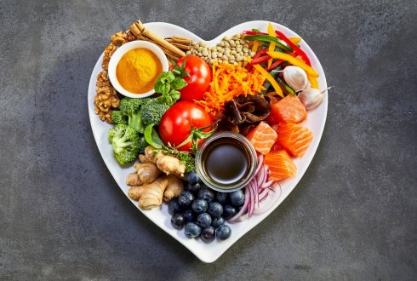
Nutrients to Fuel Your Body
Notes:
Briefly review general nutrition principles in the next few slides (Part 1). Spend the majority of the class focusing on troubleshooting health behaviour change (Part 2).

Slide 7
Protein
Builds & repairs muscle
Helps you feel full (satiety)
Slows down rise of blood sugar
Notes:
-Protein is needed to build and repair muscle, tissue, skin, nails and hair.
-Including a source of protein with meals and snacks can improve satiety (keep you feeling full longer) and slow the rise in blood glucose levels.
-Protein is found in foods such as meat, chicken, fish, eggs, beans and lentils, nuts and seeds, peanut butter, tofu, and dairy products like milk, yogurt and cheese.

Slide 8
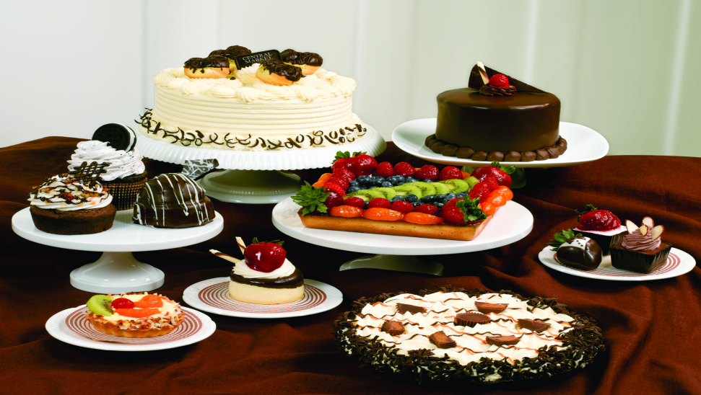
Carbohydrate
Provides energy for the body
Digests and breaks down into sugar (fuel)
Quality matters!
Notes:
-Carbohydrates provide an essential source of energy (fuel) for the body.
-Carbohydrates are found in grain products (e.g. bread, cereal, pasta, rice, crackers) and starchy vegetables (e.g. potatoes and corn). Carbohydrates also include foods that contain sugar, such as fruit, milk and yogurt, candy, cakes, cookies, donuts, and ice cream.
-The carbohydrates that you eat are converted to glucose, a sugar (fuel) that your body uses for energy.
-The quality of carbohydrates that you eat can reduce your risk of chronic disease, such as diabetes, high cholesterol and fatty liver.

Slide 9
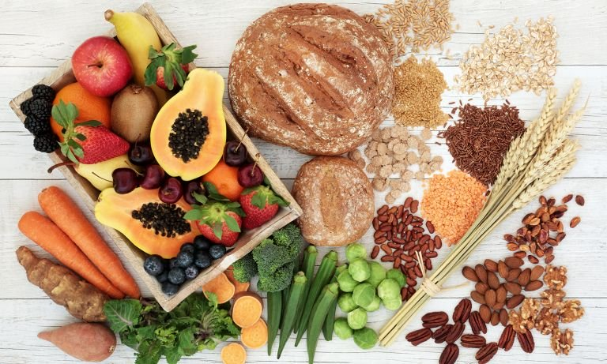
Fibre
Found in plant foods only
The part of plants that we don’t digest
Increases fullness (satiety)
Regulates blood sugar and energy levels
Lowers cholesterol
Prevents or reduces fatty liver
Protects against cancer
Promotes regular bowel movements
Notes:
-High quality carbohydrate foods are a good source of fibre.
-Dietary fibre is a type of carbohydrate. However, fibre is not digested, therefore it does not turn to sugar and it helps to prevent blood sugar spikes.
-Fibre also helps to lower blood cholesterol, manage fatty liver, protect against some cancers, promote regular bowel movements, and promote satiety.
-What foods are a source of fibre: whole grain bread, whole grain pasta, oats or other cereals made from whole grains, brown rice, wild rice, quinoa, barley, vegetables, fruit, beans and lentils, bran, flaxseed, chia seeds, psyllium and bran.
-Most of the grains that we eat should be whole grains.
-Reminder: If you are trying to increase your dietary fibre intake, increase slowly and drink lots of fluids, to avoid gastrointestinal discomfort and gas.

Slide 10
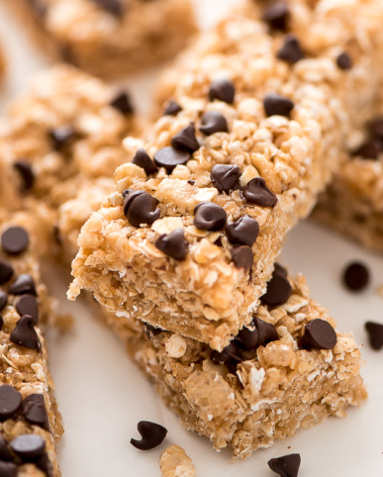
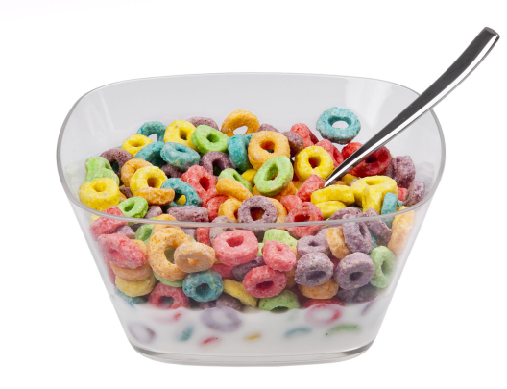
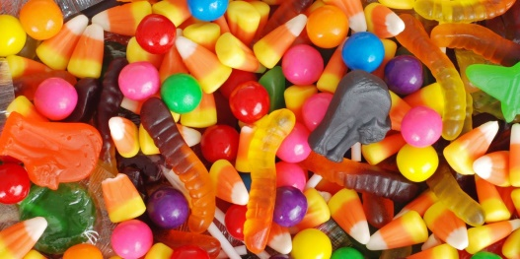
Sugar
Contributes to fatty liver, PCOS, weight gain, prediabetes & type 2 diabetes, and high cholesterol
Consider how often you enjoy desserts, ice cream, muffins/pastries, candy, chocolate, or sugary cereal
Notes:
High intake of sugar or refined “white” carbohydrates also contribute to high cholesterol and fatty liver. Although we may assume that fatty liver is caused by eating too much fat, our body takes excess sugar and stores it as fat, which is then deposited in the liver.
Lowering sugar intake:
-Enjoy fruit when you have a craving for something sweet.
-Be mindful of your portion size when choosing sweets such as candies, chocolate bars, cookies, cake, pies, pastries, ice cream, frozen desserts and donuts.
-Choose sugar-free beverages instead of regular pop/iced tea. e.g. sparkling water, diet pop, herbal tea.
-Buy cereals lower in sugar.

Slide 11
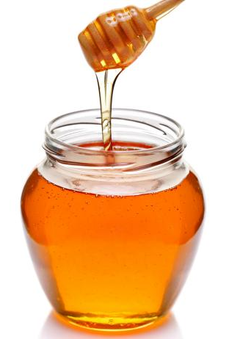
Sugar
Drink water or milk instead of pop, iced tea & juice
Eat your fruit, rather than drink it
Also consider foods with high levels of natural sugars
Honey, maple syrup, raw sugar = the same as white sugar
Notes:
-Fresh and frozen fruit contain naturally occurring sugar, but they also contain high amounts of fibre, vitamins and minerals.
-Whole fruits like apples, bananas and berries are very nutritious, even though they contain sugar. Most people do not need to limit or reduce their intake of whole fruits.
-However, fruit juice is a very concentrated source of sugar and should be limited. Even unsweetened, “no sugar added” fruit juice contains almost as much sugar as soda!​
-As well, foods made of “simple sugars” often have a very high sugar content.
-Foods like honey, maple syrup, agave, and sugar in the raw should all be limited, even though they are naturally occurring sugars and are not highly processed.
-In fact, honey and maple syrup contain the same amount of sugar (per teaspoon) as “regular” white sugar.​

Slide 12
Fat
Energy for the body
Helps absorb vitamins
Fat = Flavour!
Affects blood cholesterol
Manages fatty liver
Quality matters!
Notes:
-What have you heard about fat? Is it healthy, or not?
-Dietary fats and oils provide energy to the body and also help your body absorb certain vitamins (A, D, E, K). Fat also gives flavour to foods.
-The type of fat consumed is more important for health than the total amount of fat consumed.
-The type of fat we eat is important because it can affect the cholesterol levels in your body. High blood cholesterol is a risk factor for heart attack and stroke. Lowering your cholesterol can reduce your risk of heart disease.
-The types of fats we eat can also help to prevent or manage fatty liver disease. Fatty liver can progress to inflammation, cirrhosis or scarring of the liver, and decreased liver function.
-Also, some of the key risk factors for fatty liver disease are the presence of other common conditions, such as diabetes or insulin resistance, high cholesterol, high blood pressure, and overweight/obesity. All of these other conditions are also impacted by the quality of your dietary fat intake.

Slide 13
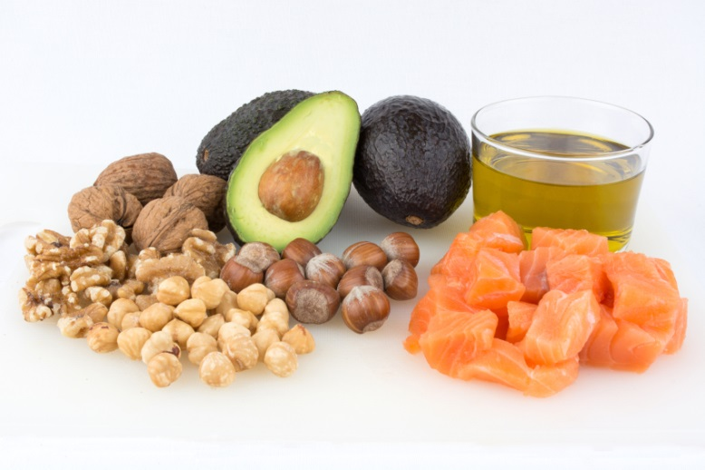
Unsaturated Fat
Protects against heart disease and liver disease
Olive, canola, sunflower & vegetable oils
Nuts and seeds
Avocado
Fish (salmon, mackerel, trout, sardines, tuna)
Notes:
-Unsaturated fats help protect us from heart disease and liver disease.
-Sources of unsaturated fats include: canola oil, olive oil, nuts & seeds, avocado, soft non-hydrogenated margarine, flaxseed, and fatty fish.

Slide 14
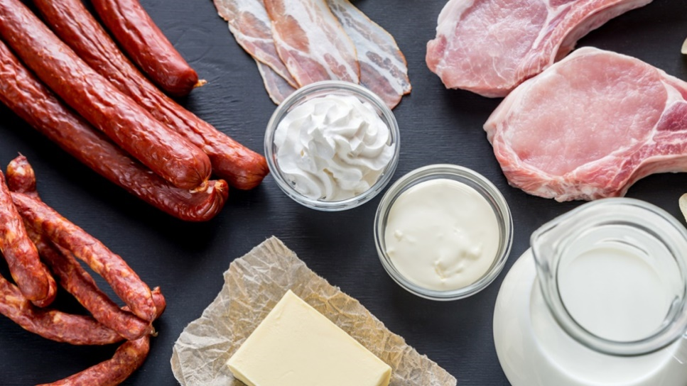
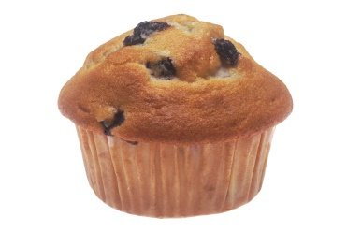
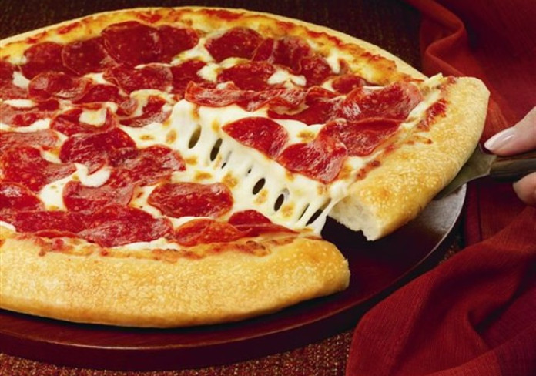
Saturated Fat
Animal fat (beef, pork, sausages, bacon)
Dairy fat (cheese, cream, butter)
Coconut and palm oils
Processed foods
Restaurant foods
Less processed = healthier!
Choose a pork chop instead of ham, bacon or deli meats
Eat homemade baked goods instead of store-bought
Notes:
-Saturated fats increase the “bad” cholesterol in our blood (LDL) which increases our risk for heart disease and liver disease.
-Sources of saturated fats include: fatty cuts of meat, full-fat dairy products (butter, cream, cheese, ice cream), lard & shortening, coconut oil, palm oil & palm kernel oil.
-As well, many packaged and highly processed food products, and restaurant foods, are high in saturated fat.
-Most of the saturated fat in the average Canadian diet doesn’t come from whole foods like beef or coconuts. Instead it comes from processed foods such as pizza, French fries, chips, cakes, cookies, donuts, ice cream, and other high fat foods like cheese.

Slide 15
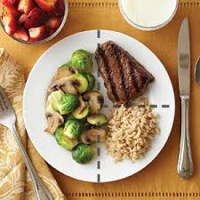
Balanced Plate
Notes:
-Now that we know some nutrition basics, how to we apply this information to a meal or snack? Follow the balanced plate method.
-Plate consists of ½ vegetables, ¼ starch, ¼ protein. These are appropriate portion sizes for each meal. You can also see a glass of milk and a side of fruit at the top of the picture.
-This balanced plate follows the same pattern as recommended by the new Canada’s Food Guide (2019).

Slide 16
Balanced Meals
Notes:
More examples of balanced meals and the plate method.
Baked salmon, roasted potatoes, roasted broccoli.

Slide 17
Balanced Meals
Notes:
Frozen pizza with extra veggies and meat added, plus raw veggies and dip on the side.

Slide 18
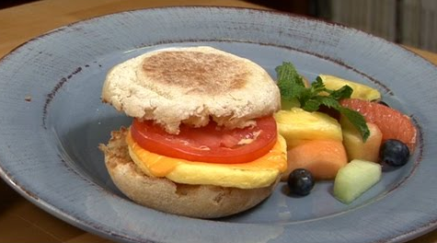
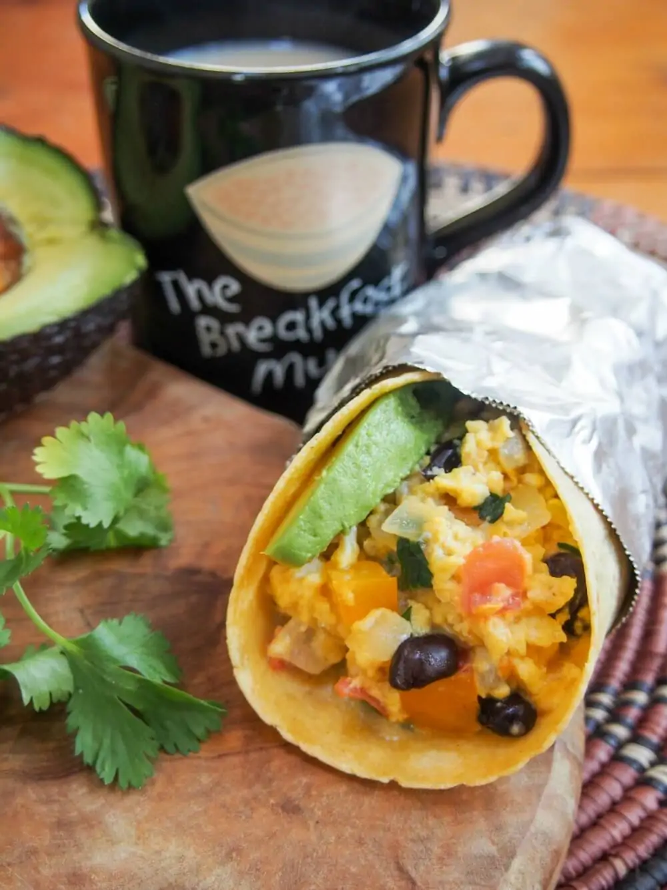
Balanced Meals
Notes:
-A balanced breakfast can be as simple as whole wheat toast with peanut butter and banana.
-A breakfast burrito made with eggs, cheese, black beans, and veggies, is a nutritious and portable breakfast.
-English muffin & egg sandwich with a side of fruit.

Slide 19
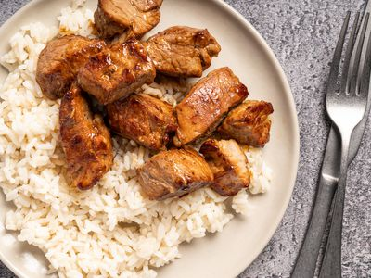
What's Missing?
Notes:
-The stir fry on the left contains meat and rice, no vegetables. The stir fry on the right is a more balanced meal – lots of vegetables, with smaller portions of meat and rice.
-When you eat a meal that doesn't look exactly like the balanced plate, think about the proportions. Your meal should contain about twice as much vegetables as rice (starch) or meat (protein).

Slide 20
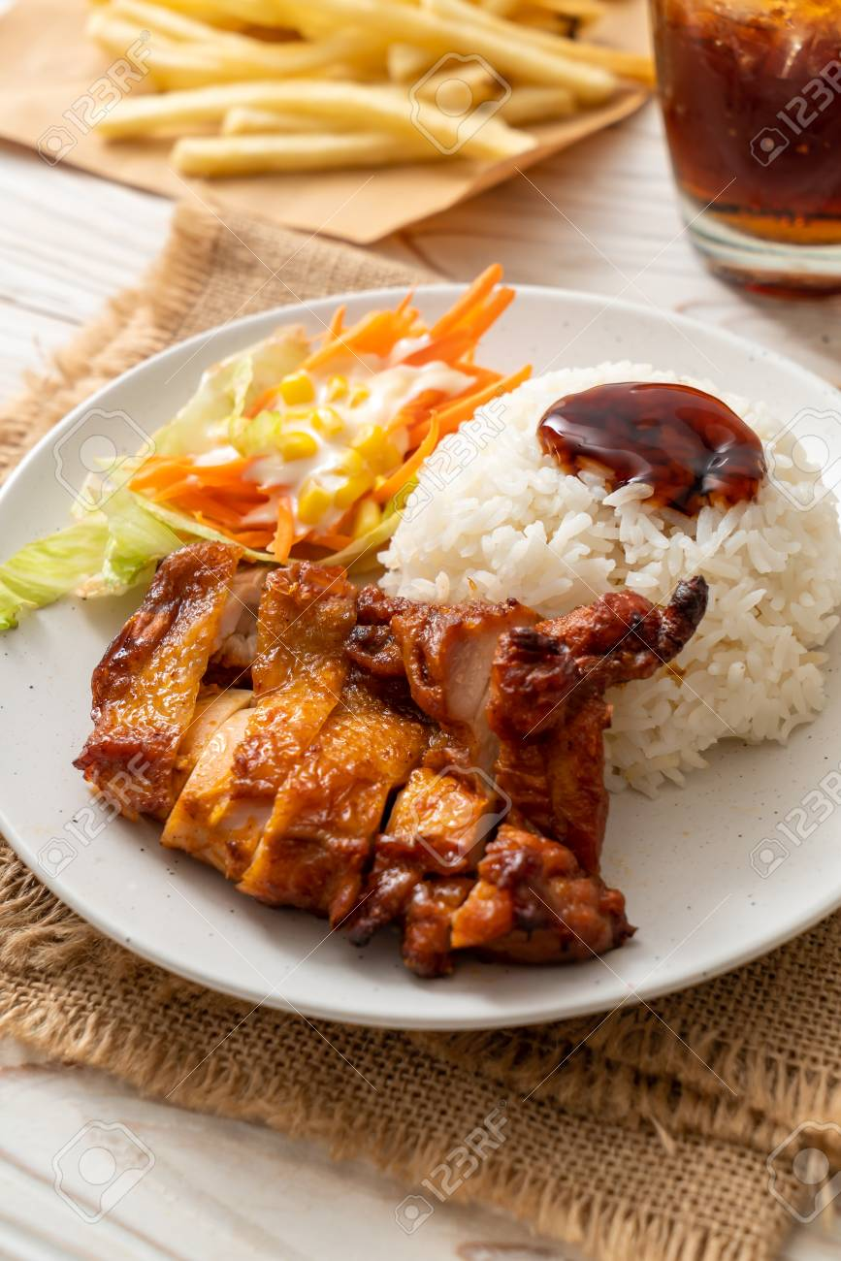
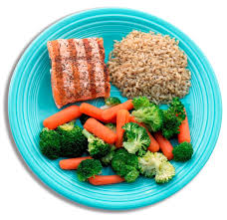
Unbalanced vs. Balanced Meals
Notes:
-Plate on the left = large portions of protein & starch, small portion of vegetables; white rice, sauces with added sugars on the chicken and rice.
-Plate on the right = balanced portions of food groups, brown rice (higher fibre), grilled salmon (unsaturated fats).
-Also compare the sizes of plates – when we use larger sized dishes, they subtly encourage us to load up our plates and eat more.

Slide 21
Play With Your Portion Sizes
Notes:
Plate on the right = the same food, but a better balance of the food groups and portions.

Slide 22
Take Home Point: Your Overall Diet Pattern is What Matters Most
Notes:
Not every single meal/snack needs to be a perfectly balanced diet. Look at how your overall food intake measures up over the course of a day or a week.
Notice that foods like chocolate, chips, butter, and candy, are still included in this plate!

Slide 23
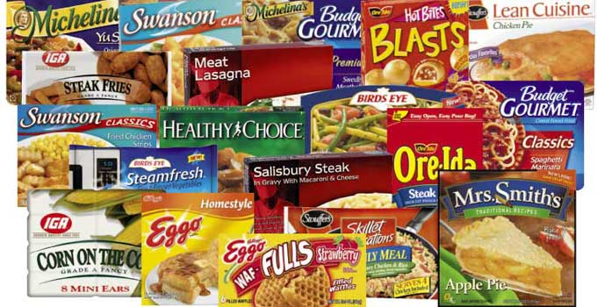
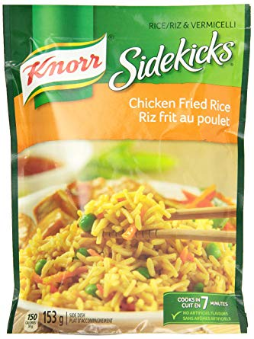
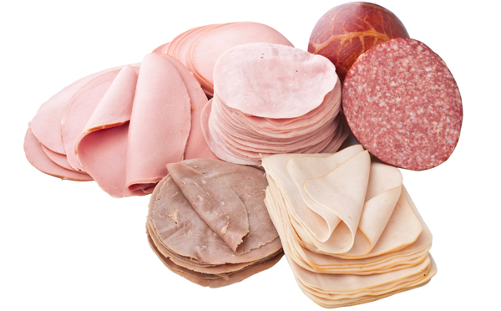
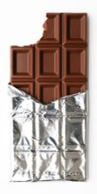
Highly Processed Foods
Often high in sugar, salt, and saturated fat
Low in fibre and vitamins/minerals
Consider how often you enjoy these foods
Notes:
-Processed foods: chicken fingers, frozen lasagna, rice and pasta side dishes (e.g. Sidekicks), processed meats (deli meats, sausages, hot dogs), canned soup, frozen dinners, pizza, some breakfast cereals and granola bars, and many packaged snack products (chips, cookies, etc.)
-These highly processed foods are usually also high in calories, salt and sugars, and contain little to no nutritional value.
-Sodium, or salt, can cause hypertension or high blood pressure, which is a risk factor for heart disease.

Slide 24
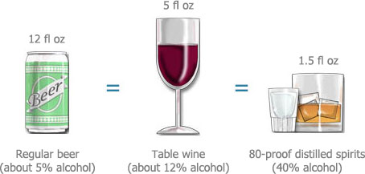
Alcohol
Maximum 1 drink per day, total 7 drinks per week
Don't save them all for the weekend
When moderation may be too much
Avoid alcohol most of the time if you have fatty liver or high triglycerides
Notes:
-For this class population, we recommend a maximum of 1 drink per day for both men and women.
-General alcohol guidelines are: Men: 3 drinks/day, maximum of 15 per week. Women: 2 drinks/day, maximum 10 per week.
-However, the recommendations are zero to minimal alcohol intake for people with fatty liver. Also consider the “empty calories” in alcohol for people who are trying to lose weight.
Health effects of alcohol:
-In moderation, alcohol may modestly increase HDL (good cholesterol). However, new research shows that even 1 drink per day can increase your risk of cancer.
-All types of alcohol raise triglycerides, increase blood pressure, and contribute to the development of heart disease and stroke.
-Alcohol is calorie-dense but doesn't provide nutrition. Consider your alcohol and calorie intake if you are concerned about weight management.
-Bottom line: If you don't drink alcohol, don't start.
A standard alcoholic drink means:
• 341 mL / 12 oz (1 bottle) of regular strength beer (5% alcohol).
• 142 mL / 5 oz wine (12% alcohol).
• 43 mL / 1-½ oz spirits (40% alcohol).

Slide 25
Isn’t this too basic?
NO!
These guidelines target many health concerns:
Fatty liver
PCOS
Type 2 diabetes and Prediabetes
Cardiovascular Disease (high blood pressure, cholesterol, heart attack & stroke)
Weight management
Mindless eating or Disordered eating
Notes:
-Fatty liver: This healthy eating plan reduces added sugars and saturated fat, increases fibre.
-Type 2 diabetes: This diet reduces added sugars, sodium, saturated fat, increases fibre, encourages low glycemic index foods.
-Cardiovascular disease: Reduces added sugars, sodium, saturated fat, increases fibre.
-Mindless eating, Disordered eating, Healthy weight: Provides balanced nutrition, Can increase enjoyment and awareness of your food intake.

Slide 26
Notes:
Take a 5 minute break. The timer will automatically start when you advance to the next slide. When you are ready to resume, again just advance to the next slide.

Slide 31
Notes:
When you are ready to resume, just advance to the next slide.

Slide 32
TIME IS UP!

Slide 33
Where Do I Start?
Notes:
We have covered a lot of nutrition information in a short time. You may feel overwhelmed with all of the potential changes that you could make. Or you may feel like you already know this information, but you have trouble “sticking to a plan” of healthy eating.
So where should you start? For the rest of this class, we will focus on common reasons why people find it difficult to eat healthy, and how to solve them.

Slide 34
Troubleshooting
What gets in the way of healthy eating for you and your family?
Lack of time
Budget
Eating out
Food cravings
Circumstances
Don’t know how to make healthy choices
Notes:
Don’t ask participants to vote again in this poll, from the beginning of the class, but do share the poll results again.
You may choose to focus on certain topics and/or skip some of these topics, based on the concerns identified by your class participants.

Slide 35
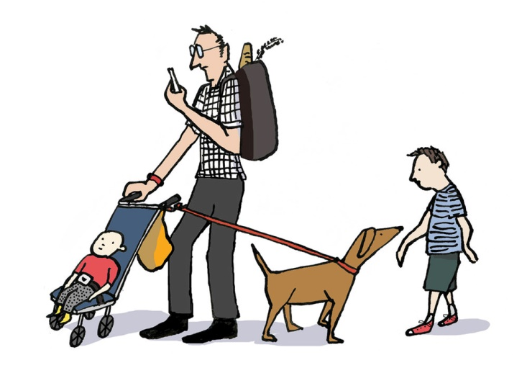
Lack of Time

Slide 36
Lack of Time
Map out your week
What days can you carve out some time?
Who can help? Spouse, children?
Create a go-to list of 10 minute meals
Try bulk meal prep or a meal box subscription
Use your gadgets: Instant Pot, slow cooker, rice cooker, air fryer
Buy groceries online
What other tips do you have? (Type in the chat box)
Notes:
-Anticipate challenges and plan ahead for the days when you don’t have time to cook. Usually we know which days of the week are the “trouble days”.
-Example: Tuesdays you only have 30 minutes to get home from work, make dinner, and then take the kids to soccer practice.
-Or Thursdays, your kids have dance class or music lessons right after school, and you don’t get home until 7:30 pm.
-Plan ahead for these days. Can you eat sandwiches for a quick supper instead of heading to the drive-thru? Or cook a double batch of supper the night before, so you can eat leftovers on the days when you are too busy to cook?
-Ask participants to create a list of 5 go-to meals that can be made in 10 minutes or less. e.g. spaghetti, tacos (defrost meat the night before), eggs & toast for supper.
-Can your spouse or older children do some or all of the meal prep, especially on busy days?
-After school, teenagers can chop vegetables and defrost meat from the freezer. When an adult gets home, all the ingredients for a stir-fry are ready to add to the frying pan and can be cooked quickly.
-If nobody is available to help with meal prep, can you do a bulk meal prep on the weekend? e.g. Chop enough vegetables to make 5 days of salads for lunch.
-Or cook a whole package of chicken breasts on Sunday and use in different ways throughout the week. e.g. Monday = make fettucine alfredo and add your precooked chicken. Tuesday = chicken Caesar salad. Wednesday = chicken quesadillas.
-Add your meal plan to your shared family calendar (whether an online/Google calendar or a paper calendar). If you and your spouse share the cooking duties, whoever gets home first knows what to start cooking for dinner.
-Buy your groceries online (saves time rushing to the grocery store and waiting in lines). You can grocery shop from your couch at 10:00 pm and schedule for pickup at your convenience.

Slide 37
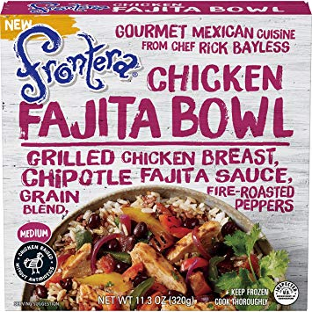
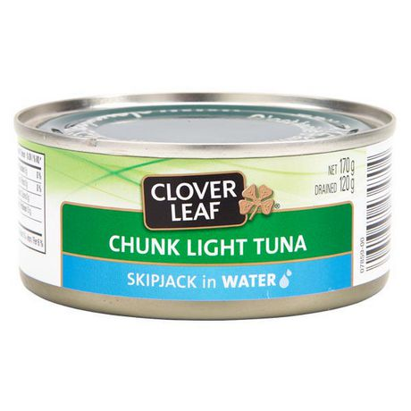
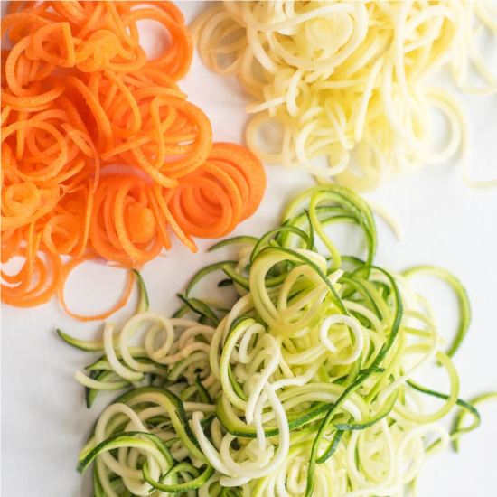
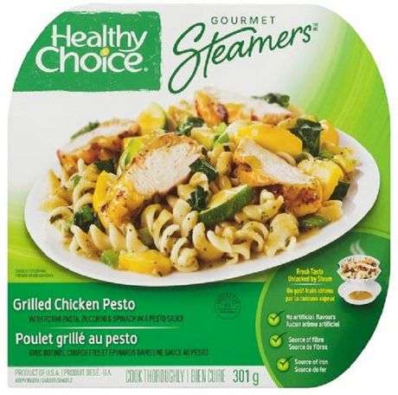
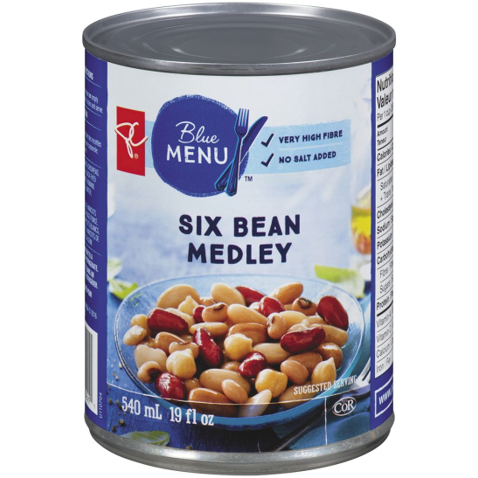
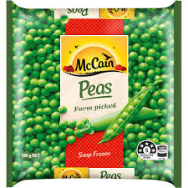
Options for Convenience
Notes:
-Here are some examples of convenient foods that are also healthy. Use these to your advantage to reduce prep time for meals.
-Select frozen TV dinners that look close to the "Balanced Plate". Or use this frozen meal as a base and then add extra nutrition to the TV dinner. Pack a frozen meal + a piece of fruit for lunch. Even though it’s a processed food, it can be a healthier choice than a burger and fries.
-Frozen vegetables, spiralized vegetable noodles, pre-cut fruit and vegetable trays.
-Canned beans and canned tuna.
Direct clients to review the handout “Convenience Foods and Quick & Easy Meal Ideas” which will be emailed to participants after the class.

Slide 38
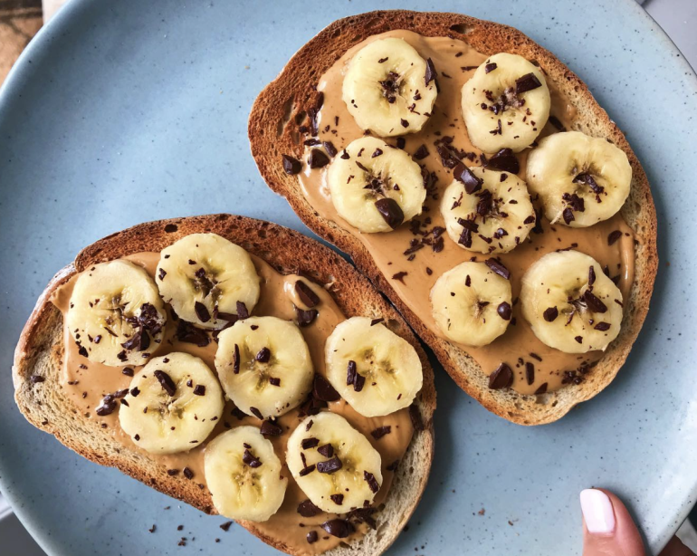
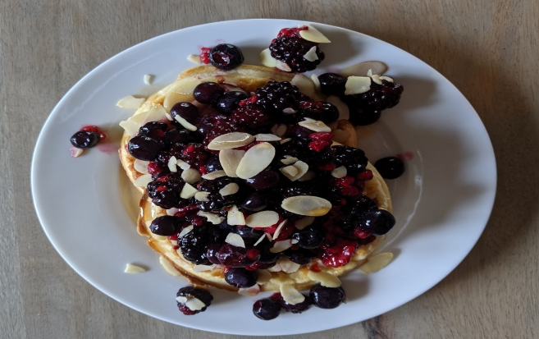
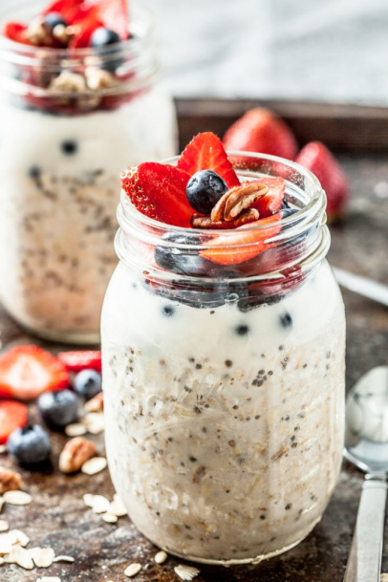
Quick & Easy Breakfast Ideas
Notes:
Also refer to handout “Convenience Foods and Quick & Easy Meal Ideas”. Will be emailed to participants after the class.
-Whole grain toast with peanut butter and banana (if you want to be fancy, add a few chocolate chips!)
-Overnight oats (lots of recipes available online)
-Eggo waffle topped with yogurt and fresh or frozen fruit

Slide 39
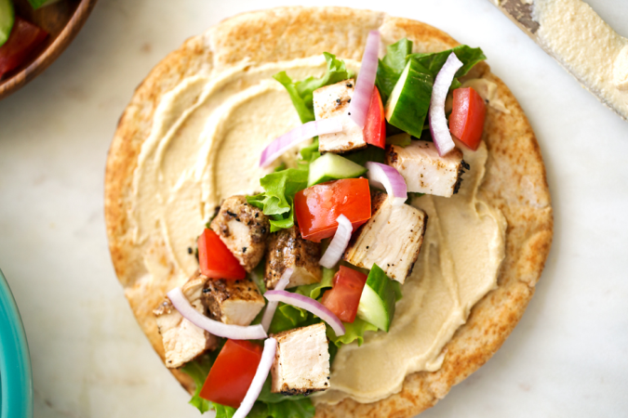
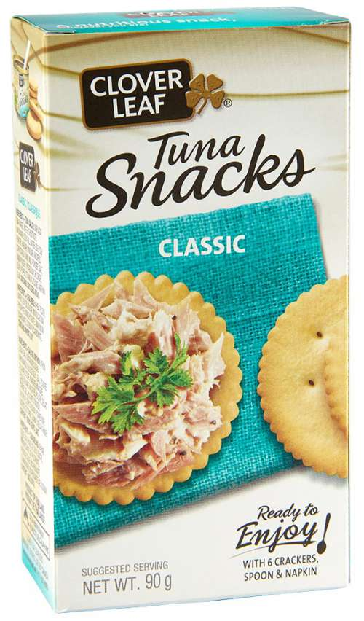
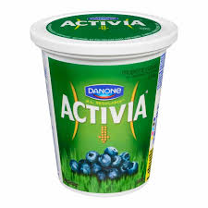
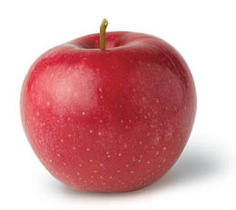
Quick & Easy Lunch Ideas
Notes:
-Whole grain wrap. Add precooked chicken strips + hummus + bagged salad or other vegetables. Plus yogurt on the side.
-Tuna + crackers with a piece of fruit.

Slide 40
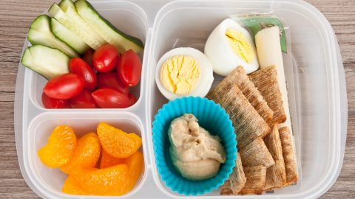
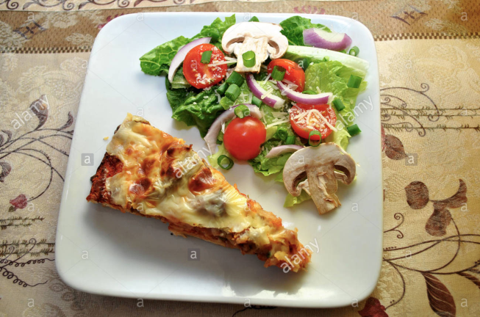
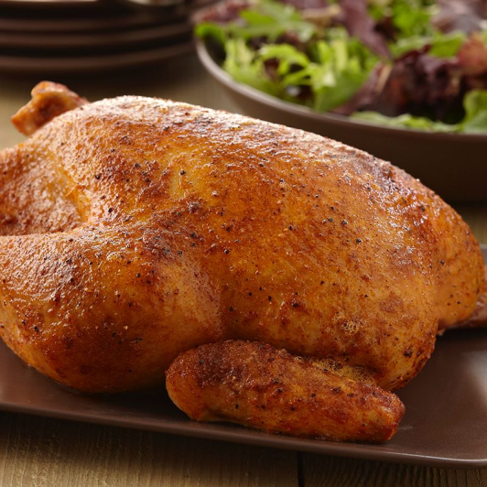
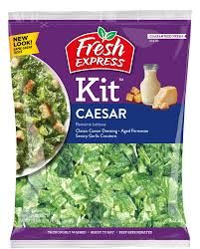
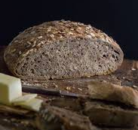
Quick & Easy Supper Ideas
Notes:
-Rotisserie chicken + Caesar salad kit + whole grain bread.
-Frozen pizza + bagged salad.
-Have a snack or picnic-type supper: Crackers with cheese or hummus + boiled eggs or sliced meat + cut up vegetables and fruit. Simple but balanced. Portable if you need to eat in the car with kids, and it can be prepped in advance.

Slide 41
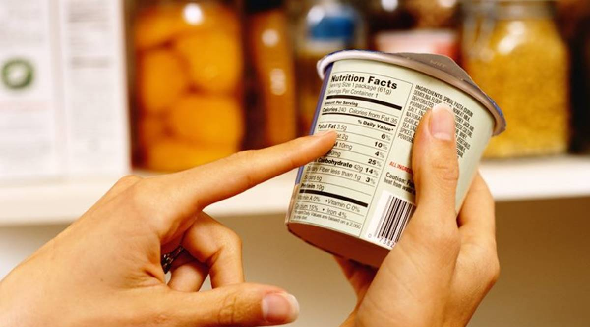
Label Reading

Slide 42
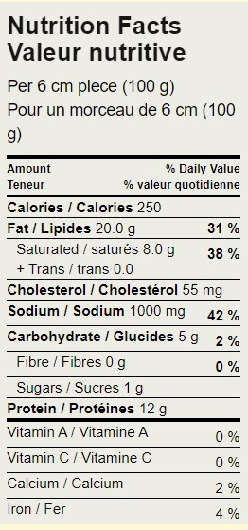
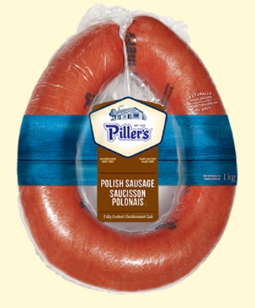
Label Reading
2 ½” piece (1/10th of sausage ring)
Notes:
We will use this Polish sausage as an example of how to read a Nutrition Facts label.

Slide 43
Label Reading
1) Look at the serving size
Compare to your actual intake
2 ½” piece (1/10th of sausage ring)
Notes:
Look at the serving size and compare to your actual intake. The serving size on this label is for one piece of sausage that is 6 cm or 2 ½ inches (100 g).
To get an accurate picture of the nutrition you are actually eating, you may need to double or triple the amounts listed on the nutrition label. I suggest that you measure the portions of food you eat and compare it to the serving size on the Nutrition Facts table.

Slide 44
Label Reading
1) Look at the serving size
Compare to your actual intake
2) Look at the % daily value (% DV)
2 ½” piece (1/10th of sausage ring)
Focus on:
Sodium (limit)
Saturated fat (limit)
Fibre (eat more)
Notes:
Important nutrients of concern for fatty liver, prediabetes, dyslipidemia and hypertension = sodium, saturated fat, and fibre.
The quantities of these nutrients are also a general indicator about how healthy a food is.

Slide 45
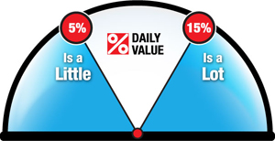
Label Reading
Notes:
For any nutrient on the nutrition facts table, 5% DV or less is considered a small amount of that nutrient. 15% DV or higher is considered a large amount of that nutrient.

Slide 46
Label Reading
a) Sodium
Aim for 15% DV or less (the lower, the better)
Remember the serving size
If you eat a 5-inch piece of sausage = 2 servings
2 ½” piece (1/10th of sausage ring)
42% DV of sodium per serving
x 2 servings
84% daily value of sodium
(actual intake)

Slide 47
Label Reading
b) Saturated Fat
Total fat content is not very important
Total fat = unsaturated + saturated + + trans fats
Saturated fat is a better indicator of the food’s overall nutrition quality
Aim for saturated fat of 15% DV or less (the lower, the better)
2 ½” piece (1/10th of sausage ring)
Notes:
Blue arrows point to total fat content. Red arrows point to saturated fat content.
Saturated fat is a better indicator of the food’s nutrition quality, rather than the total fat content.
Bottom line for clients: For the most part, you can disregard the amount of total fat in the food. Instead, focus on the saturated fat content.
-----Presenter note-----​
-You don’t need to explain this unless a client is confused about how the grams and % DV of fats are displayed on the label.
-Total fat = 20.0g per serving / Saturated fat = 8.0g / Trans fat = 0.0g / Unsaturated fat = 12.0g (not displayed on the label, but can be calculated based on the total fat content)​
-Health Canada established a % DV for total fat and a separate, lower % DV specifically for saturated & trans fats.
-31% DV means that this food contains 31% of the total recommended daily intake for total fat (which is 75g = total intake of saturated + unsaturated + trans fat).
-There is a separate sub-limit of 20 grams/day for saturated & trans fats. 38% DV means this food contains 38% of the total recommended daily intake for saturated fat.
-This 20g limit of saturated & trans fat is also included as part of the 75g limit of total fat. i.e. Limit to 20g saturated fat + 55g unsaturated fat = 75g total. Not 20g saturated fat + 75g total fat = 95g total.

Slide 48
Label Reading
2 ½” piece (1/10th of sausage ring)
c) Fibre
Aim for 15% DV or more (the higher, the better)

Slide 49
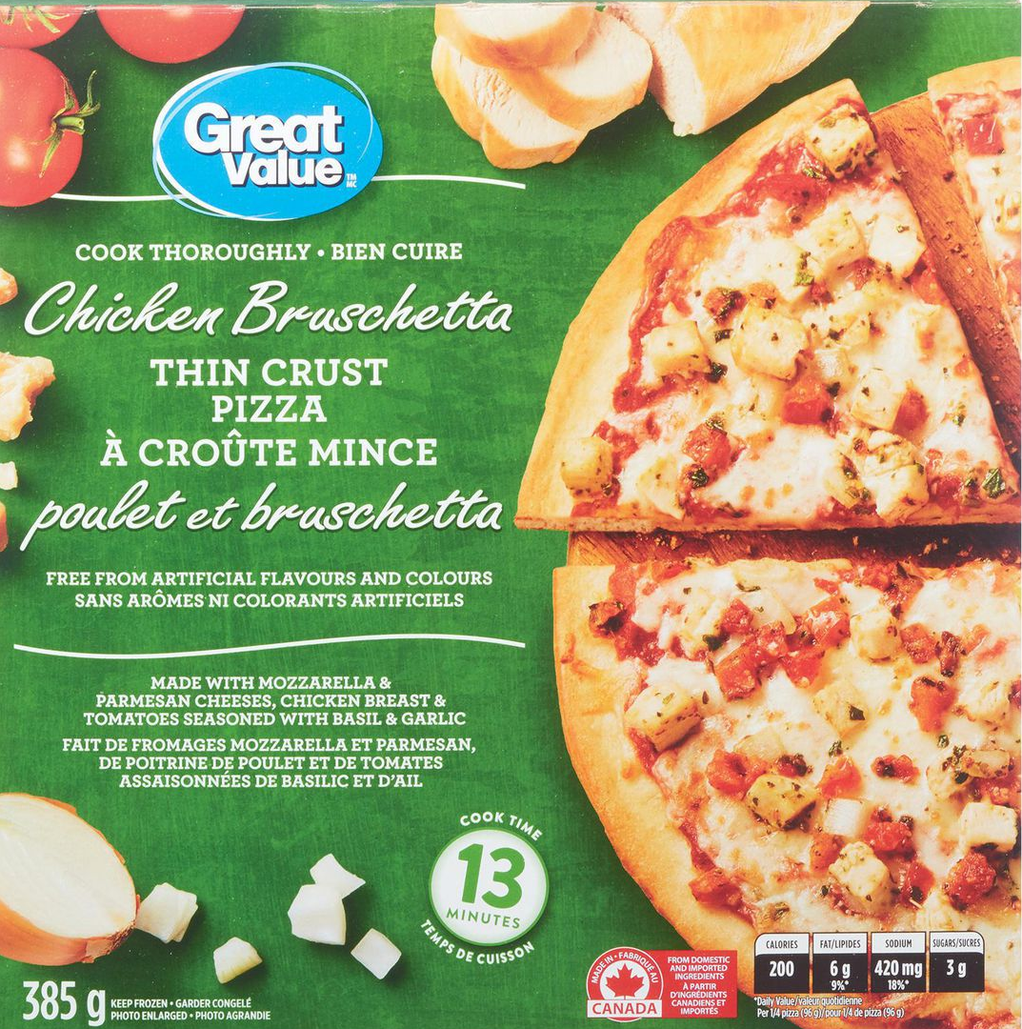
Comparing Foods
Notes:
Now I will show you how to use the Nutrition Facts label to compare similar foods – in this example, 2 types of frozen pizza.
On the left is a Delissio 3 meat thick crust pizza and on the right is a chicken bruschetta thin crust pizza.

Slide 50
Comparing Foods
Notes:
Quick reminder: For any nutrient, 5% DV is a small amount and 15% DV is a high amount of that nutrient.

Slide 51
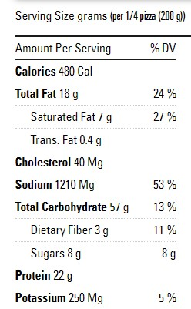
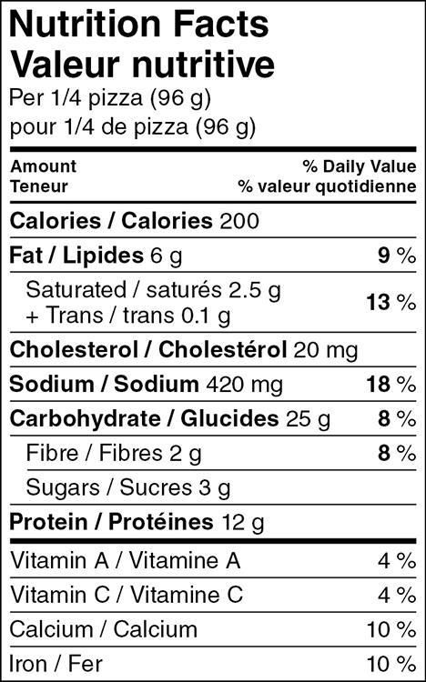
Comparing Foods
1) Serving size
2) Saturated fat
3) Sodium
4) Fibre
37 g net carb per 2/3 cup
Notes:
Step 1. Look at the serving size. Both labels are for a serving size of ¼ of the pizza.
(Presenter note: The Delissio pizza is 208g weight because it is a thick crust pizza and the Great Value chicken pizza is 96g weight because it is thin crust. Will you eat a smaller serving of the Delissio pizza, since it’s a larger weight? Many people will eat the same serving size of ¼ of the pizza, regardless of thin vs. thick crust).
Step 2. Compare the saturated fat intake.
-The Delissio pizza contains 27% DV saturated fat (because it contains 3 types of processed meats = pepperoni, Italian sausage & beef, and probably more cheese).
-The Great Value pizza contains 13% DV saturated fat because it’s made with chicken, which is a leaner meat.
Step 3. Compare the sodium intake.
-The Delissio pizza contains 53% DV sodium (again because of the processed meat) whereas the Great Value pizza contains 18% DV sodium.
-On the chicken pizza, the DV for sodium is still above our target of 15%. However, you may not find a food that is “perfect” in every category. But when we compare, we can see the chicken pizza is a much lower sodium choice.
Step 4. Compare the fibre content.
-The Delissio pizza contains 11% DV fibre, while the GV pizza contains 8% DV fibre. (Note: the Delissio pizza probably has more fibre simply because the serving size/weight is much larger).
-Even though the Delissio pizza contains slightly more fibre, we can safely say that the Great Value pizza is the healthier choice between the two options, because it has a lower content of saturated fat and sodium.
Take home message: You don’t have to give up your favourite foods. But you can make some small changes to the types of foods you eat to make them more nutritious (e.g. choose thin crust pizza with chicken and vegetables, rather than thick crust pizza with pepperoni and sausage).

Slide 52
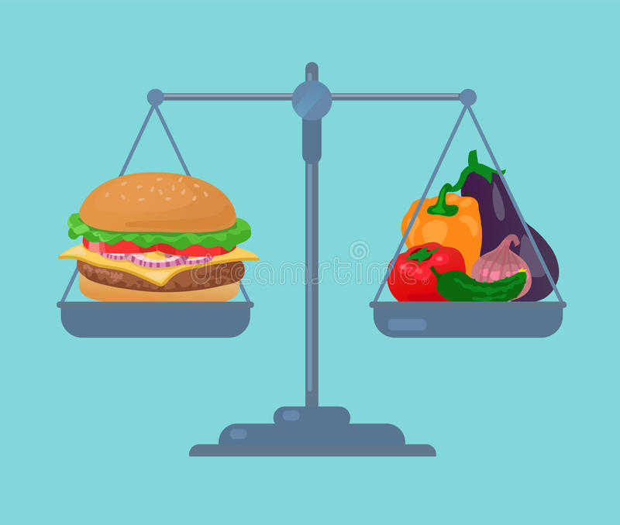
How to Balance a Meal

Slide 53
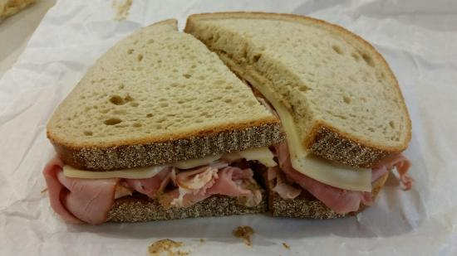
How to Balance a Meal
Lunch 1
Lunch 2
Ham & swiss sandwich
On rye bread
With mayo & butter
Chocolate pudding
Iced tea
Tuna, egg salad or roast chicken sandwich
Whole wheat bread or wrap
With mayo & mustard
Yogurt
Water, sparkling water, or hot tea
Notes:
CHOOSE EITHER SLIDE 53 OR 54 TO PRESENT.
Examples using healthier convenience foods to make a meal less processed, more balanced, and increase the nutrition quality.
These slides are also included on the handout “How to Balance a Meal” which will be emailed to participants after the class.
Sandwich:
-Whole wheat bread instead of rye bread (higher fibre).
-Tuna/egg/roast chicken filling instead of processed meat and cheese (lower sodium and saturated fat).
-Keep the mayo, but use mustard instead of butter (lower saturated fat).
Side dishes: Yogurt and water instead of pudding and iced tea (lower added sugars).

Slide 54
How to Balance a Meal
Supper 1
Supper 2
Macaroni & cheese
Macaroni & cheese
Add frozen peas
Add canned tuna or beans
Notes:
Supper 1: Only macaroni & cheese (mostly starch, minimal protein).
Supper 2: Mac & cheese with canned tuna or canned beans + frozen peas. This simple changes provide extra protein, vegetables, and fibre. It also reduces the overall sodium content of the meal, since you will consume a smaller portion of processed food (mac & cheese).

Slide 55
Budget Friendly Meals

Slide 56
Smart Shopping
Eat at home instead of buying coffee and take-out meals
Medium coffee or tea, 5 days a week = over $500 per year!
Only buy what’s on your list
Online grocery shopping can reduce impulse purchases
Check what foods you already have at home (freezer or pantry) and build meals around those foods
Be intentional about “first in, first out” eating
Notes:
-Eat at home. Medium Tim Horton’s coffee/tea = $1.98 after tax, x 5 days/week x 52 weeks = $514.80 per year (as of Jan 6, 2021)
-Check what foods you already have at home. Think about food that you currently have in your fridge or your cupboards. Does any of it need to be used soon?
-Do you have some fresh vegetables that are near the end of their shelf life? How could you make them into a meal? How about a stir fry or a soup?
-What about the roast that’s been sitting in your freezer for ages? Maybe you could buy some potatoes and carrots to cook with the roast. And how about some fresh buns to make roast beef sandwiches with the leftovers?
-Use “first in, first out” principles to reduce food waste and therefore save money.

Slide 57
Lower Cost Foods
Frozen and canned vegetables & fruit are less expensive and still nutritious
Buy foods that don't spoil quickly (e.g. apples, carrots)
Inexpensive protein: beans, lentils, eggs, canned fish
For more tips: UnlockFood.ca/en/Articles/Budget
Notes:
When buying fresh produce with a short shelf life (e.g. lettuce, berries) plan to eat these foods earlier in the week before they spoil.
At the same time, also buy some heartier fruits and vegetables that will last longer and eat these at the end of the week (e.g. apples, carrots, coleslaw mix without dressing).

Slide 58
Save Money by Reducing Waste
Don't buy more than you will actually eat
Give veggies & fruit “center stage” in the fridge
Consider a meal box subscription (e.g. Chef’s Plate, Hello Fresh)
Time versus money?
Whole vegetables vs. pre-cut fruit & veggie trays
Whole chicken vs. boneless skinless chicken breasts
The average Canadian household
wastes $1,766 of food per year
Notes:
-The annual cost of avoidable food loss and waste in Canada is $1,766 per household, which is approximately $150 per month.
-Source: https://www.producer.com/farmliving/food-waste-costs-canadian-economy-49-billion-a-year/
-Don't buy more food than you will actually eat. Just because it’s a “good deal”, will you eat it all? Don't buy the Costco-sized bag of salad if you will throw out half of it.
-If you buy the Costco-sized bag of chips because it’s cheaper, you are likely to eat a bigger portion of chips, and may sabotage your health goals.
-However, if you do actually eat all the food (especially non-perishable items), buying in bulk can sometimes save money.
-Give veggies & fruit “center stage” in the fridge. Instead of relegating fresh produce to the crisper drawer, put your vegetables and fruit at eye level so it’s the first thing you see when you open the fridge. Make your usual go-to foods (e.g. meat, cheese) less accessible at the back of the fridge.
-Meal box subscription. You receive exactly the amount of food that you need to prepare the meal, so there is no food waste. This may balance out the higher cost of the box, versus cooking from scratch.
-Meal boxes also give you an opportunity to try out new ingredients or new recipes with less risk. If you learn that you don’t like quinoa, you only have to eat it for this meal and you didn’t spend $10 on a large bag of quinoa at the grocery store.
-Time vs. money. If you buy whole, uncut vegetables they may sit in your fridge and not get eaten until you throw them away.
-If you buy a pre-cut veggie tray, you are more likely to eat the vegetables since it’s more convenient. Even though the veggie tray is a higher upfront cost, you will be spending less money on food waste.

Slide 59
Eating Out

Slide 60
Strike a Balance While Eating Out
Buy only part of the meal (burger) and pack veggies and cheese/yogurt on the side
Drink water and skip the fountain drink
Order “plain” food to reduce fat and salt intake
Order from the kids menu for a smaller portion
Consider the grocery store deli
Avoid the “health halo” (e.g. Subway)
Find sit-down restaurants in your neighbourhood that make less processed food and order ahead
Notes:
Refer to “Eating Away from Home” handout, to be emailed after the class.
1) Order plainer food in smaller portion sizes (e.g. double hamburger from McDonald’s instead of a Big Mac or bacon double cheeseburger).
2) Many grocery store deli options are not deep fried and you can add fruit/veggies from the store to balance the meal.
3) Health Halo: The image that restaurants promote to make you feel good about buying their food.
-e.g. Subway markets themselves as being fresh and healthier than other fast food restaurants. In reality, many of the subs contain similar amounts of calories, saturated fat and sodium, as a McDonald’s Big Mac! And that’s just the sandwich, not including chips or cookies at Subway.
-But if you think that you’ve made a healthy choice by ordering a sub instead of a burger, often you feel that you deserve to make an unhealthy choice to go with it, so you add the cookies and soda to make your sub a combo.
-Even though you pay more for the meal combo and it’s a poor choice for your health, you walk away feeling like you made a healthy choice.

Slide 61
Food Cravings

Slide 62
Dealing With Cravings
Cravings are often associated with:
Intense feelings or emotions
Stress, fatigue, sadness, happiness
Eating too little or skipping meals
Boredom and personal habits
Certain circumstances
Watching TV or movies
Kids going to bed
Playing computer or video games

Slide 63
Dealing With Cravings
Find ways of managing boredom or stress that don’t involve food
Reading, puzzles, knitting, crafting, exercise
Phone or video call with friends & family
Group classes about managing cravings and/or emotional eating:
Craving Change class: www.wrha.mb.ca/groups
Eat Your Heart Out class: https://womenshealthclinic.org/what-we-do/ medical-services/nutrition/
Notes:
-Mindful eating: When was the last time that you sat down and just ate, without doing anything else at the same time? Watching TV, checking your phone, eating at your desk, or in the car? Or when was the last time that it took you more than 10 minutes to eat a meal?
-Making time to eat slowly can help you to enjoy your food more, make healthier food choices, and prevent overeating. You may also enjoy eating with other people and spending time together.

Slide 64
Consider Your Circumstances
Do you have too much going on?
Involved in too many activities/commitments?
Alison’s story
Notes:
We can talk about saving time, saving money, and eating healthier, but maybe the problem is that you are simply too busy. Are you trying to do too many things – even if they are good things? This is a true story about a client seen by a dietitian. Names have been changed to protect privacy.
-Alison is a married mother of 2 boys, aged 11 and 14. Alison was referred to a dietitian because she recently found out she has fatty liver.
-Alison’s blood sugars have been rising into the prediabetes range over the last few years and her cholesterol is getting high too.
-She already has good cooking skills, so Alison asks the dietitian to help her figure out how she can eat healthier considering her busy lifestyle:
-Alison works full time and her husband also works full time as a shift worker.
-Her sons are both involved in sports, with multiple practices per week and games on the weekends. Her only night off at home is on Sunday.
-Most days Alison is awake by 6:00 am. She often works through lunch and eats something from Tim Hortons at her desk.
-She finishes work, rushes home, picks up her sons and goes to a drive-thru on the way to basketball or karate or swimming.
-When she is able to cook at home, it is usually something like a frozen pizza that requires little prep time and can be eaten quickly, either at home or in the car.
-Sometimes, Alison doesn’t eat at all but she makes sure that her sons eat, because they are so active.
-By the time she gets home from activities, it is often 9:00 pm and she is exhausted. Alison ends up watching Netflix for an hour or two and snacking on foods like chips and microwave popcorn before going to bed.
-Alison is also very involved in her church. Since she is known for both her organizational skills and her baking, she is often the first person asked to help with events and to make food for fundraisers and other special occasions. Alison feels guilty about refusing to help, so she always says yes.
What can Alison do? We discussed her health concerns, her commitments, her hopes for the future, her eating and physical activity habits, and more.
-3 months later, Alison came back for her follow-up appointment with the dietitian and she was doing so much better.
-After our discussion, Alison realized that her schedule was not allowing her to take care of herself properly and that it wasn’t good for her boys to be eating so much fast food either.
-Alison held a family meeting and the family agreed that all of the kids’ extracurricular activities would be rescheduled to include only Monday and Tuesday evenings.
-This meant fewer sports commitments overall, but the boys were actually relieved to have more time to play with their friends and just relax.
-Alison also decided that she would only accept planning and baking responsibilities for 2 events per year at her church.
-With these changes, Alison now has 5 nights per week at home to do some healthy cooking, pack a lunch, relax and go out for a walk, visit with a friend, or spend time with her husband and sons. She is sleeping better, and her stress level is lower so she doesn’t have as many cravings for chips.
-Alison and her husband are relieved because with less sports and restaurant meals, they are saving money and even had time to go on a date last month!
-Her fatty liver, blood sugars and cholesterol are improving and Alison feels that she can continue with her lifestyle changes.
Are you doing too many “good things”? Do we truly need to do all of them? What are your most important priorities for your life?

Slide 65
But I Need to Lose Weight!
Notes:
During today’s class, we haven’t really talked about losing weight. You may think, or your doctor may have told you, that you need to lose weight in order to manage your health and reduce your risk of disease. But is that really true?

Slide 66
Do I Need to Lose Weight?
John and Linda decide to improve their lifestyle after finding out that John has fatty liver.
They give up pop and start walking together in the evening for 30 min instead of watching TV.
John loses 10 lbs in 2 months, but Linda’s weight doesn’t change.
NO!
Is he healthier than she is?
Notes:
Is John healthier than Linda? NO!
Why not? Because they are doing the same behaviours (walking and giving up pop).

Slide 67
What Factors Influence Weight?
Genetics
Age
Hormones
Some medications
Some medical conditions
Family habits and culture
Social determinants of health
And many more...
Notes:
-We can see that there are many factors besides diet and exercise that influence our weight and our health. We can improve our health by following healthy habits like eating a balanced diet, regular exercise, limiting alcohol, and not smoking. We reap the health benefits of these activities, no matter how much we weigh.
-However, as we saw in the example of John and Linda, doing these healthy habits does not necessarily mean you will lose weight.
-Why not? Because our body weight is an OUTCOME based on many factors. We cannot directly control our weight because we cannot control all of the factors that determine weight. (Weight is an outcome. Weight itself is not a behaviour or a direct action).

Slide 68
Notes:
Presenter note: Don’t discuss this slide in detail. Just say:
-“This picture provides a visual representation of the different factors affect your health. Some of these factors you can change, and some you cannot change.”
-“Social support networks: Did you know that maintaining social connections by engaging with family and friends can improve your health?” (Note: Social support accounts for ~30% of our health outcomes.)
-“Access to health care is another major effect on your health. You can improve your health by attending routine doctor’s appointments and attending a class like this one today. As well, it’s important to find a health care provider that you feel comfortable with, so you are able to engage in preventative health care and also receive treatment when you are unwell.”
For participants who are interested in learning more about the core determinants of health, recommend the Eat Your Heart Out program at Women’s Health Clinic (weight and determinants of health are discussed in detail in that program).
---Presenter note---
Core determinants of health, in order from most to least impactful:
1) Income and social status, 2) Social support networks, 3) Education and literacy, 4) Employment/working conditions, 5) Social environments, 6) Physical environments, 7) Personal health practices and coping skills, 8) Healthy child development, 9) Biology and genetic endowment, 10) Health services, 11) Gender, 12) Culture.
-From Eat Your Heart Out session 5.

Slide 69
Body Mass Index (BMI)
BMI is often used to measure health, but it's the wrong tool to use
Can misclassify people in larger bodies to be seen as “not healthy” or people in smaller bodies as “healthy” even when they are not
Notes:
-BMI is not a good measuring tools of our health status.
-BMI was developed in the 1800s by a mathematician to categorize people within a population. BMI was never meant to evaluate individual people. The BMI formula was not based on measures of health and it does not predict a person’s health.
-The BMI “number” does not give you any information about body composition (bone mass, muscle mass, and fat mass). For this reason, among others, BMI misclassifies healthy people in larger bodies as being unhealthy.
-As well, a person in a smaller body may have a lower BMI, but that person may actually be UNhealthy. Consider a person who smokes and drinks alcohol every day, but happens to be slim.
---Background information only---
Orpana et al. (2010): Canadian study n =11,326.
Found increased risk of mortality only for BMI <18.5 and >35. BMI 25-29.9 had significant reduced risk of death; BMI 18.5-25 and 30-35 no increased risk.
Tomiyama et al. (2016): Alternate explanations for the association between weight loss and improved health include: Better levels of exercise, nutrition, reduced insulin resistance, reduced weight stigma. These confounding factors are often not considered/accounted for when assuming that weight loss = improved health.
Robison et al. (2007): No evidence that weight loss is an effective intervention for improving long term health for a large number of individuals.
-Fatness does not cause hypertension, lipid disorders, or DM2. All of these conditions improve significantly with lifestyle changes, with little or no weight loss, and sometimes weight gain.
-In reviewing the Framingham Heart Study and NHANES, all excess mortality associated with obesity was accounted for when the impact of weight cycling was considered.

Slide 70
95% will , and often more than they lost originally
Notes:
Up to 95% of people who lose weight on a diet will gain the weight back within 2-5 years. 33-66% of dieters will gain back more weight than they lost originally.
(NIH Panel, 1992; Stunkard et al., 1958; Mann et al., 2007; Fildes et al., 2015).
Diets are harmful. Dieting results in:
-Lower metabolism; so we store fat more easily from eating fewer calories
-Increased hunger and food cravings
-Decreased attention span, fatigue, irritability
-Decreased muscle mass
-Poor nutritional intake
-Feeling "obsessed" or fixated on food
-Feelings of failure; reduced self-esteem

Slide 71
yo-yo dieting
yo-yo dieting
Notes:
Weight cycling (often occurs with yo-yo dieting) is associated with:
-Increased mortality / risk of death
-Increased risk of coronary heart disease, heart attack and stroke
-Increased risk of type 2 diabetes
-Increased blood pressure
-Increased risk of some types of cancer
-Increased inflammation
-Decreased immune function
-Decreased metabolic rate
-Decreased physical activity
-Binge eating
-Loss of muscle mass
-Increased risk of osteoporotic fractures
-Emotional distress, reduced self-esteem
-Increased likelihood of over-eating in stressful situations
-Increased weight, independent of BMI and age

Slide 72
What Can I Do?
More behaviours = more benefits
Healthy eating
Physical activity
Quit or reduce smoking & vaping
Improve sleep
Reduce stress
Changing these factors will improve your health and your weight may not change...
...and that's ok!
Notes:
---Presenter note: Personal health practices and coping skills accounts for ~25% of our health outcomes---
1) Healthy Eating: Eating a balanced diet is one of the most important things you can do to protect your health. Healthy eating can help to improve your cholesterol levels, reduce your blood pressure and control your blood sugar. The best way to start is to eat a variety of different foods every day, as we've talked about today.
2) Physical Activity: Want to feel better, have more energy, and add years to your life? Get up and move. Being physically active can reduce your risk of heart disease, stroke, type 2 diabetes and cancer.
-For most of us, the easiest way to get moving is to make activity part of everyday life. Experts recommend aiming for 150 minutes per week, which can be broken up into 30 minutes 5 days per week. If you’re just starting out, even 5-10 minutes a day of activity provides significant health benefits. Any amount of exercise is better than none.
3) Smoking: Both smoking and vaping are linked to many health risks, including cancer and heart disease. Most of these negative effects can be reversed after you quit smoking, and some of the health benefits start within a few hours of quitting. Benefits of quitting include reducing your risk of diabetes, cardiovascular disease, COPD, and 12 types of cancer.
4) Sleep: Getting enough sleep is important for both physical and mental health, and improving your overall quality of life.
-Long term lack of sleep raises your risk of diabetes, high blood pressure, heart attack and stroke, regardless of your age or exercise habits, because inadequate sleep is a form of stress on your body.
-Inadequate sleep influences the production of stress hormones like cortisol, and hunger and fullness hormones, which may result in food cravings.
-As well, both sleep deprivation and variable bedtime (inconsistent sleep onset) are associated with higher weight (BMI).
5) Stress: What is stress? Everyone feels it differently. Although stress happens first in the mind, it has strong effects on the body.
-Prolonged stress can cause or exacerbate a number of health problems, including heart disease, stroke, high blood pressure, depression, IBS and migraines.
-Spending even 10 minutes at a time doing something you enjoy can go a long way toward beating the stressors of everyday life.
**The more healthy behaviours that you do, the more benefits to your health. For every healthy behaviour that you adopt, your risk of death decreases significantly, regardless of your body size or weight.
-At the same time, don’t feel discouraged that you have to change everything, especially all at once. Making one or two healthy changes provides a lot of “bang for your buck”. For a person in a larger body, adopting one healthy habit reduces your relative risk of death by almost half. Adopting two healthy habits reduces risk by another 50%.
**However, it's also important to note that doing these healthy behaviours does not guarantee that you will lose weight... and that's ok!
-Every body has a natural set point weight at which our body feels happiest. This is determined by your genetics and is different for every person.
-When you care for your body by finding healthy ways of living (whatever that may be), your body will naturally settle at the place where it wants to be.
-Do what you are capable of doing, and trust your body to respond in the way that it's meant to be.

Slide 73
If I Don’t Lose Weight, Why Bother with Self-Care?
More energy
Reduce stress
Better sleep
Improve digestion
Good role modeling for children & grandchildren
Reduce fatty liver
Lower blood sugar, cholesterol & blood pressure
Prevent diabetes, heart attack, stroke
Longer life and better quality of life
Notes:
If you’re still suspicious that you don’t need to lose weight to be healthier, here are some of the other benefits of healthy living.

Slide 74
How to Cook an Egg
Colour (clear → white)
Texture (liquid → solid)
Time (3 minutes)
Notes:
Here is another way to think about weight versus health.
-Have you ever cooked an egg? How do you know when it's fully cooked and ready to eat? (Photo 1 raw egg, Photo 2 partially cooked, Photo 3 fully cooked).
-The "white" of the egg changes from clear to white. The texture changes from liquid to solid. You might use a timer to help you judge that an egg is cooked after 3 minutes. You could even use a thermometer to measure the internal temperature of the egg.
-You are using colour, texture or time to MEASURE whether or not the egg is cooked.
-Now, would you use a measuring tape to measure the size or diameter of the egg? Will that tell you if the egg is cooked? Of course not.
-What about using measuring spoons? Again, that won't help you judge if the egg is cooked or not.
-The point of this example is to show you that just because you CAN measure something, does not mean that the measurement is USEFUL.
-We know that using a measuring tape isn't useful to measure if an egg is cooked. In the same way, our weight is NOT a useful measurement of our health and well-being.

Slide 75
Something to Ponder
Are you measuring the right things?
If I lost weight, how would my life be different?
Can you achieve that same goal without losing weight? What would that look like?
Notes:
-If it's still hard to believe that weight loss is NOT the answer, consider:
-Are you measuring the right things? What are you using as your benchmark to judge success?
-If you lost weight, how would your life be different? Think "big picture". Possible answers: I would be more confident, my clothes would fit better, less joint pain, more energy, need less medications, I would "feel better".
-Now consider, is there a way to reach that goal or target without losing weight?
-If you want to reduce your muscle or joint pain, physical activity is the best medicine. Often clients are concerned that their pain will worsen if they start exercising.
-However, for most people with arthritis or other chronic pain, low impact physical activity like walking or swimming actually improves your mobility and reduces pain in the long run. You reap these benefits even without weight loss.
-In terms of feeling self-confident: Even supermodels have parts of their bodies that they don't like. What makes you valuable besides how you look? Do you feel that you deserve to be happy, or that you are a person worthy of love, at any size?

Slide 76
For More Information
Health At Every Size LindoBacon.com/_resources/self-help-resources
What is Diet Culture? ChristyHarrison.com/blog/what-is-diet-culture
Dieting Causes Weight GAIN YouTube.com/watch?v=udvXZY5awGM
"My goal weight? Wherever my body lands when I'm prioritizing my health
without sacrificing my joy." -Miranda Galati

Slide 77
For More Information
Handout “Helpful Websites & Apps”
Physical Activity WinnipegInMotion.ca
Sleep SleepFoundation.org/sleep-topics
Stress HeartAndStroke.ca/healthy-living/reduce-stress
SmokersHelpline.ca (or call 1-866-366-3667)
Notes:
The "Helpful Websites & Apps" handout will be emailed to participants after the class.

Slide 78
For More Information
Other health education groups, including Physical Activity Essentials & Preparing for Success www.wrha.mb.ca/groups
Eat Your Heart Out course (relationship with food) Women's Health Clinic: (204) 947-1517

Slide 79
For General Nutrition Questions

Slide 80
Need More Support? Meet with a Registered Dietitian (Optional)
Do you have private health insurance? Find a private practice dietitian here: www.CollegeOfDietitiansMB.ca/find-a-dietitian/ private-practice
If you don't have insurance, you may still be able to see a dietitian. Visit www.wrha.mb.ca/nutrition and select Find A Dietitian

Slide 81
Questions? Un-mute your microphone or use the chat box
Please complete an evaluation
Notes:
Survey Monkey link: https://www.surveymonkey.com/r/TSDP8RW
Put the Survey Monkey link into the chat box so that participants can complete the survey immediately.​
​
Survey link will also be included in the email sent to participants after today’s session.​

Slide 82
References: BMI is Not a Useful Measure of Health
Nuttall, F. Q. (2015). Body mass index - Obesity, BMI, and health: A critical review. Nutrition Today, 50(3), 117-128. https://doi.org/10.1097/NT.0000000000000092
Orpana, H. M., Berthelot, J., Kaplan, M. S., Feeny, D. H., McFarland, B., & Ross, N. A. (2010). BMI and mortality: Results from a national longitudinal study of Canadian adults. Obesity, 18(1), 214-218. https://doi.org/10.1038/oby.2009.191
Tomiyama, A. J., Hunger, J. M., Nguyen-Cuu, J., & Wells, C. (2016). Misclassification of cardiometabolic health when using body mass index categories in NHANES 2005–2012. International Journal of Obesity, 40, 883–886. https://doi.org/10.1038/ijo.2016.17

Slide 83
References: Diets Don’t Work
Dansinger, M. L., Tatsioni, A., Wong, J.B., Chung, M., & Balk, E.M. (2007). Meta-analysis: The effect of dietary counseling for weight loss. Annals of Internal Medicine, 147(1), 41-50. https://www.healthevidence. org/view-article.aspx?a=meta-analysis-effect-dietary-counseling-weight-loss-17172
Fildes, A., Charlton, J., Rudisill, C., Littlejohns, P., Prevost, A. T., & Gulliford, M. C. (2015). Probability of an obese person attaining normal body weight: Cohort study using electronic health records. American Journal of Public Health, 105(9), e54-e59. https://ajph.aphapublications.org/doi/10.2105/AJPH.2015.302773
Logel, C., Stinson, D. A., & Brochu, P. M. (2015). Weight loss is not the answer: A well-being solution to the “Obesity Problem”. Social and Personality Psychology Compass, 9(12), 678-695. https://doi.org/10.1111/ spc3.12223
Mann, T., Tomiyama, A. J., Westling, E., Lew, A., Samuels, B., & Chatman, J. (2007). Medicare’s search for effective obesity treatments: Diets are not the answer. The American Psychologist, 62(3), 220-233. https://pubmed.ncbi.nlm.nih.gov/17469900
NIH Technology Assessment Conference Panel. (1992, June 1). Methods for voluntary weight loss and control [conference panel]. Technology Assessment Conference. https://doi.org/10.7326/0003-4819-116-11-942
Rubino, F., Puhl, R. M., Cummings, D. E., . . . Dixon, J. B. (2020). Joint international consensus statement for ending stigma of obesity. Nature Medicine, 26(4), 485-497. https://www.ncbi.nlm.nih.gov/pmc/articles/ PMC7154011/
Stunkard, A., & McLaren-Hume, M. (1958). The results of treatment for obesity: A review of the literature and report of a series. A.M.A. Archives of Internal Medicine, 103(1), 79-85. https://doi.org/10.1001/ archinte.1959.00270010085011

Slide 84
References: Weight Cycling
Montani, J., Viecelli, A. K., Prévot, A., & Dulloo, A.G. (2006). Weight cycling during growth and beyond as a risk factor for later cardiovascular diseases: The ‘repeated overshoot’ theory. International Journal of Obesity, 30, S58–S66. https://doi.org/10.1038/sj.ijo.0803520
Robison, J., Putnam, K., & McKibbin, L. (2007). Health at every size: A compassionate, effective approach for helping individuals with weight-related concerns – Part I. Workplace Health & Safety, 55(4), 143-150. https://journals.sagepub.com/doi/10.1177/216507990705500402
Robison, J., Putnam, K., & McKibbin, L. (2007). Health at every size: A compassionate, effective approach for helping individuals with weight-related concerns – Part II. Workplace Health & Safety, 55(5), 185-192. https://journals.sagepub.com/doi/10.1177/216507990705500503

Slide 85
References: Health at Every Size / Emphasis on Health Behaviour Changes
Bacon, L., Stern, J. S., Van Loan, M. D., & Keim, N. L. (2005). Size acceptance and intuitive eating improve health for obese, female chronic dieters. Journal of the American Dietetic Association, 105(6), 929-936. https://doi.org/10.1016/j.jada.2005.03.011
Bacon, L., & Aphramor, L. (2011). Weight science: Evaluating the evidence for a paradigm shift. Nutrition Journal, 10, 9. https://doi.org/10.1186/1475-2891-10-9
Bombak, A. (2014). Obesity, health at every size, and public health policy. American Journal of Public Health, 104, e60-e67. https://doi.org/10.2105/AJPH.2013.301486
Clifford, D., Ozier, A., Bundros, J., Moore, J., Kreiser, A., & Neyman Morris, M. (2015). Impact of non-diet approaches on attitudes, behaviors, and health outcomes: A systematic review. Journal of Nutrition Education and Behavior, 47(2), 143-155. https://doi.org/10.1016/j.jneb.2014.12.002
Matheson, E. M., King, D. E., & Everett, C. J. (2012). Healthy lifestyle habits and mortality in overweight and obese individuals. The Journal of the American Board of Family Medicine, 25(1), 9-15. https://doi.org/10.3122/jabfm.2012.01.110164
Mensinger, J. L., Calogero R. M., Stranges, S., & Tylka, T. L. (2016). A weight-neutral versus weight-loss approach for health promotion in women with high BMI: A randomized-controlled trial. Appetite, 105(1), 364-374. https://doi.org/10.1016/j.appet.2016.06.006
Schaefer, J. T., & Magnuson, A. B. (2014). A review of interventions that promote eating by internal cues. Journal of the Academy of Nutrition and Dietetics, 114(5), 734-760. https://doi.org/10.1016/ j.jand.2013.12.024

Slide 86
Acknowledgments
Development team:
Shauna Doerksen, RD CDE & Dawne Lachapelle, RD CDE
Reviewer team:
Aimee Bowcott, MPH RD CDE CRE; Shauna Doerksen, RD CDE; Veena Gorkoff, RD CDE; Jenna Hart, RD CDE; Dawne Lachapelle, RD CDE; Rosanne Lesage, RD CDE; Jodis McCaine, RD CDE; Kathleen McClinton, MSc RD CDE; Marni Robert MEd RD CDE CRE; Sarah Ross, RD

