Slide 1
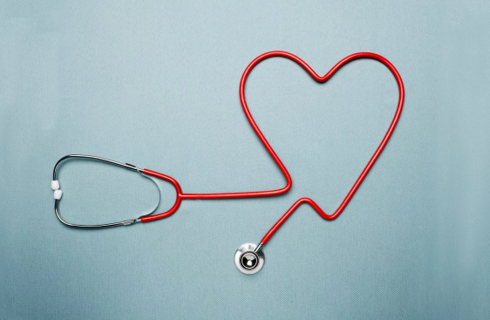
CLASS #1 Heart Health Essentials

Slide 2
ONLINE CLASS ETIQUETTE
Minimize distractions
Turn off the TV, radio, cell phone ringer
Privacy & security
Asking questions
Chat box
Zoom tips
Turn off your webcam
Mute your microphone
Group introductions
Notes:
1) Minimize distractions on the participants’ end. Presenter: Ensure your background is appropriate/not distracting.
2) Privacy & security sample script:
-Just like online shopping or email, Virtual Care has some inherent privacy and security risks that your health information may be intercepted or unintentionally disclosed.
-Feel free to share your personal experiences or questions during our group discussion time, but please be aware that your personal information will be shared with anyone accessing this webinar.
3) Participant questions.
-Please let me know when you have a question by typing it into the chat box (explain where to find the chat box). I will be monitoring the chat throughout the session.
-Or you can un-mute your microphone and ask your question out loud, if you prefer.
4) Zoom tips. Turning off participants’ webcams saves bandwidth and reduces freezing/glitches.
-On the next slide, show clients how to turn their microphone and webcam on & off.
5) Icebreaker/Introductions. Allow participants to introduce themselves. In the interest of time, you may want to encourage participants to introduce themselves before the class starts (while waiting for participants to log in 15 minutes before the class).
Does anyone have any questions before we get started?

Slide 3
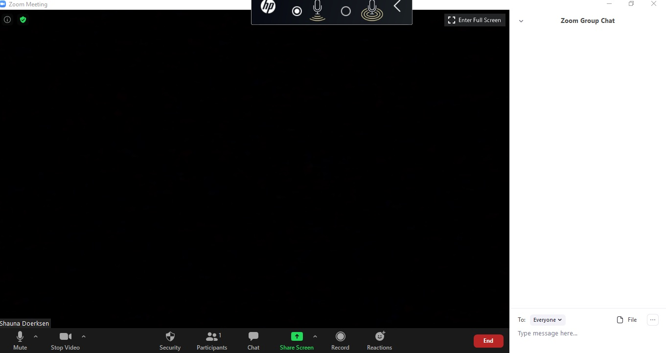
Notes:
Arrows pointing to chat icon in taskbar and the chat box on the right side of the screen.
Arrow pointing to mute and stop video in the taskbar.

Slide 4
Outline
What is cardiovascular disease?
Know your targets for blood pressure & cholesterol
Ways to reduce your risk
Warning signs and symptoms
What’s next?

Slide 5
FALSE
People who are at a healthy body weight don't have to worry about high cholesterol.
Notes:
Create a Zoom poll:
“People who are at a healthy body weight don't have to worry about high cholesterol.”
a) True
b) False
A person with any body type can have high cholesterol. It is important that all people have their cholesterol checked regularly.
Genetics plays a large part in your blood cholesterol levels, regardless of your weight. As well, even in your childhood and teenage years, plaque buildup or damage to your blood vessels can start to happen now and then many years later, lead to clogged arteries.
Heart disease and stroke are leading causes of death in Canada, responsible for 27.3% of all deaths. Over 1.3 million Canadians are living with heart disease (H&S 2016).

Slide 6
How the Heart Works
https://www.youtube.com/watch?v=CWFyxn0qDEU
Notes:
Let’s watch a 3 minute video to understand how the heart works. https://www.youtube.com/watch?v=CWFyxn0qDEU
Arteries are red blood vessels that carry blood away from the heart. Veins are blue blood vessels that carry blood towards the heart.
Prior to class: Preload this YouTube link so that it is ready to go when you want to watch it.
-Click Share Screen.
-Choose the YouTube video, then at bottom of the window, check off “USE COMPUTER AUDIO” then press OK.
-Be sure to mute your microphone or at least don't speak over the audio while the video is playing.

Slide 7
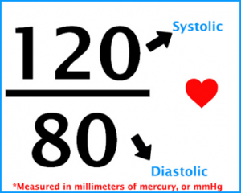
Understanding Blood Pressure
Amount of pressure in the arteries during contraction of heart muscle
Amount of pressure when heart muscle is between beats
Notes:
Blood Pressure:
The top number refers to the amount of pressure in your arteries during contraction of your heart muscle. This is called “systolic pressure”.
The bottom number refers to your blood pressure when your heart muscle relaxes between beats. This is called “diastolic pressure”.

Slide 8
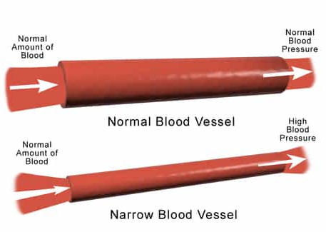

Slide 9
Blood pressure
Low Risk: 120 / 80
Medium Risk: 121-139 / 80-89
High Risk: 140+ / 90+
Notes:
Blood Pressure
Low Risk: 120/80
Medium Risk: 121-139/80-89
High Risk: 140+/90 → may be okay for older adults (age >75)
-These numbers are general targets; your doctor or specialist may have given you a more personalized target for your blood pressure.
-Sometimes your provider might ask you to check your blood pressure at home, but this isn’t necessary for everyone. For those of you who want to check your blood pressure at home, the instructions of how to do so are included near the end of this presentation.

Slide 10
true
You can feel “fine” even if your cholesterol and/or blood pressure are high.
Notes:
CREATE A ZOOM POLL: True/False
You will almost never experience symptoms of high cholesterol. The way to know if you have high blood cholesterol is to check your numbers with a simple blood test at the lab. Early treatment of high cholesterol is critical because if left untreated, it can contribute to your risk of heart attack and stroke.

Slide 11
Blood Cholesterol
Waxy, fat-like substance
Found in every cell of the body
LDL (“lousy” or bad cholesterol)
Builds up plaque on the inside of blood vessels
HDL (“healthy” or good cholesterol)
Cleans up and removes plaque from vessels
Triglycerides (another type of fat in the blood)
Affects blood clotting
Notes:
-Cholesterol is one of the fats in blood. Cholesterol is used to make cell membranes, vitamin D and hormones.
-High blood cholesterol is a risk factor for heart disease and stroke. Lowering your cholesterol can dramatically reduce your risk of heart disease.
-We check your cholesterol every 1-5 years to determine your heart disease risk. Once we know what your risk is, we can sometimes stop checking your cholesterol levels.
-The liver also produces cholesterol (80% of total blood cholesterol).
---Optional notes-----
Dietary cholesterol is found in meat, poultry, eggs and dairy (only in “animal foods” not “plant foods”). However, dietary cholesterol has much less of an impact on blood cholesterol, versus foods high in saturated and trans fat. We will discuss these foods more in Class 2 “Eating for Heart Health”.
-Ways to lower LDL: Decrease intake of total fat, saturated & trans fats; Increase intake of omega-3 fats, soy products and fibre; Increase physical activity; Quit smoking; Reduce stress.
-Ways to increase HDL: Increase physical activity; Quit smoking; Weight loss.
-Ways to lower TG: Decrease intake of sugar/sweets/desserts; Decrease or abstain from alcohol; Increase physical activity; Decrease intake of saturated & trans fats; Increase omega-3 fats; Quit smoking.

Slide 12
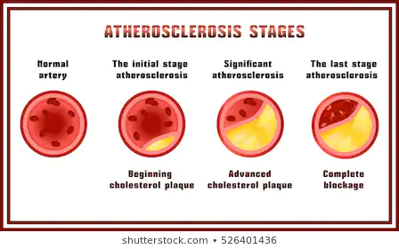
CLOGGED ARTERIES (ATHEROSCLEROSIS)
Notes:
Atherosclerosis is also known as “clogged arteries”.
-A plaque of cholesterol and white blood cells can build up inside the blood vessel, slowly over time. This restricts the flow of blood through the artery.
-Atherosclerosis and/or coronary artery disease often have no symptoms until the blood vessel is very clogged.

Slide 13
Target Cholesterol Levels
Total cholesterol: 5.2 or lower
HDL cholesterol:
Men: 1.0 or higher
Women: 1.3 or higher
LDL cholesterol:
No statin / Low risk: 3.5 or lower
If diabetes, previous heart disease, kidney disease, or if taking a statin: 2.0 or lower (or 50% reduction)
Triglycerides: 1.7 or lower
Notes:
Here are some general targets for cholesterol levels. Your doctor or specialist may set different targets for you based on your individual risk level.
-Some people can reach their cholesterol targets simply by making lifestyle changes, while others may need medication to help them out. But taking medications does not mean that you “failed” at lifestyle changes.
-80% of the cholesterol in our body is produced by the liver. Genetically, some people’s bodies produce more cholesterol than others.
-Important note: Cholesterol medications (statins) lower your heart disease risk, no matter what your cholesterol level is. The risk reduction comes just from taking the statin, it is not proportional to how much the statin lowers your cholesterol levels.
---Optional notes---
Your cholesterol target levels depend on your risk for heart disease over the next 10 years. Some cholesterol targets (LDL) are even lower if you have diabetes, because diabetes itself is a risk factor for heart disease (regardless of your cholesterol level).

Slide 14
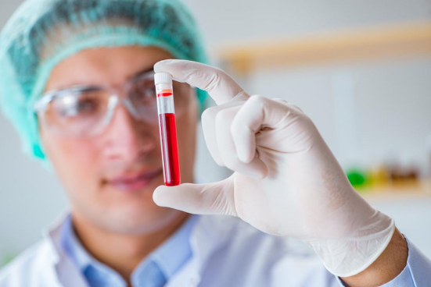
MAYBE
I should have my cholesterol checked every year after age 40.
Notes:
Zoom poll: “I should have my cholesterol checked every year after age 40.” True/False
(We suggest allowing clients to answer as TRUE or FALSE, but the correct answer is MAYBE).
Your doctor may test your cholesterol levels annually or once every 5 years. It depends on your risk of heart disease.
---Background information only---
-In patients over 40 at low risk of CVD, test lipids every 5 years.
-In patients with Framingham Risk Score >10%, check lipids annually.
-Consider earlier screening in ethnic groups at increased risk (e.g. South Asian or First Nations).
Screen all patients with the following conditions regardless of age:
Clinical evidence of atherosclerosis, Abdominal aortic aneurysm, Diabetes, Arterial hypertension, Current cigarette smoking, Stigmata of dyslipidemia (arcus cornea, xanthelasma or xanthoma), Family history of premature CVD, Family history of dyslipidemia, Chronic kidney disease, Obesity (BMI>30), Inflammatory bowel disease (Crohn’s, colitis, celiac), HIV infection, Erectile dysfunction, COPD, Hypertensive diseases of pregnancy.

Slide 15
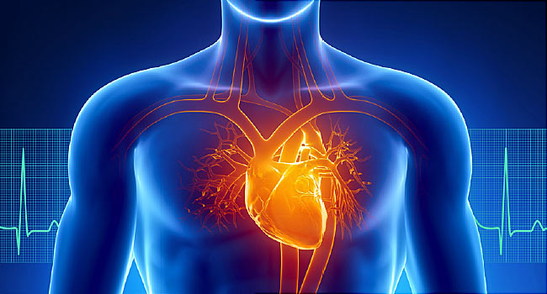
HEART DISEASE
Notes:
Now that we’ve talked about the heart and some of its conditions, let’s take a closer look at a few other common terms.
Heart Disease is a group of conditions affecting the heart. These can include chest pain, heart attack, cardiac arrest, and heart pumping problems.

Slide 16
CHEST PAIN (Angina Pectoris)
Notes:
The main symptom of coronary artery disease is called “angina pectoris” or “angina” which means a strangling feeling in the chest. We get this feeling because there is not enough blood flow within these smaller blood vessels leading to the heart.
Angina can come and go based on your level of physical activity or exertion, stress, and many other factors. Just because the pain goes away, doesn’t mean the problem goes away too.

Slide 17
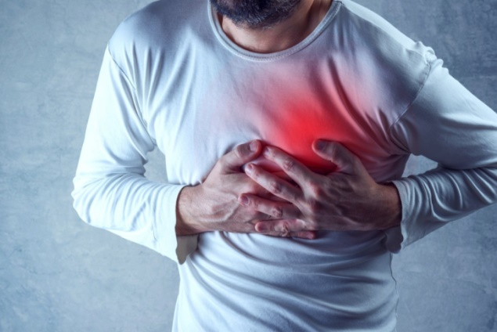
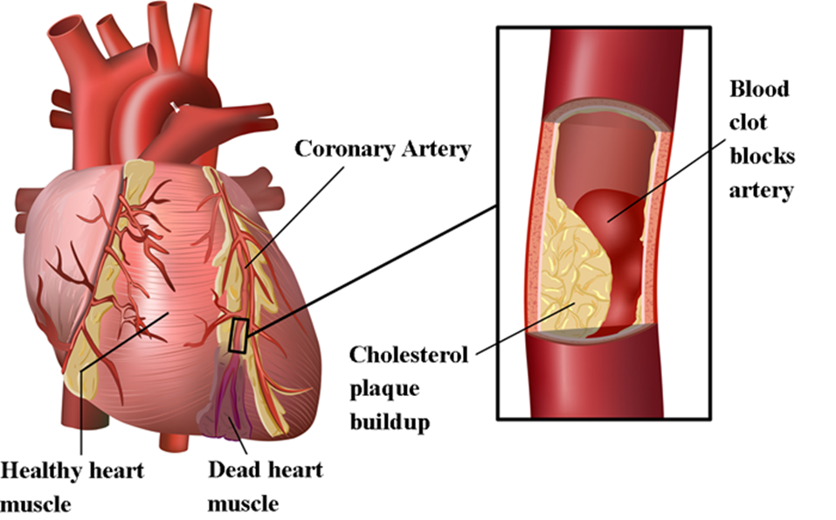
Heart Attack (Myocardial infarction)
Blood clot
(Thrombosis)
Notes:
If cholesterol plaques become unstable and break off inside the blood vessel, the clot will move downstream through the blood vessel (where the arteries get narrower) and it will get stuck. This blood clot will block an artery, and is called a “thrombosis”.
If it is a full vessel blockage, this means that any of the organs and tissues that use the blood supply will start to die, as they cannot receive oxygen.
In the heart, this is called a myocardial infarction or “MI”. It is commonly known as a heart attack. A heart attack can occur at different levels of severity, depending on the amount of arterial blockage that happens.

Slide 18
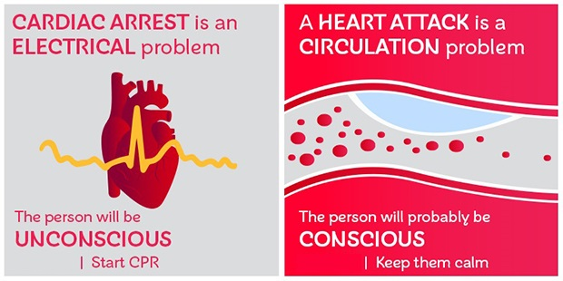
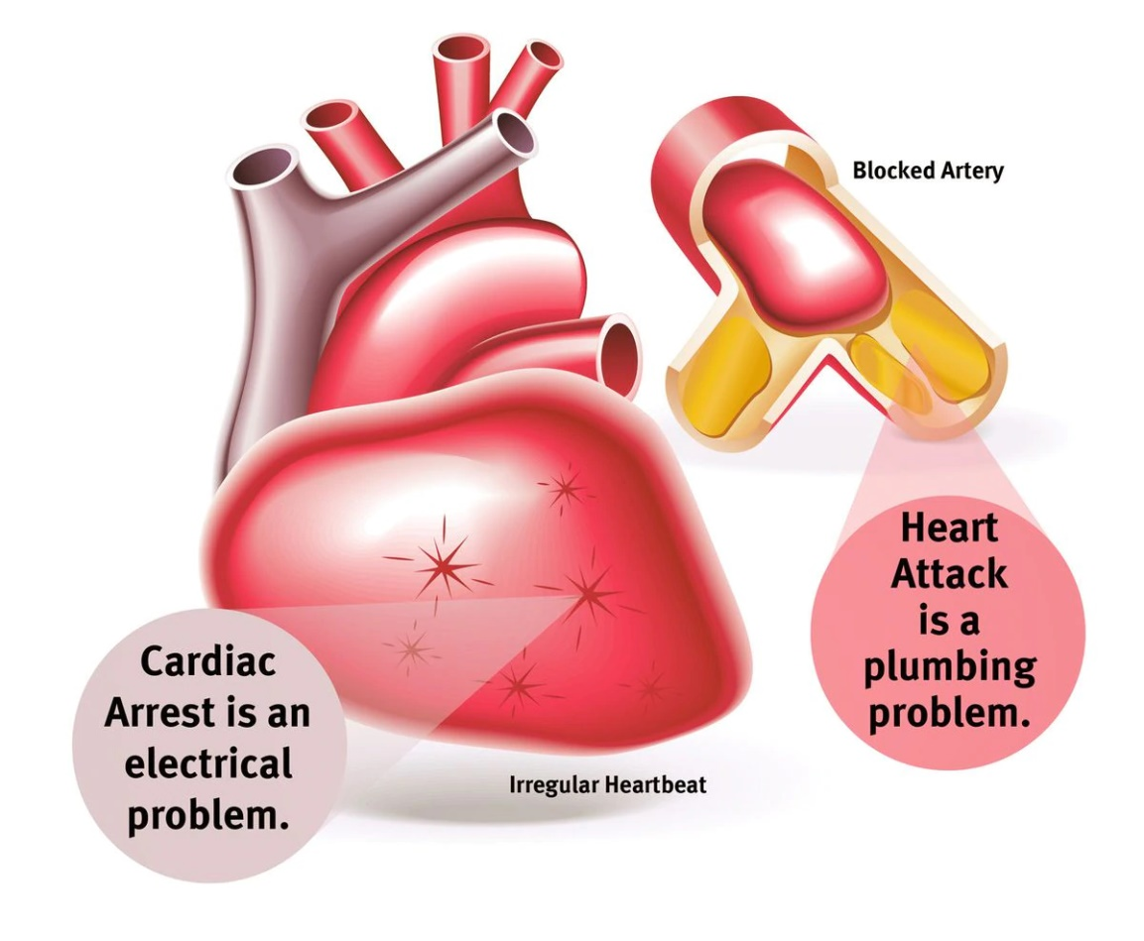
Cardiac Arrest (HEART STOPS)
Call 911
Call 911
Notes:
Another term you may have heard is “cardiac arrest”. This means “stopping of the heart”. This is different from a heart attack.
A cardiac arrest is a problem with the electrical system of the heart. A heart attack is a plumbing problem (clogged pipes/arteries).
An electrical malfunction sometimes causes an irregular heartbeat or abnormal heart rhythm. If the electrical malfunction event is large enough, or if something interrupts the electrical conductivity of the heart, then the heart will stop beating.

Slide 19
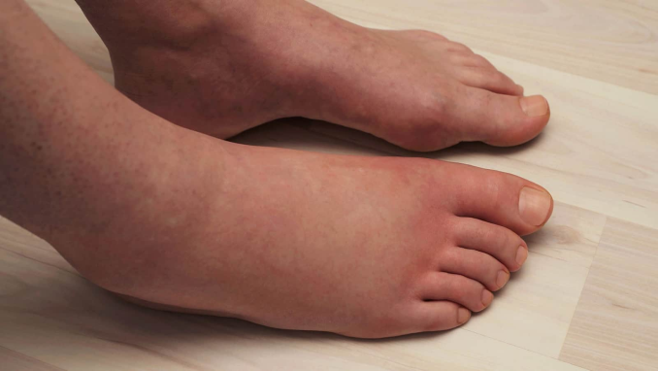
Heart Failure
Notes:
Heart failure is a different condition in which the heart is weak and it doesn’t pump blood as well as it should. Heart failure means that the heart moves blood at a much slower rate than normal, and therefore not as much oxygen is being circulated through the body.
There are 2 types of heart failure:
-Weak pump (systolic): The heart muscle is weak, which means the heart muscle gets stretched thin and floppy.
-Stiff pump (diastolic): The heart muscle is too stiff, which means that it can’t relax between beats and the heart chambers can’t properly fill with blood.
-Because the heart is not pumping well, your circulation can become poor, which can cause fluid build up or swelling around the arms, feet, ankles, legs, and lungs.
As you now understand, “heart failure” is very different than a “heart attack” or “cardiac arrest”.

Slide 20
STROKE
Mini stroke = Transient Ischemic Attack (TIA)
Notes:
A stroke occurs when the blood supply to part of your brain is interrupted or reduced. Brain tissue is blocked from getting oxygen and brain cells begin to die within minutes.
Ischemic stroke is the most common type of stroke. It happens when the brain's blood vessels become narrowed or blocked, causing severely reduced blood flow. Blocked or narrowed blood vessels are caused by fatty deposits that build up in blood vessels – the same idea as coronary artery disease, but instead within the blood vessels in your brain.
Hemorrhagic stroke occurs when a blood vessel in your brain leaks or ruptures. Brain hemorrhages can result from uncontrolled high blood pressure, taking an excessively high dose of blood thinners (or combining natural supplements like fish oil or garlic pills with an anticoagulant), or bulges at weak spots in your blood vessel walls (called an aneurysm).
A transient ischemic attack (TIA) - sometimes known as a mini stroke - is a temporary period of symptoms similar to those you have in a stroke.
Mini strokes are caused by a temporary decrease in blood supply to part of your brain, which may last as little as five minutes. Like an ischemic stroke, a TIA occurs when a clot or debris reduces or blocks blood flow to part of your nervous system.
If you think you've had a TIA, seek emergency care even if your symptoms got better. It's not possible to tell if you're having a stroke or TIA based only on your symptoms. If you've had a TIA, it means you may have a partially blocked or narrowed artery leading to your brain. Having a TIA increases your risk of having a full-blown stroke later.

Slide 21
FALSE
Heart disease runs in my family, so there’s nothing I can do to prevent it.
Notes:
ZOOM POLL QUESTION
Although people with a family history of heart disease are at higher risk, you can take steps to dramatically reduce your risk.
Create an action plan to keep your heart healthy. Next, we will talk about some of the factors that you can change.

Slide 22
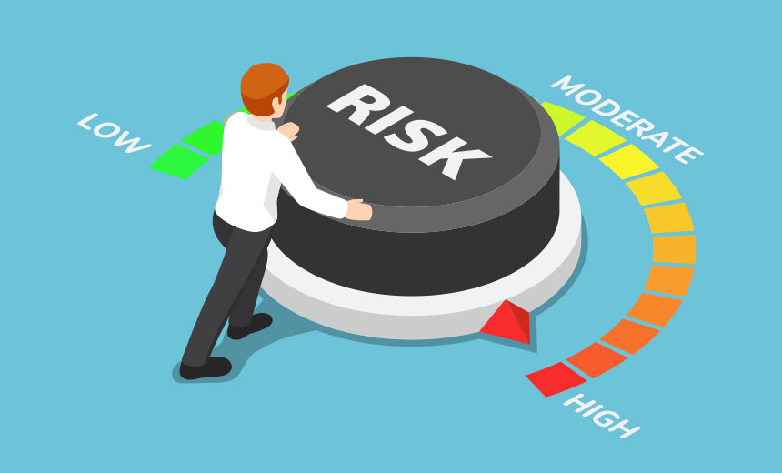
Risk factors

Slide 23
Risk Factors
Non-Modifiable
Modifiable
Age
Sex
Ethnicity
Family history
Sleep apnea
Diet
Alcohol intake
Physical activity
Stress
Smoking/Substances
Medications
Notes:
Ethnicity: First Nations, Metis, Inuit, African or South Asian heritage

Slide 24
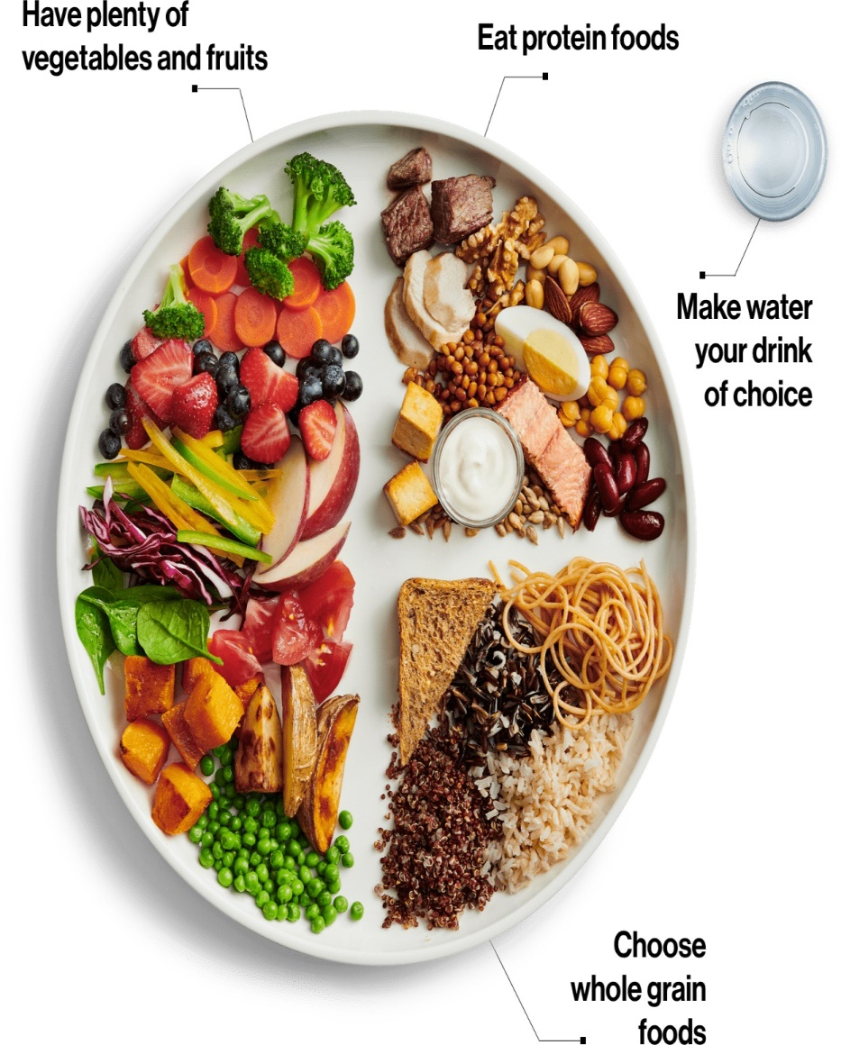
Healthy Eating
Notes:
I recommend that everyone eat a variety of healthy foods, with choices lower in saturated fat, salt, and sugar; eat more whole grains, and plenty of fruits and vegetables. This advice is the same for people with cardiovascular disease or risk of CVD.
To understand how diet affects heart health, and to learn healthy eating tips, make sure to join us next week for the second class of this series, “Eating for Heart Health”.

Slide 25
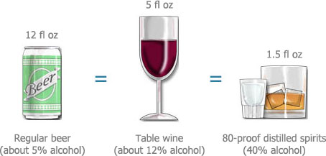
ALCOHOL – MAXIMUM RECOMMENDED
Men: 2-3 drinks per day (total 15 per week)
Women: 1-2 drinks per day (total 10 per week)
When moderation may be too much
Avoid alcohol most of the time if you have fatty liver or high triglycerides
Notes:
Drinking too much of any type of alcohol can increase your blood pressure and contribute to the development of heart disease and stroke.
-In moderation, alcohol may actually modestly increase HDL. However, alcohol raises triglycerides and provides extra calories.
-Excessive alcohol intake can also damage the liver, pancreas, sex organs, brain, veins/arteries/heart, and nervous system.
If you drink alcohol, limit yourself to no more than:
-Men = maximum 2-3 drinks per day, to a weekly maximum of 15.
-Women = maximum 1-2 drinks per day, to a weekly maximum of 10.
-If you have high blood triglycerides or fatty liver disease, it is recommended to abstain from alcohol most of the time, even further below these guidelines.
-Otherwise, if you don’t drink, don’t start (even for the HDL increase).
A standard alcoholic drink means:
• 341 mL / 12 oz (1 bottle) of regular strength beer (5% alcohol).
• 142 mL / 5 oz wine (12% alcohol).
• 43 mL / 1-½ oz spirits (40% alcohol).

Slide 26
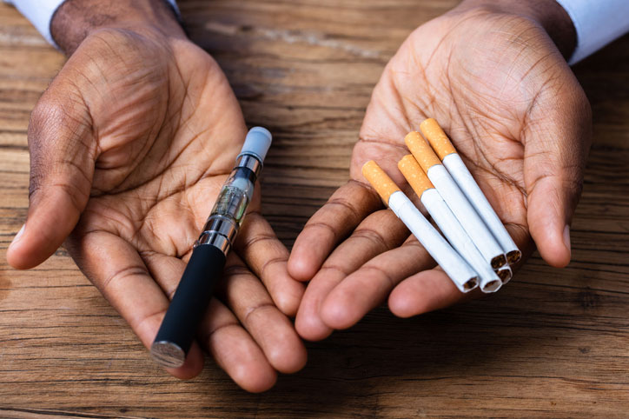
Smoking and vaping
Vaping
Cigarettes
↑ Risk of heart attack & coronary artery disease
Vaping + cigarettes = MORE harmful
Long term effects??
↓ HDL (good cholesterol)
↓ Blood vessel size
↑ Blood pressure
↑ Blood clotting
Notes:
Cigarette smoking increases the risk of coronary heart disease. Smoking decreases HDL, narrows blood vessels, increases blood pressure, increases the tendency for blood to clot, and decreases exercise tolerance.
Vaping also has an increased risk of heart attack and coronary artery disease, even if you don’t vape every day.
-((Background: Initial research shows vaping is lower risk than cigarette smoking. But vaping is still almost double the risk of heart disease, versus non-smoking)).
-Interestingly, using both cigarettes AND vaping appears to be MORE harmful than using either cigarettes alone or vaping alone (Heart & Stroke Fdn, 2018).
-((Vaping alone = 2x risk of heart attack (vs. non-smoking). Vaping + cigarettes = 5x risk of heart attack (vs. non-smoking)).
-Other health concerns have arisen with vaping products, because we don’t know the long-term health effects of inhaling propylene glycol or vegetable glycol OR the long-term effects of second-hand exposure.
-As well, any type of nicotine use can damage the developing brain in youth and adolescents. Emerging evidence indicates that there is potential for vaping to be a gateway to tobacco use and nicotine addiction.

Slide 27
Cannabis / MARIJUANA
THC (psychoactive ingredient) stimulates the heart
↑ Heart rate and irregular heartbeat
Makes the heart pump harder
↑ Risk of heart attack, stroke, and irregular heartbeat for several hours after consumption
Notes:
-THC, the psychoactive ingredient in marijuana, stimulates the heart. THC increases heart rate, dilates blood vessels, and makes the heart pump harder.
-The risk of heart attack, irregular heartbeat (atrial fibrillation) or ischemic stroke is higher for several hours after consuming marijuana.
---Presenter note--- If participants ask about CBD products:
-CBD does not seem to have the negative cardiovascular effects of THC.
-In fact, CBD may reduce blood pressure, reduce cardiomyopathy and endocarditis, and reduce the risk of MI and stroke.
-However, most of these are animal studies and there is little good quality evidence in humans. At this point, the evidence is insufficient to report a beneficial effect of CBD on heart health.

Slide 28
substance Use
Substance use (prescription or other) can cause irregular heart rate, stroke, or heart attack:
Opiates (e.g. fentanyl, codeine)
Sleep aids (e.g. zopiclone, benzodiazepines)
Recreational drugs
Notes:
Opioids (e.g. fentanyl, codeine) are central nervous system depressants. They can cause heart palpitations, dilated blood vessels, reduce blood flow to the brain, and change the electrical signals of the heart. These problems can lead to stroke, heart failure and death.
Sleep medications (e.g. zopiclone, benzodiazepines) can cause low blood pressure and lowered heart rate (bradycardia).
Recreational drugs (e.g. cocaine, heroin) increase the risk of hypertension, irregular heartbeat, atherosclerosis (clogged arteries), blood clots, heart failure, and heart attack.

Slide 29
Physical activity
Notes:
Being active for at least 150 minutes per week can help reduce the risk of chronic disease (such as high blood pressure and heart disease) and premature death.
Physical activity can also help to: Maintain functional independence, Maintain mobility, Improve fitness, Maintain body weight, Maintain bone health, Improve mental health.

Slide 30
Notes:
---Briefly review this slide and encourage participants to attend Physical Activity Essentials (class #3 in the Heart Health series)---
-If you are not currently active, start slowly and speak to your health care provider before starting any physical activity. For most people, continuing with a sedentary lifestyle is much more dangerous than beginning to exercise.
-If you have had a recent cardiac event (heart attack or stroke), then talk to your healthcare team before you increase your physical activity. Safe ways to resume activity are also discussed in the Physical Activity Essentials class and in the Cardiac Rehabilitation program.
-Keeping active doesn’t have to involve going to the gym, lifting weights or running. Small changes in the amount of activity you get can make a difference.
-We recommend a minimum of 150 minutes per week of moderate to vigorous physical activity. 150 minutes = 30 minutes, 5 days a week. You can further break this down into 10 minute chunks. Every little bit counts!
Examples of light exercise: beginning a stationary biking program, walking at a slow pace.​
Moderate intensity exercise: brisk walking, swimming.​
Vigorous: jogging, cross country skiing.

Slide 31
Manage Stress
Living with health problems can be stressful
Physical and emotional stress increases health risks:
↑ Blood pressure
↑ Blood clots
↑ Blood sugar
More difficult to make good lifestyle choices
↓ Immune function
↓ Mental health
Notes:
You might feel stressed if you have too much to do, if other people are asking a lot of you, or you have to deal with things you can’t control. Stress is normal when receiving and having to manage a new medical diagnosis.
Being stressed can lead you to fall into unhealthy habits such as eating unhealthy foods, smoking, drinking too much alcohol, or not getting enough physical activity.

Slide 32
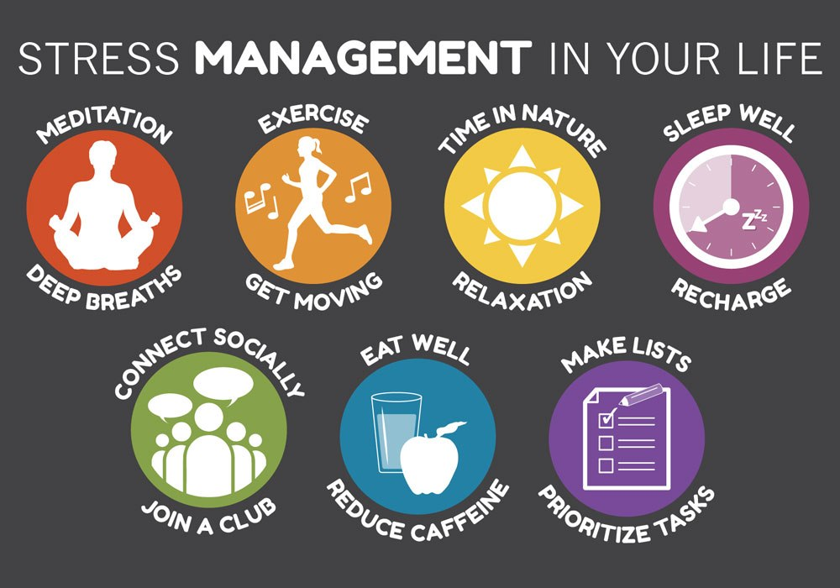
manage stress
You are in control!
Take 10 minutes to make one small change
Notes:
Ask participants what they do to manage stress - any tips to share with the class?
Remember, you are in control! Take 10 minutes to make some small changes. Choose one area of stress management to work on at a time!
The handout “Stressed Out” will be emailed to participants after the class.

Slide 33
Taking Medication
Take medications as prescribed
Reduces your risk of new health problems
Helps stop existing problems from getting worse
Have a conversation about risks, side effects, and options with your doctor or pharmacist
Keep a current list of your medications
Notes:
-Many clients feel that requiring medication is a failure of some kind – THIS IS NOT TRUE.
-Having many different types of treatment for heart disease (nutrition, physical activity, medication) work together and increase your overall impact on the problem.
-Medications are prescribed because your provider has weighed the pros and cons and believes that the benefits for you outweigh the risks.
-If you are worried about starting a new medication, ask your doctor or pharmacist to explain to you why they recommend you take the medication and what else you can do to help manage the problem with lifestyle.
-Example: If a person has high cholesterol, the doctor may recommend that the person take a drug called a statin to help reduce your risk of a heart attack or stroke.
-To help this problem with lifestyle, the person could quit smoking (if they are a smoker), eat more fibre and less unhealthy fats, and exercise more.
-The medication may still be needed, but it is important for you to know what options you have and make a decision that works for you. The more treatments you choose, the better the outcome.

Slide 34
Taking medication
Medications may be prescribed for a variety of reasons:
Make it easier for your heart to pump blood
Open (dilate) blood vessels
Slow down a heart that beats too fast
Remove excess fluid from the blood (also reduce shortness of breath and swelling in legs & feet)
Slow down plaque formation in blood vessels
Prevent blood clots by making blood less "sticky"
Notes:
-It is important to know what each of your medications is for. This way, you can discuss what are the pros and cons of taking each medicine.
-People who take their medications as prescribed, over the long term have fewer additional heart attacks and lower their risk of dying from heart disease.
-If you stop taking your medication without being told by your doctor, you will be giving up those benefits.
---Presenter note---
-Quickly review the list of reasons why meds are prescribed. Don't need to spend a lot of time on this - encourage people to talk with their pharmacist or doctor/NP.
-Please know that you can make an appointment with the pharmacist at your drugstore to discuss all your questions. Call ahead and make an appointment!

Slide 35
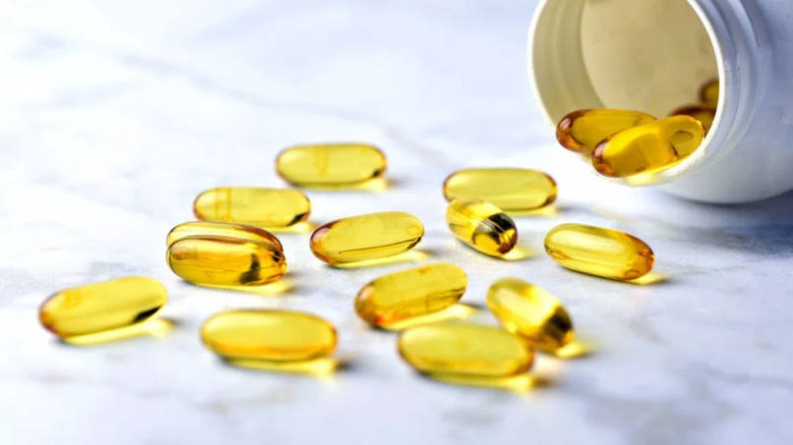
FALSE
Fish oil supplements can cure cardiovascular disease.
Notes:
ZOOM POLL QUESTION
-No, fish oils will not cure cardiovascular disease, but they do have a positive effect. One type of polyunsaturated fat is omega-3, which can help prevent blood clots, reduce the risk of stroke, and lower triglycerides.
-The best sources of omega-3 fat are cold-water fish such as salmon, sardines, mackerel, herring, and rainbow trout. We will discuss this in more detail next week in the class “Eating for Heart Health”.
Fish oil supplements/pills DO NOT have the same benefit as consuming fish in food form. Fish oil may lower your triglyceride levels, but when you consume in supplement form, this does not translate into reduced cardiovascular risk. You obtain the health benefits from eating fish, not from taking a supplement.

Slide 36
Natural Health Products
Can interfere with your heart medications or cause other health problems
Garlic pills, Fish oils, Grapefruit
Always check with your pharmacist or doctor before taking any non-prescription medications or alternative therapies
NATURAL DOES NOT ALWAYS MEAN SAFE!
Notes:
Some non-prescription products, including natural health products and herbal supplements, can stop your heart medications from working properly and can cause other health problems.
Have you heard of any medications or supplements that can do this?
-Garlic pills or fish oils can thin your blood too much if you’re already taking a blood thinner.
-Grapefruit can interact with some statins (cholesterol pills).

Slide 37
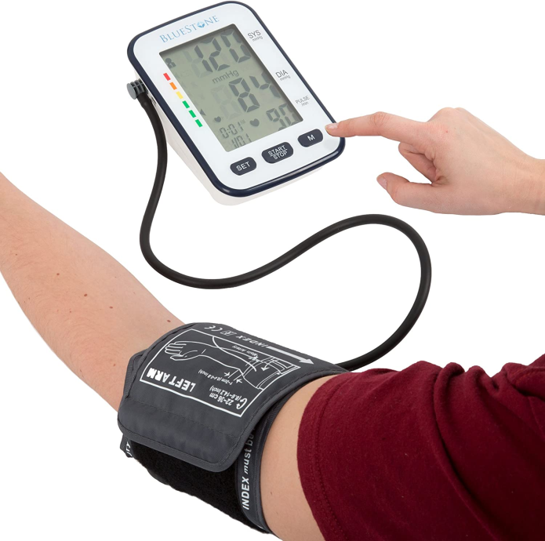
Managing heart disease
Monitor at home only if your doctor asks you to:
Blood Pressure
Rest for 5 minutes before testing
No talking
Don’t cross your legs
Support your arm on a chair or table
Notes:
---Presenter note---
Don’t read through this slide. Just tell clients that it is there for their reference, if they want to check their blood pressure at home.
For clients who want more information, refer to their doctor and/or the Heart & Stroke Foundation website.

Slide 38
Managing heart disease
Monitor at home only if your doctor asks you to:
Daily Weight (if you have Heart Failure)
Weighing yourself daily tells you if your body is retaining fluid
Extra fluid → Makes your heart work harder
Gaining or losing 4-5 pounds is a big weight change
Call your doctor if this happens
Ask your doctor about Heart Failure Zones
Notes:
---Presenter note---
Don’t read through this slide. Just tell clients that it is there for their reference, if they have heart failure and have been told to monitor their weight.
For clients who want more information, refer to their doctor and/or the Heart & Stroke Foundation website.

Slide 39
WARNING SIGNS & SYMPTOMS OF A HEART ATTACK
Chest pain/ache | Lightheadedness or fainting
Chest squeezing, pressure, or fullness | Anxiety
Shortness of breath / Difficulty breathing | Sweating
Heartburn that doesn’t get better with antacids | Cold, clammy skin
Upper body pain, sore back, sore shoulders/arms | Paleness
Abdominal pain | General weakness
Sore jaw | Unexplained fatigue (can last for days)
Nausea, with or without vomiting | NOT JUST CHEST PAIN!
Notes:
Presenter note: You don’t need to read through the list of symptoms, but comment on the wide variety of possible symptoms. A heart attack does not always equal chest pain.

Slide 40
WARNING SIGNS & SYMPTOMS OF A STROKE
Confusion | Double vision
Trouble speaking / Slurring words | Blurry or blackened vision
Trouble understanding what others are saying | Headache (especially sudden or severe)
Numbness, weakness or paralysis of the face, arm or leg (especially 1 side) | Vomiting
Mouth drooping | Dizziness
Loss of balance or trouble walking
FAST = Face, Arms, Speech, Time
Notes:
Face = Is it drooping?
Arms = Can you raise both?
Speech = Is it slurred or jumbled?
Time = To call 911 right away.
Presenter note: You don’t need to read through the entire list of symptoms, but comment on the wide variety of possible symptoms.

Slide 41
WHAT TO DO
Call 911 immediately (or have someone call for you)
Do not drive yourself to the hospital
Keep a list of emergency contacts and your medications
Notes:
Don’t drive yourself to the hospital, even if you feel ok. Partly due to the risk of causing a car accident.
But more importantly because, if you take an ambulance, paramedics can start life-saving medications while you are en-route to the hospital.
Keep a list of your medications and your emergency contacts, both in your wallet and by the phone. Emergency personnel will want this information.

Slide 42
GOAL SETTING
heartandstroke.ca/articles/the-first-step-to-healthy-change
Notes:
We have covered a lot of information today. It can be overwhelming to think about all the possible changes you could make to improve your health. It helps to break down these changes into goals, specifically into a type of goal called a SMART goal.
Encourage clients to attend “Preparing for Success” (class #4 in the Heart Health series) to learn more about goal setting.
Clients can also visit the link at the bottom of the slide to read about the steps of setting a SMART goal.

Slide 43
FOR MORE INFORMATION
Heart & Stroke Foundation www.heartandstroke.ca
Lipid Clinic at St. Boniface Hospital
www.cardiacsciencesmb.ca
Other health education classes, including Physical Activity Essentials & Preparing for Success www.wrha.mb.ca/groups

Slide 44
More information about quitting / reducing Smoking
Commit To Quit group www.wrha.mb.ca/groups
Smoker’s Helpline: 1-877-513-5333
Peer support www.facebook.com/groups/ManitobaQuits/
Manitoba Lung Association www.mb.lung.ca
Talk to your doctor and health care team

Slide 45
Thank you
Any questions?
Use the chat function or
un-mute your microphone
Notes:
Evaluation: Survey to be done at the end of the series (not after each class).

Slide 46
ACKNOWLEDGMENTS
Development team:
Laurie Andrews, RD CDE; Janet Cranston, Reh-Fit Centre; Shauna Doerksen, RD CDE; Melissa Fuerst, MSc RD; Jennifer Gibson, BSP ACPR EPPh; Dawne Lachapelle, RD CDE; Alyssa Lewis, RD CDE; Joyce Loftson, RD; Kathleen McClinton, MSc RD CDE; Lorna Shaw-Hoeppner, MPH RD; Rhea Vaags-Olafson, BA CSEP-CEP EIMC-Level 2; Elyse Wood BScN RN
Working group:
Aimee Bowcott, MPH RD CDE CRE; Shauna Doerksen, RD CDE; Jenna Hart, RD CDE; Rosanne Lesage, RD CDE;​ Jodis McCaine, RD; Sheila Pelagio, BHEcol BN RN CTE; Colin Reeve, BSP CDE CRE CTE; Cindy Sanchez, RN BN CDE; Cheryl Shaver, BScPharm CTE

