Slide 1
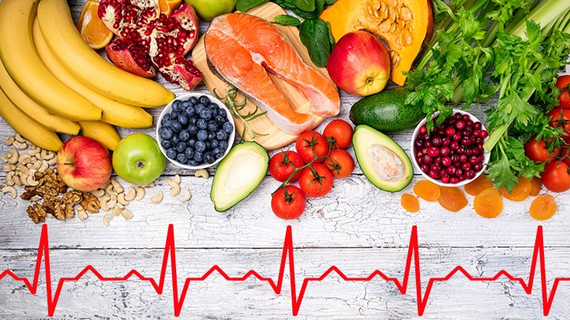
CLASS #2 EATING FOR HEART HEALTH
Notes:
This program is open to anyone who:
Has high cholesterol or high blood pressure.
Has a family history of heart disease and is interested in prevention strategies.
Has pre-diabetes/diabetes.
Had a heart attack, stroke or cardiovascular disease and wants to learn how to optimize their health.

Slide 2
ONLINE CLASS ETIQUETTE
Minimize distractions
Turn off the TV, radio, cell phone ringer
Privacy & security
Asking questions
Chat box
Zoom tips
Turn off your webcam
Mute your microphone
Group introductions
Notes:
1) Minimize distractions on the participants’ end. Presenter: Ensure your background is appropriate/not distracting.
2) Privacy & security sample script:
-Just like online shopping or email, Virtual Care has some inherent privacy and security risks that your health information may be intercepted or unintentionally disclosed.
-Feel free to share your personal experiences or questions during our group discussion time, but please be aware that your personal information will be shared with anyone accessing this webinar.
3) Participant questions.
-Please let me know when you have a question by typing it into the chat box (explain where to find the chat box). I will be monitoring the chat throughout the session.
-Or you can un-mute your microphone and ask your question out loud, if you prefer.
4) Zoom tips. Turning off participants’ webcams saves bandwidth and reduces freezing/glitches.
-On the next slide, show clients how to turn their microphone and webcam on & off.
5) Icebreaker/Introductions. Allow participants to introduce themselves. In the interest of time, you may want to encourage participants to introduce themselves before the class starts (while waiting for participants to log in 15 minutes before the class).
Does anyone have any questions before we get started?

Slide 3
Notes:
Arrows pointing to chat icon in taskbar and the chat box on the right side of the screen.
Arrow pointing to mute and stop video in the taskbar.

Slide 4
CLASS OUTLINE
Dietary fats
Sugar
Fibre
Sodium (salt)
Processed foods
Label reading
Putting it all together

Slide 5
TRUE OR FALSE?

Slide 6
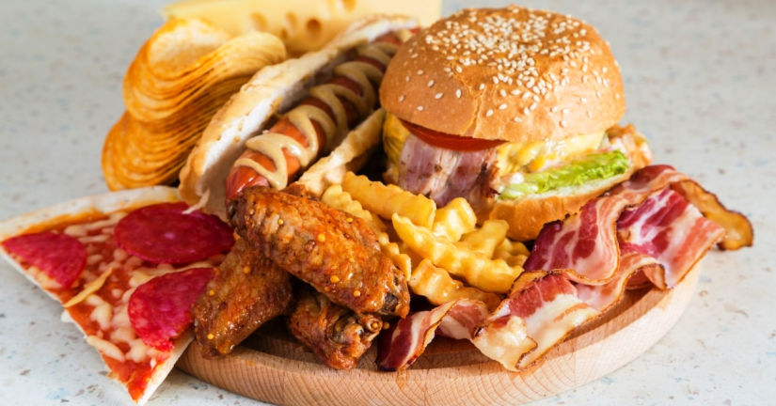
FALSE
I must avoid my favourite foods to keep my cholesterol in range.
Notes:
CREATE A ZOOM POLL QUESTION.
False! It is important to enjoy your meals and the foods you are eating, though some foods should be eaten in moderation.
Focus on including delicious heart healthy foods in your diet - increase fibre, choose healthy fats, enjoy a variety of fruits and vegetables.

Slide 7
LOWERING cholesterol: types of fats

Slide 8
DIETARY FATS
Provide energy to the body
Help absorb nutrients from food
Give flavour to food
Make you feel full (increase satiety)
Type versus amount of fat is important
Notes:
What have you heard about fat? Is it healthy, or not so much?​ Dietary fats and oils provide energy to the body, and also help your body absorb fat soluble vitamins such as A, D, E and K. You need fat in your diet for normal body functions, healthy skin and hair, and insulation to protect our vital organs. Fat also gives flavour to foods and makes you feel full for longer.
The type of fat consumed is more important for health than the total amount of fat consumed.​
The type of fat we eat is important because it can affect the cholesterol levels in your body. High blood cholesterol is a risk factor for heart attack and stroke. Lowering your cholesterol can reduce your risk of heart disease.

Slide 9
Dietary Fats
Unsaturated Fats
Polyunsaturated & Monounsaturated
Saturated Fats
Increase HDL (good cholesterol)
& Decrease LDL (bad cholesterol)
Increase HDL (good cholesterol)
& Increase LDL (bad cholesterol)
Notes:
Types of fat = unsaturated, saturated (and trans)
The type of fat we eat is very important because it can affect the cholesterol levels in your body.
Unsaturated fats are “good” because they lower our LDL and maintain our HDL. They also help protect us from heart disease.
Saturated fats increase the “bad” cholesterol in our blood, which increases risk for heart disease.
((Trans fats increase the “bad” cholesterol and also decrease the “good” cholesterol levels in our blood.))

Slide 10
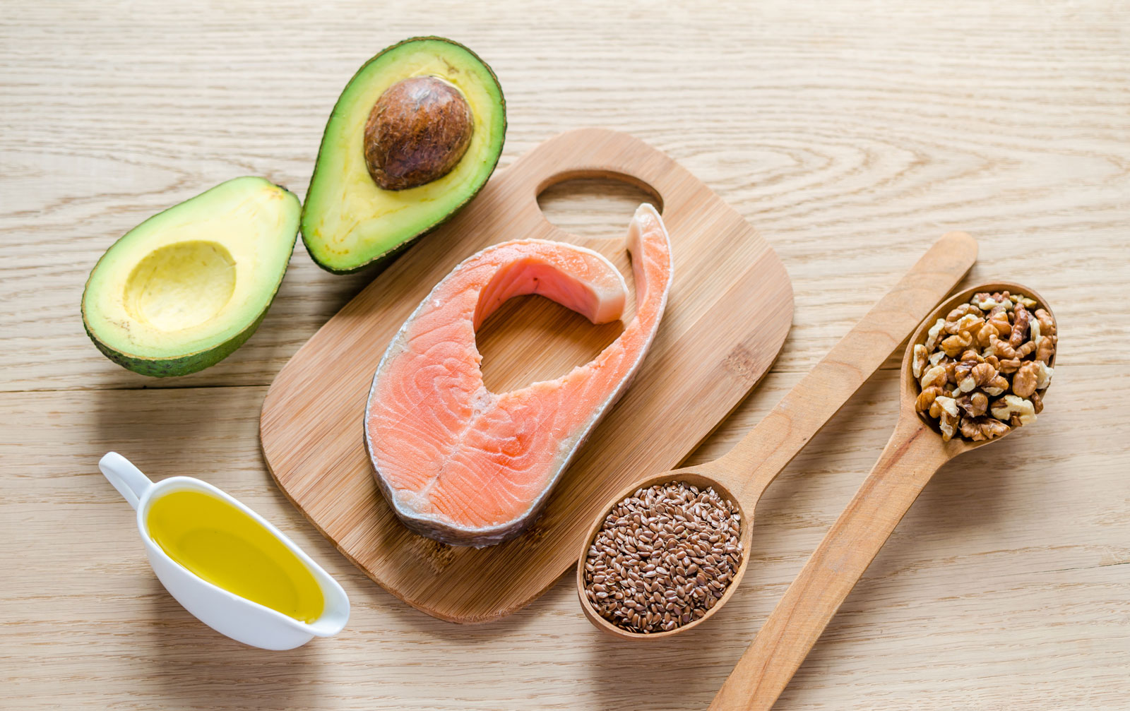
Healthy fats: Unsaturated (polyunsaturated & monounsaturated)

Slide 11
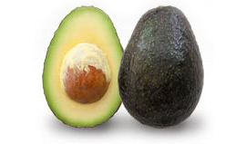
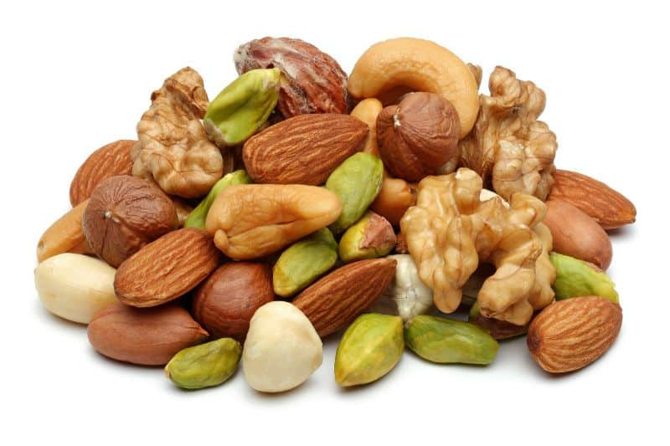
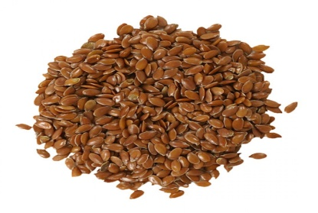
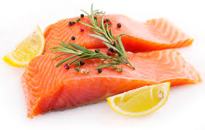
Sources of Unsaturated Fats
Plant & vegetable oils
Olive, canola, sunflower, soybean, peanut oils
Non-hydrogenated margarine
Avocado (fruit or oil)
Nuts & seeds
Flaxseed
Fatty fish
Salmon, mackerel, trout, sardines
Notes:
Unsaturated fats help protect us from heart disease and liver disease.​ These healthy fats come from plant-based foods and fish.
Sources of unsaturated fats include: canola oil, olive oil, nuts & seeds, avocado, non-hydrogenated soft margarine, flaxseed, fatty fish (salmon, mackerel, trout, sardines).​

Slide 12
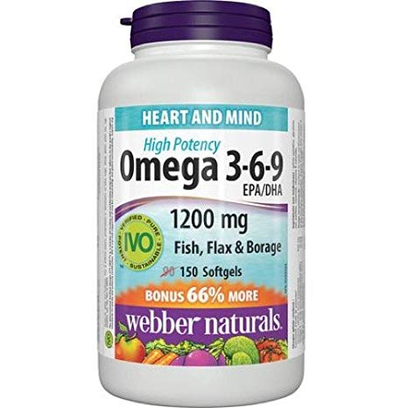
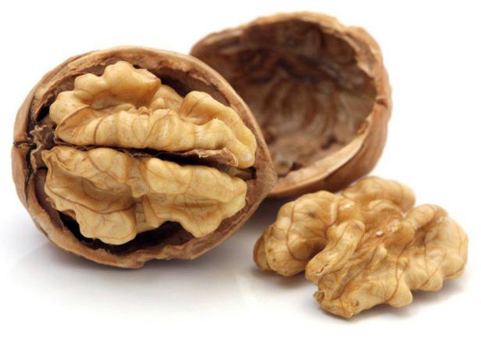
OMEGA-3 FATS
A specific type of unsaturated fat
Helps prevent blood from sticking & clotting
Lowers triglycerides
Fatty fish (salmon, mackerel, trout, sardines)
Small amount in walnuts and ground flaxseed
Supplements may not reduce heart disease risk
Focus on food sources of omega-3
Notes:
1) Omega-3 fats are heart healthy fats that have many functions in our body, including reducing blood clotting, lowering cholesterol and triglycerides.
2) Omega-3 comes from fatty fish such as salmon, sardines, mackerel, and tuna, as well as from walnuts and ground flaxseed in lesser amounts. (Ground flaxseed increases the bioavailability of omega-3 versus whole flaxseed)
3) Supplements: Some evidence suggests that omega-3 supplements may help to lower triglycerides, but that does not translate to reduced cardiovascular risk. It is best to get your omega-3 from food, especially from fish. However, if you decide to take a supplement, ensure it contains omega-3 only. Omega 3-6-9 pills contain a very small amount of omega-3. We already obtain plenty of omega-6 and omega-9 fats from our diet.

Slide 13
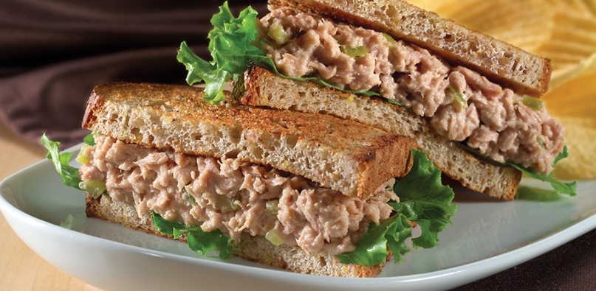
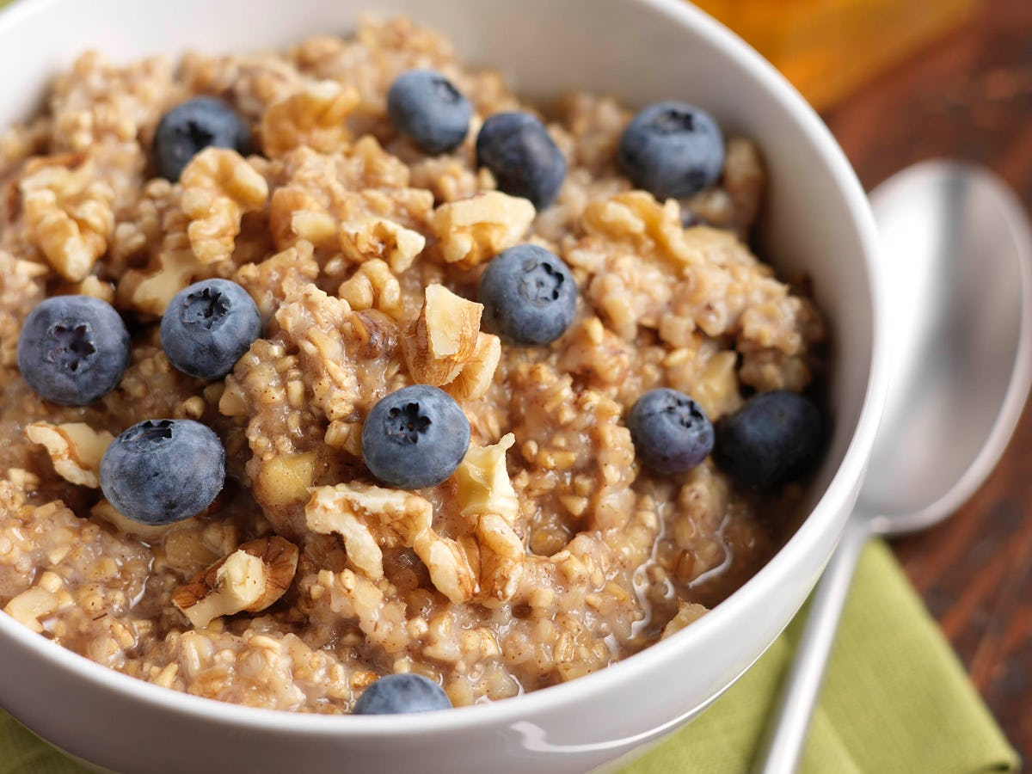
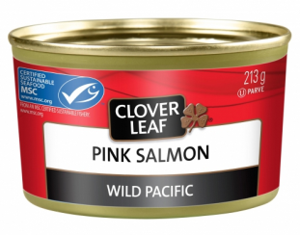
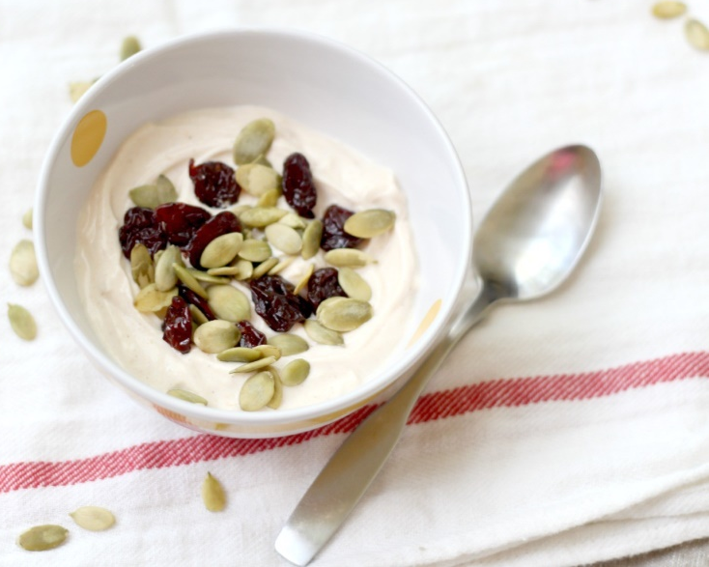
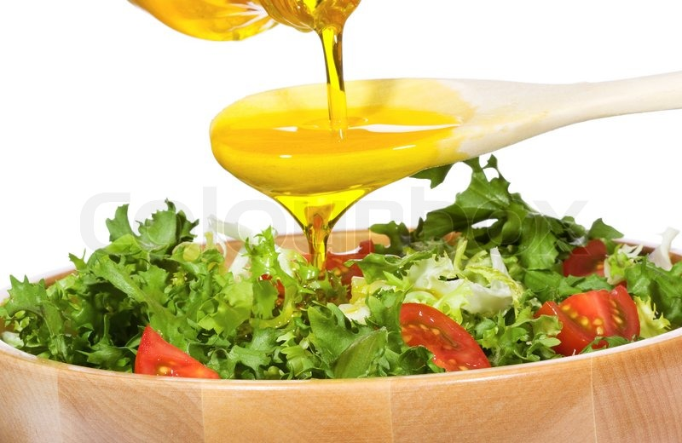
WAYS TO INCLUDE OMEGA-3 FATS
Notes:
-Eat fish 2-3 times per week. Use canned salmon to make a quiche for dinner. Or try a twist on tuna salad - add diced apples and walnuts for extra crunch.
-Sprinkle ground flaxseed on cereal, yogurt, oatmeal. Or use ground flax seed in baked goods and smoothies.
-Add walnuts or pumpkin seeds to a salad, yogurt or baked goods.
-Use olive oil or canola oil in a salad dressing or when cooking & baking.

Slide 14
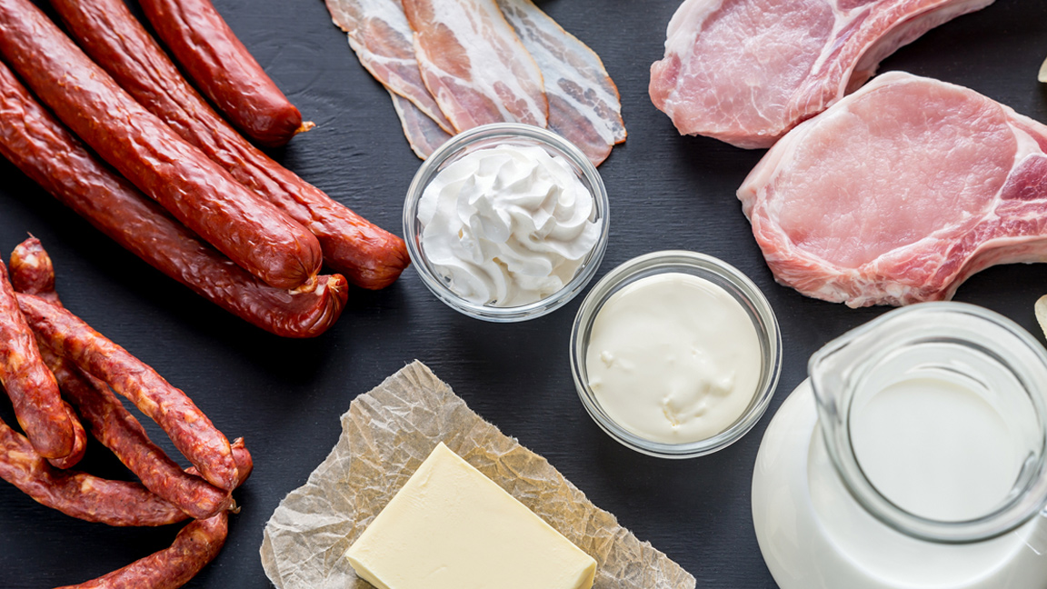
Limit: Saturated fats

Slide 15
Sources of saturated fats
Meats
Visible fat, chicken skin, marbling in steak
Processed meat
Deli meat, sausage, bacon, pepperoni, hot dogs
Dairy
Cheese, butter, cream, ice cream
Coconut and palm oils
Coconut milk, chocolate, store-bought baked goods & pastries
Notes:
Saturated fats increase the “bad” cholesterol in our blood (LDL) which increases risk for heart disease and liver disease.​
Sources of saturated fats: fatty cuts of meat, whole-fat dairy products (butter, cream, cheese, ice cream), lard & shortening, coconut oil, palm oil & palm kernel oil.
---Background info---
There are different dietary saturated fatty acids. There is emerging evidence to suggest that the health effects of fats could vary depending on the food sources (e.g. animal vs plant). The food source from which the saturated fat is derived may have different effects on cardiovascular disease.

Slide 16
Poll question

Slide 17
SOURCES OF SATURATED FATS
Where does most of the saturated fat come from in the typical Canadian diet?
Meat
Butter and dairy fat
Pre-prepared and processed foods
Notes:
CREATE A ZOOM POLL QUESTION. (The answer is C).

Slide 18
SOURCES OF SATURATED FATS
c. Pre-prepared and processed foods
Store-bought baked goods, pastries, cookies, cake
Ice cream
Pizza
Processed meats (deli meat, sausage, hot dogs)
Fast food & most other restaurant foods
Notes:
Most of the saturated fat in the average North American diet doesn’t come from whole foods like beef or coconuts. Instead it comes from processed foods such as pizza, cakes, cookies, doughnuts, ice cream, and cheese.

Slide 19
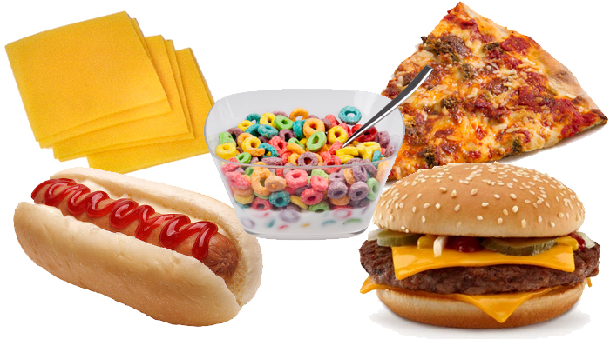
Highly Processed Foods
Major sources of saturated fat, sodium & sugar
Eating a lot of highly processed foods increases your risk of heart disease and stroke
Refer to handout: How to Balance a Meal
Notes:
Highly processed foods are a major source of saturated fats in the diet. These highly processed foods are usually also high in calories, sodium and sugars, and contain little to no nutritional value.
Sources of highly processed foods: processed meats (deli meats, sausages and hot dogs); chips and many other packaged snack foods; French fries; pastries such as cookies, donuts, cakes; candy and chocolates; some breakfast cereals; pre-prepared or quick-cooking dishes such as pizza, frozen dinners, and rice & pasta side dishes “Sidekicks”.
Sometimes affording healthier options isn't possible, and often highly processed foods cost less. If processed foods are in your price range, you can still choose healthier options. A handout about choosing less processed foods ("How to Balance a Meal") will be emailed to you after today’s class.
Examples of healthier processed foods:
-Choose frozen meals or TV dinners that are lower in sodium and saturated fat (e.g. Lean Cuisine, Healthy Choice steamers, PC Blue Menu, Smart Ones).
-Choose breakfast cereals that are lower in sugar and higher in fibre.
-Add natural foods to processed foods (i.e. add frozen green beans or broccoli to store-bought soups or Kraft Dinner).

Slide 20
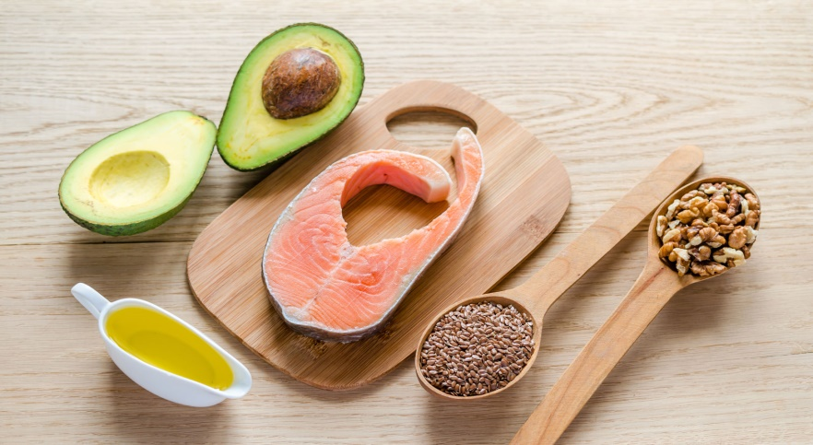
Substitute Types of Fat
“Low fat” or “Fat free” processed foods: Not necessarily healthy
Replace saturated fats with unsaturated fats to improve cholesterol levels and
lower heart disease risk
Notes:
The confusion around fats and their impact on our health has led to a lot of processed foods labelled “low fat” on grocery store shelves. While these products may indeed be lower in fat, that doesn’t necessarily make them healthy. In fact, these foods are often highly processed and loaded with calories, sodium and sugar, instead of fat.
The type of fat consumed is more important than the amount of total fat consumed. Replace saturated and trans fats with unsaturated fats to help improve our cholesterol levels and lower heart disease risk.
Focus on a healthy balanced diet of vegetables and fruits, whole grains, and protein from a variety of sources such as legumes, nuts, lower-fat dairy and alternatives, lean meats, and fish.

Slide 21
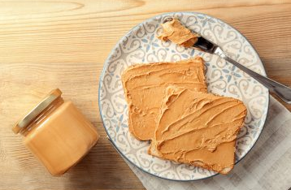
Substitute Types of Fat
When cooking & baking, use olive, canola or peanut oils instead of butter
Snack on roasted, unsalted nuts instead of crackers & cheese
Instead of butter on toast, add peanut butter or avocado
Snack on air-popped instead of microwave popcorn
Skip the baked goods at coffee break and enjoy fruit instead

Slide 22
WHAT ABOUT TRANS FATS?
Food manufacturers are no longer allowed to add trans fats to foods in Canada
Small amounts of trans fats occur naturally in some foods
We don’t know how naturally occurring trans fats affect our health
Notes:
We used to worry a lot about trans fat intake. However, Health Canada banned the most unhealthy sources of trans fat (i.e. partially hydrogenated oils) as of September 2020. Take-home point: You don't need to worry a lot about trans fats anymore.

Slide 23
TRUE OR FALSE?
Notes:
CREATE A ZOOM POLL QUESTION.

Slide 24
FALSE
Butter is healthier than margarine because it's more natural
Notes:
Both margarine and butter are high in fat, so use both in moderation. Instead, select unsaturated fats most often (e.g. soft non-hydrogenated margarines made from canola oil, olive oil or soybean oil).
Remember that one change — like switching from butter to soft margarine — is a good step, but likely won’t be enough on its own to reduce your cholesterol to healthy levels. Other diet and lifestyle changes or medication may be needed, as your health care team recommends.

Slide 25
LOWERING triglycerides: LIMIT ALCOHOL & SUGAR

Slide 26
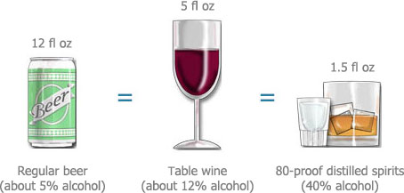
ALCOHOL: MAXIMUM RECOMMENDED
Men: 2-3 drinks per day (total 15 per week)
Women: 1-2 drinks per day (total 10 per week)
When moderation may be too much
Avoid alcohol most of the time if you have fatty liver or high triglycerides
Notes:
Drinking too much of any type of alcohol can increase your blood pressure and contribute to the development of heart disease and stroke.
-In moderation, alcohol may actually modestly increase HDL. However, alcohol raises triglycerides and provides extra calories.
-Excessive alcohol intake can also damage the liver, pancreas, sex organs, brain, veins/arteries/heart, and nervous system.
If you drink alcohol, limit yourself to no more than:
-Men = maximum 2-3 drinks per day, to a weekly maximum of 15.
-Women = maximum 1-2 drinks per day, to a weekly maximum of 10.
-If you have high blood triglycerides or fatty liver disease, it is recommended to abstain from alcohol most of the time, even further below these guidelines.
-Otherwise, if you don’t drink, don’t start (even for the HDL increase).
A standard alcoholic drink means:
• 341 mL / 12 oz (1 bottle) of regular strength beer (5% alcohol).
• 142 mL / 5 oz wine (12% alcohol).
• 43 mL / 1-½ oz spirits (40% alcohol).

Slide 27
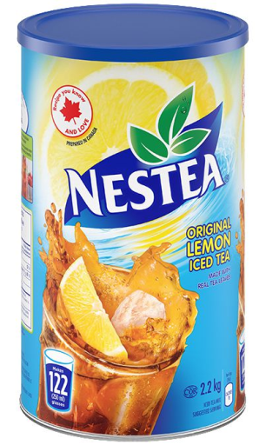
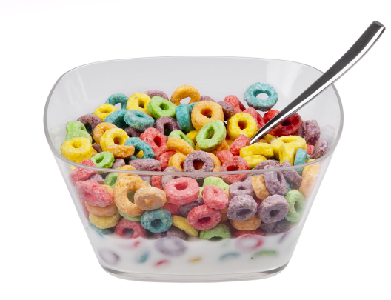
LIMIT: SUGARS
High sugar foods raise triglycerides and increase risk of heart disease & stroke
Consider how often you enjoy desserts, ice cream, muffins/pastries, candy, chocolate, or sugary cereal
Notes:
High intake of sugar or refined “white” carbohydrates also contributes to high cholesterol, especially triglycerides. Although we may assume that high cholesterol is caused by eating too much fat, our body takes excess sugar and stores it as fat, in the form of cholesterol (lipoproteins).​
​
Lowering sugar intake:​
-Enjoy fruit when you have a craving for something sweet.​
-Be mindful of your portion size when choosing sweets such as candies, chocolate bars, cookies, cake, pies, pastries, ice cream, frozen desserts and donuts.​
-Buy breakfast cereals that are lower in sugar.

Slide 28
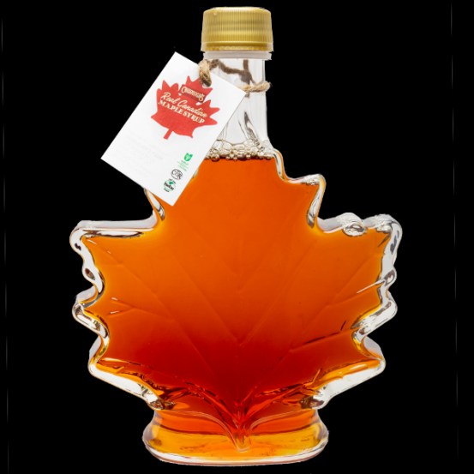
LIMIT: SUGARS
Drink water or milk instead of pop, iced tea & juice​
Eat your fruit, rather than drink it​
Also consider foods with high levels of natural sugars​
Honey, maple syrup, raw sugar = the same as white sugar​
Notes:
-What about the sugar content of fruit? Fresh and frozen fruit contain naturally occurring sugar, but they also contain high amounts of fibre, vitamins and minerals. ​ Whole fruits like apples, bananas and berries are very nutritious, even though they contain sugar. Most people do not need to limit or reduce their intake of whole fruits.​
-However, fruit juice is a very concentrated source of sugar and should be limited. Even unsweetened, “no sugar added” fruit juice often contains almost as much sugar as soda!​​
​
-As well, foods made of “simple sugars” often have a very high sugar content.​
-Foods like honey, maple syrup, agave, and sugar in the raw should all be limited, even though they are naturally occurring sugars and are not highly processed.​ In fact, honey and maple syrup contain the same amount of sugar (per teaspoon) as “regular” white sugar.​​

Slide 29
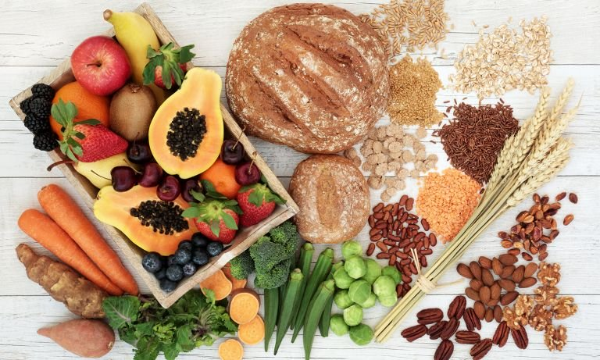
LOWERING cholesterol & triglycerides: increase fibre

Slide 30
DIETARY FIBRE
Found in plant foods only
The part of plants that we don’t digest
Lowers LDL (bad cholesterol)
Lowers blood sugar
Improves bowel health
Helps you feel full (satiety)
Notes:
Plant-based, unprocessed foods are a good source of fibre.​ Fibre helps to lower blood cholesterol, manage blood sugar, protect against some cancers, promote regular bowel movements, and promote satiety/fullness.
​
Sources of fibre: whole grain bread, whole grain pasta, oats or other cereals made from whole grains, brown rice, wild rice, quinoa, barley, vegetables, fruit, beans and lentils, bran, flaxseed, chia seeds, psyllium and bran.​
Most of the grains that we eat should be whole grains.​ Reminder: Increase the amount of dietary fibre slowly and drink plenty of fluids to avoid GI discomfort and gas.​

Slide 31
DIETARY FIBRE
Two types: soluble fibre & insoluble fibre
Both are healthy
Daily recommended intake:
25-38 grams/day of total fibre (soluble + insoluble)
Notes:
The average Canadian eats 11-14 g/day of fibre (less than half our needs).

Slide 32
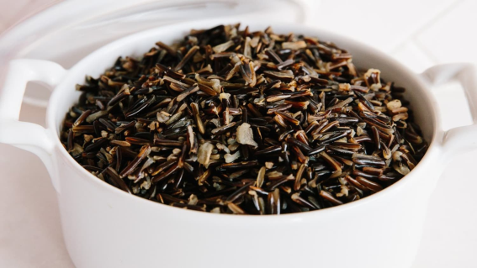
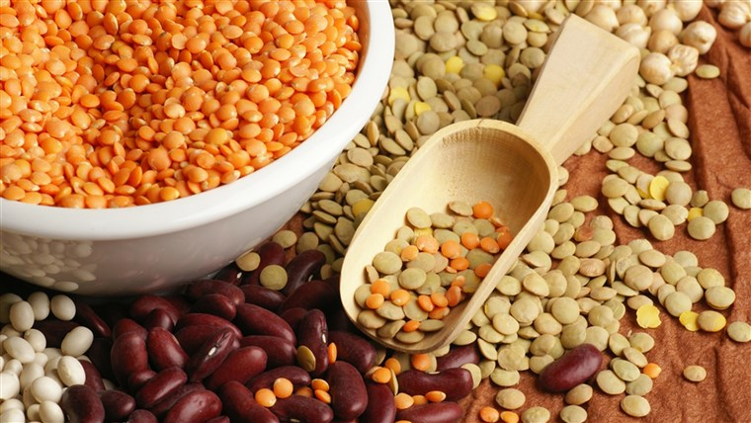
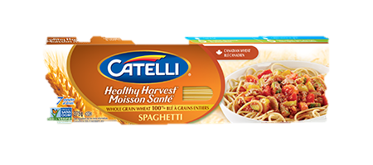
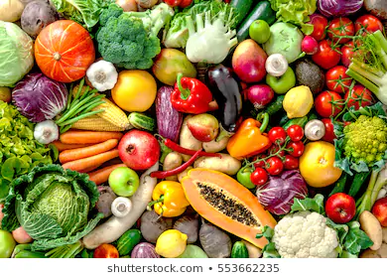
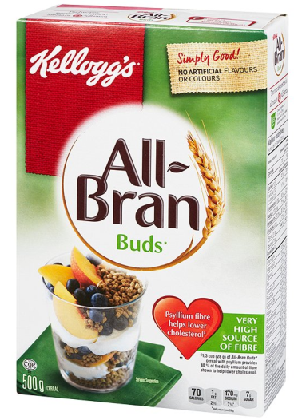
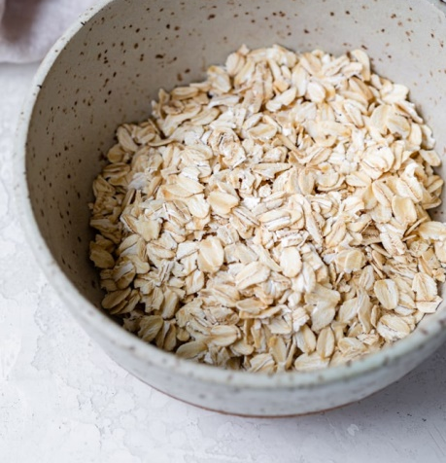
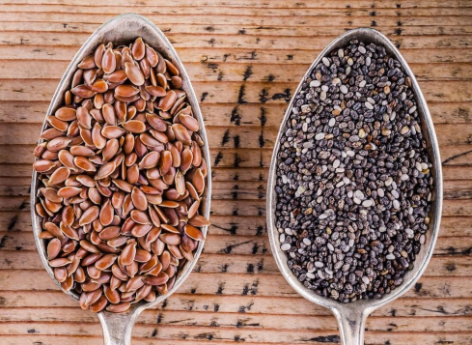
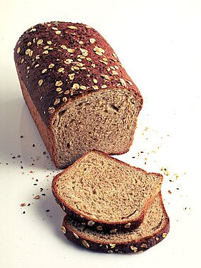
WAYS TO INCREASE FIBRE
Notes:
Ways to increase fibre:
-Choose 100% whole grain or whole wheat breads instead of white or rye bread.
-Eat quinoa, brown rice or wild rice instead of white rice, basmati or jasmine rice.
-Choose whole grain pasta instead of the typical “white” pasta.
-Eat a variety of fresh, frozen or canned fruits and vegetables.
-Cook with beans and lentils. Replacing beans instead of meat in recipes also reduces saturated fat intake.
-Choose high fibre cereals like oatmeal or All Bran.
-Add flaxseed or chia seeds to yogurt, cereal, or smoothies.
-Inexpensive sources of fibre: frozen fruits and vegetables; canned or dried beans and lentils; brown rice; sweet potato and white potatoes; popcorn.

Slide 33
LOWERING BLOOD PRESSURE: LIMIT SALT (SODIUM)

Slide 34
Sodium (SALT)
A mineral that is essential for health
High salt intake can raise blood pressure
Most Canadians eat way too much salt
Sea salt, rock salt, Himalayan pink salt: Not healthier than table salt
Notes:
Salt is an essential nutrient. The proper balance of sodium and fluid is necessary for the health of the heart, liver and kidneys.
Too much salt in our diet increases blood pressure, which can lead to kidney disease, heart disease or stroke.
High salt intake can increase water retention. If you have heart failure, this can translate to swelling in your legs and feet. Excess salt can also cause fluid buildup around the heart, which makes breathing more difficult.
Current Canadian sodium intake is 3000 mg per day, which is double the amount that we need (AI = 1500 mg/d and DRI = 2300 mg).
About 75% of both adults and children exceed the recommended intake of sodium.
Sea salt and gourmet salts contain the same amount of sodium as regular table salt.

Slide 35
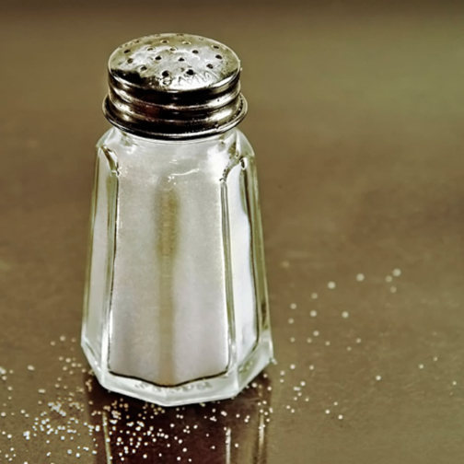
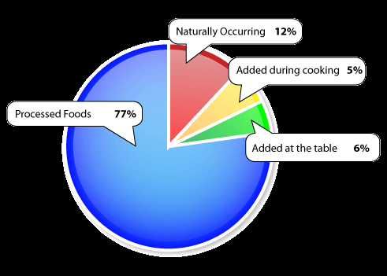
Sodium – Where Is it?
Notes:
Guess how much salt you get from your diet?
-Naturally occurring in foods = 12%
-Added to food at the table or during cooking = 11%
-Processed and restaurant foods = 77%
More than 75% of both adults and children exceed the recommended daily sodium intake.

Slide 36
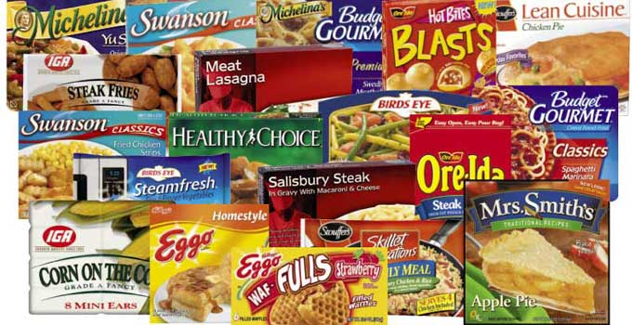
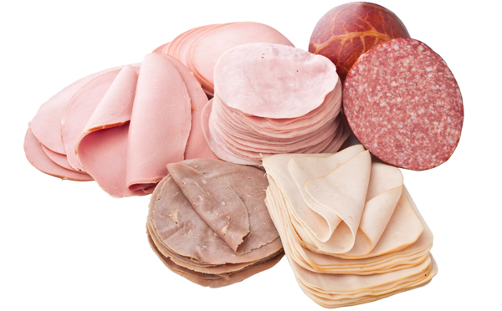
Highly Processed Foods
Notes:
-The best way to reduce sodium intake is to limit intake of processed foods such as canned or packaged soups, flavoured rice/pasta packages (Sidekicks), frozen dinners (e.g. lasagna, chicken fingers), processed meats, pizza, French fries, chips, cakes, cookies, donuts, some breakfast cereals and granola bars.
-Use only small amounts of condiments like ketchup, soy sauce, pickles, olives, gravies, and salad dressings.

Slide 37
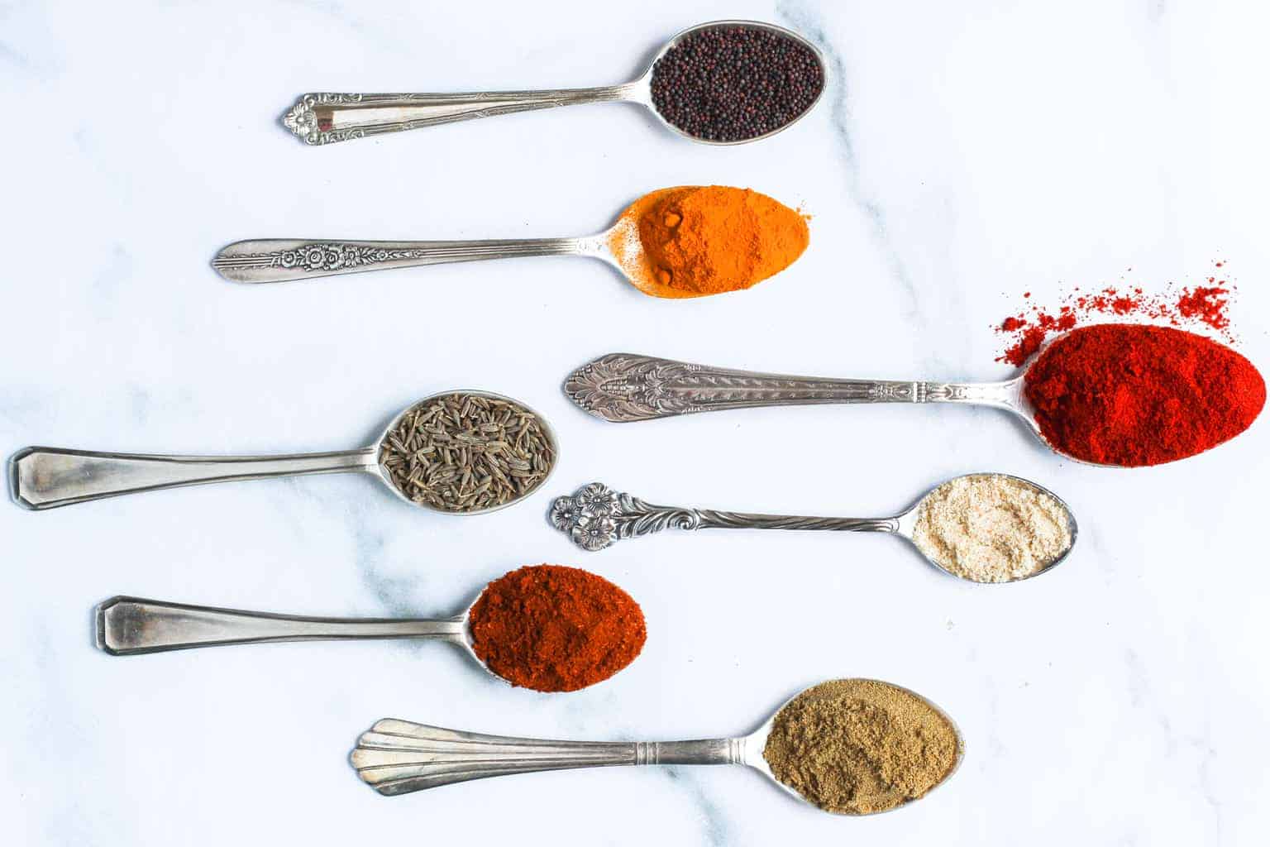
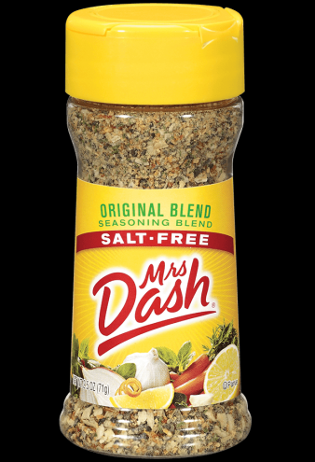
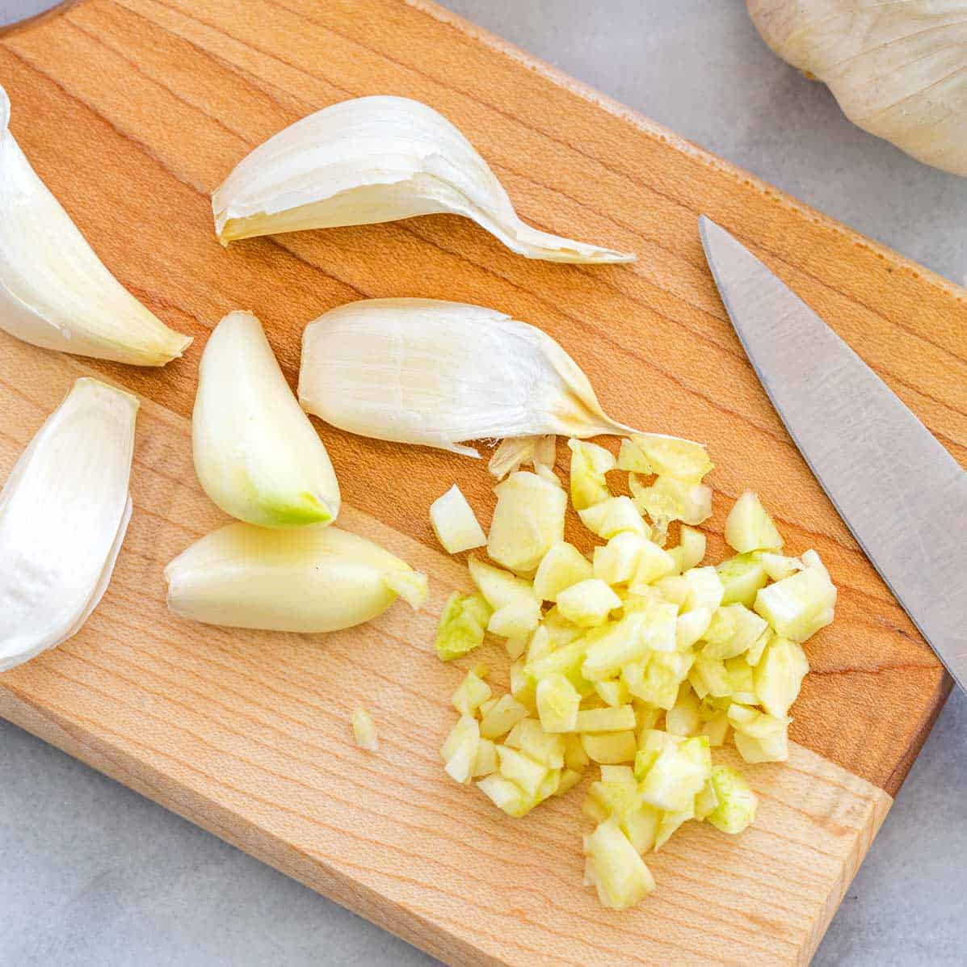
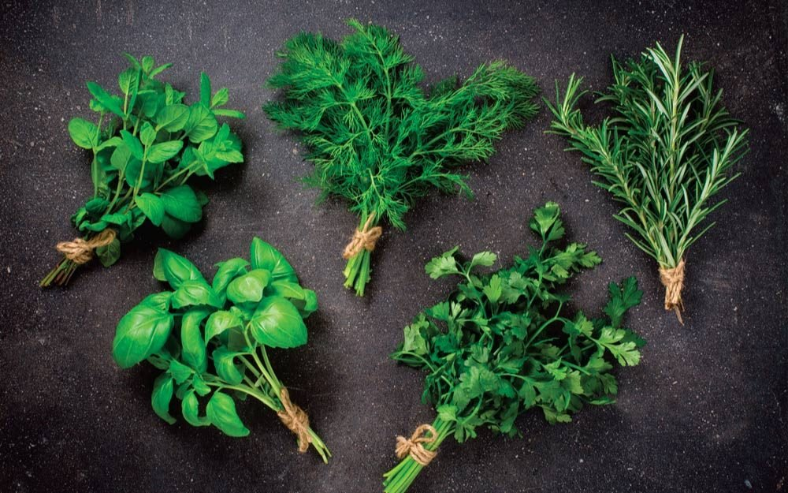
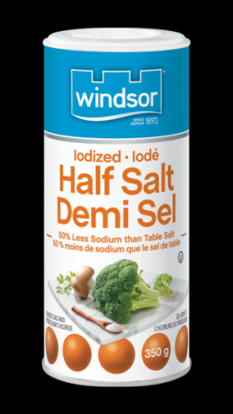
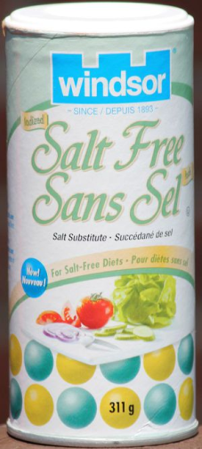
How to add flavour without salt
Talk to your doctor before using salt substitutes (e.g. Half Salt, No Salt)
Notes:
Limiting salt may change the flavour of foods; it will take a while for your taste buds to adjust. Less salt doesn’t mean less flavour – you can use herbs and spices in place of salt to allow foods to have flavor.
Talk to your doctor before taking a salt substitute (such as Half Salt or No Salt) because these can interfere with your blood pressure and heart medications.
Instead, use a seasoning blend containing no salt (e.g. Mrs. Dash). Or create your own blend of herbs and spices.

Slide 38
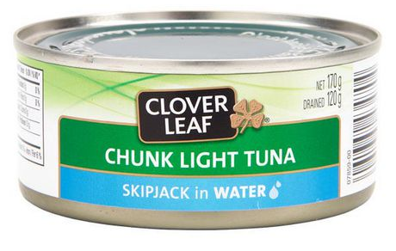
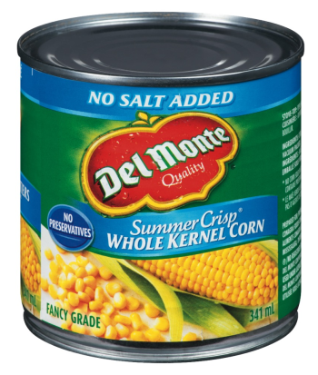
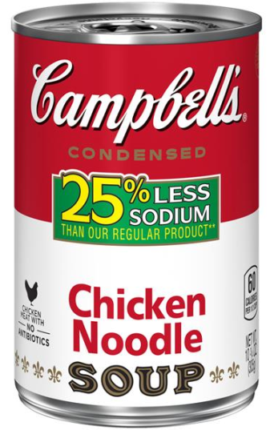
WAYS TO REDUCE SODIUM INTAKE
Limit sodium intake to max 2300 mg per day
Notes:
Increase intake of fresh and frozen vegetables & fruit
Choose canned tuna/salmon or peanut butter sandwiches instead of deli meat
Cook more meals at home instead of take-out/restaurant foods
Choose low-sodium canned foods

Slide 39
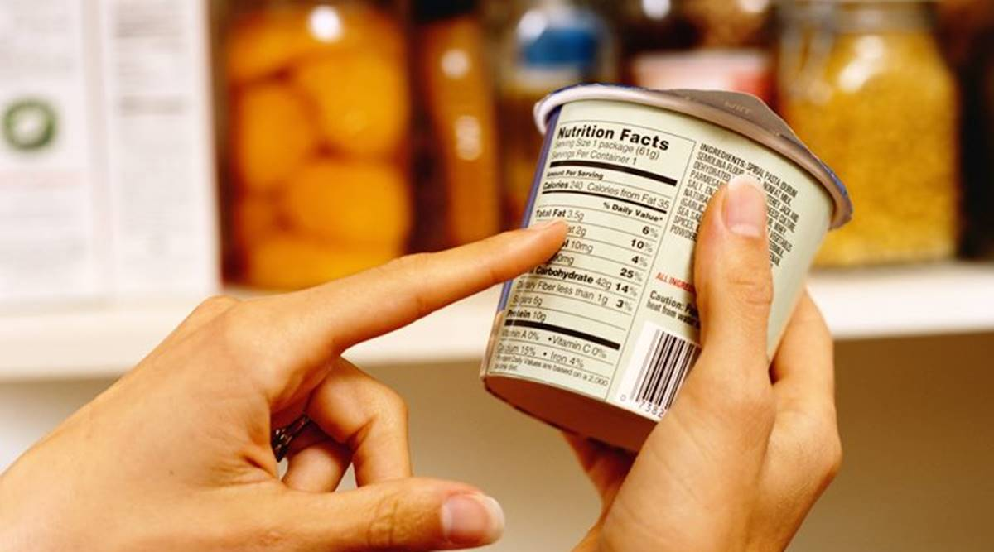
LABEL READING

Slide 40
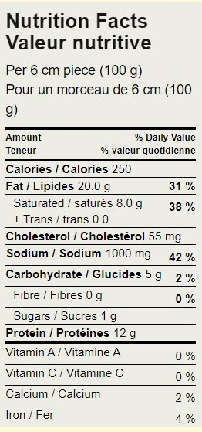
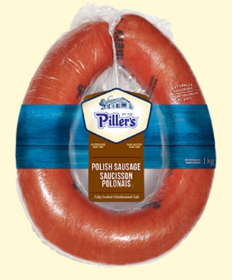
LABEL READING
2 ½” piece (1/10th of sausage ring)
Notes:
Now let’s review label reading. We will use this package of Polish sausage for our example.

Slide 41
LABEL READING
1) Look at the serving size
Compare to your actual intake
2 ½” piece (1/10th of sausage ring)
Notes:
1. Look at the serving size and compare to your actual intake. The serving size on this label is for one piece of sausage that is 6 cm or 2 ½ inches (100 g). That equals 1/10th of the entire sausage ring.

Slide 42
LABEL READING
1) Look at the serving size
Compare to your actual intake
2) Look at the % daily value (% DV)
2 ½” piece (1/10th of sausage ring)
Focus on:
Sodium (limit)
Saturated fat (limit)
Fibre (eat more)
Notes:
2. To get an accurate picture of the nutrition you are actually eating, you may need to double or triple the amounts listed on the nutrition label. I suggest that you measure the portions of food you eat and compare it to the serving size on the nutrition facts table.

Slide 43
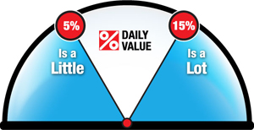
LABEL READING

Slide 44
LABEL READING
a) Sodium
Aim for 15% DV or less (the lower, the better)
Remember the serving size
If you eat a 5-inch piece of sausage = 2 servings
2 ½” piece (1/10th of sausage ring)
42% DV of sodium per serving
x 2 servings
84% daily value of sodium
(actual intake)

Slide 45
LABEL READING
b) Saturated Fat
Total fat content is not very important
Total fat = unsaturated + saturated + + trans fats)
Saturated fat is a better indicator of the food’s overall nutrition quality
Aim for saturated fat of 15% DV or less (the lower, the better)
2 ½” piece (1/10th of sausage ring)
Notes:
Blue arrows point to total fat content. Red arrows point to saturated fat content.
Saturated fat is a better indicator of the nutritional quality of the food, versus the total fat content.
-----Presenter note-----
Total fat = 20.0g per serving / Saturated fat = 8.0g / Trans fat = 0.0g / Unsaturated fat = 12.0g (not displayed on the label, but can be calculated based on the total fat content)

Slide 46
LABEL READING
2 ½” piece (1/10th of sausage ring)
c) Dietary Cholesterol
Cholesterol in food has very little effect on blood cholesterol levels
Saturated fat is a better indicator of the food’s overall nutrition quality
Notes:
Nutrition labels on food can be helpful when choosing heart-healthy foods, but you need to know what to look for.
The dietary cholesterol content of foods actually has very little effect on your blood cholesterol level. The saturated fat content of foods has a greater impact on your blood cholesterol.
Also, many “low-cholesterol” foods still contain high levels of saturated fat.
Dietary cholesterol is only found in animal-based foods (e.g. cheese, meat). However, many plant based foods are still high in saturated fats and therefore increase cholesterol (e.g. coconut oil, baked goods made with palm oil).

Slide 47
LABEL READING
2 ½” piece (1/10th of sausage ring)
d) Fibre
Aim for 15% DV or more (the higher, the better)

Slide 48
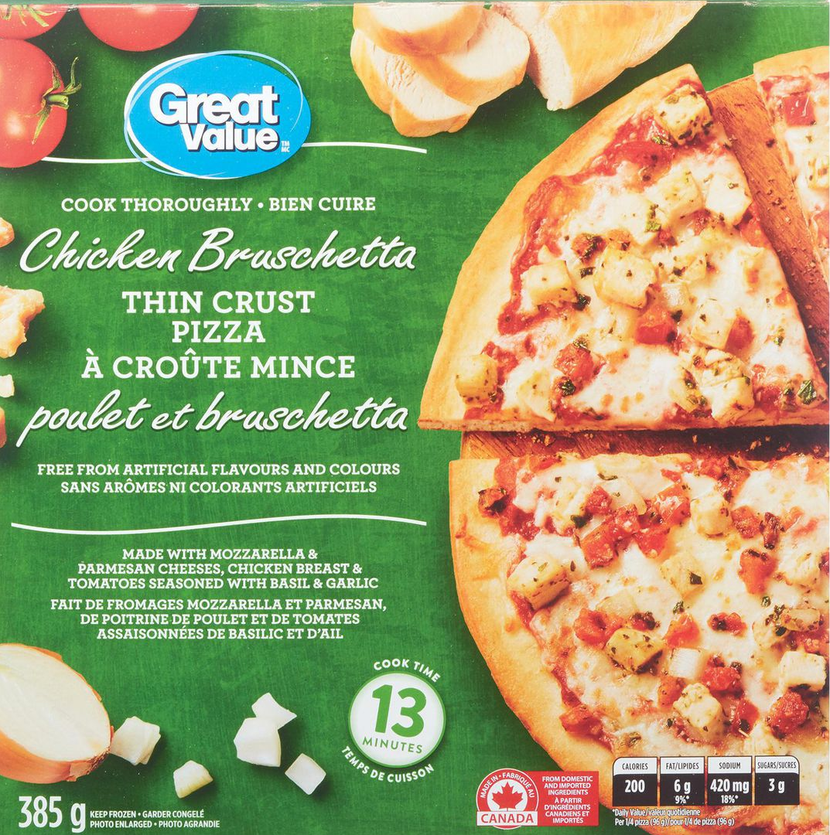
COMPARING FOODS
Notes:
Now I will show you how to use the Nutrition Facts label to compare similar foods – in this example, 2 types of frozen pizza.
On the left, we have a 3 meat thick crust pizza versus on the right, chicken bruschetta thin crust pizza.

Slide 49
LABEL READING
Notes:
Reminder: For any nutrient, 5% DV is a small amount and 15% DV is a high amount of that nutrient.

Slide 50
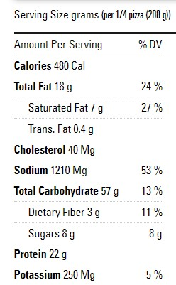
COMPARING FOODS
1) Serving size
2) Saturated fat
3) Sodium
4) Fibre
37 g net carb per 2/3 cup
Notes:
Look at the serving size. Both labels are for a serving size of ¼ of the pizza. (Presenter note: the Delissio pizza is 208g weight because it is a thick crust pizza and the Great Value chicken pizza is 96g weight because it is thin crust).
Compare the saturated fat intake. The Delissio pizza contains 27% DV saturated fat (because it contains 3 types of processed meats = pepperoni, Italian sausage & beef, and possibly more cheese on the pizza). The Great Value pizza contains 13% DV saturated fat because it’s made with chicken, which is a leaner meat.
Compare the sodium intake. The Delissio pizza contains 53% DV sodium (again because of the processed meat) whereas the GV pizza contains 18% DV sodium. The DV for sodium is still above our target of 15%. However, you may not find a food that is “perfect” in every category. But when we compare, we can see the chicken pizza is a much lower sodium choice.
Compare the fibre content. The Delissio pizza contains 11% DV fibre, while the GV pizza contains 8% DV fibre. (Note: the Delissio pizza probably has more fibre simply because the serving size/weight is much larger).
Take home message: You don’t have to give up your favourite foods. But you can make some small changes to the types of foods you eat to make them more nutritious (e.g. choose thin crust pizza with chicken and vegetables, rather than thick crust pizza with pepperoni and sausage).

Slide 51
Take home point: The overall pattern is what matters most!

Slide 52
BALANCED MEALS: HEALTHY PLATE METHOD
Benefits to using the Plate Method:
Healthy, balanced meals
Portion control
Increase fullness & satiety
Notes:
We have given you with a lot of information about different components of food, but now let’s bring it all together. What does all this information actually mean when you are feeding your family?
-The plate method is an easy way to help you to plan meals that are balanced and with portions that leave you feeling satisfied.
-Review the portion sizes. Plate consists of ½ vegetables, ¼ starch, ¼ protein. You can also see a glass of milk and a side of fruit. These are appropriate portion sizes for each meal.
-This balanced plate method also follows the same pattern as recommended by the new Canada’s Food Guide (2019).
-Can anybody identify which nutrients would be beneficial for heart health in this meal? Fibre (brown rice & vegetables), Unsaturated fat & omega-3 (salmon), Low sodium, Lean protein.

Slide 53
Notes:
Examples of the plate method.
Using our pizza example: ½ plate pizza (carbohydrates + protein) with ½ plate salad or other vegetables.

Slide 58
FOR MORE INFORMATION
Heart & Stroke Foundation
Delicious recipes & nutrition information www.heartandstroke.ca
Unlock Food
Dietitian-approved meal plans & nutrition information www.unlockfood.ca
Other health education classes, including Physical Activity Essentials & Preparing for Success www.wrha.mb.ca/groups

Slide 59
FOR GENERAL NUTRITION QUESTIONS

Slide 60
NEED MORE SUPPORT? Meet with a Registered Dietitian (optional)
Do you have private health insurance? Find a private practice dietitian here:
www.CollegeOfDietitiansMB.ca/find-a-dietitian/ private-practice
If you don't have insurance, you may still be able to see a dietitian.
Visit www.wrha.mb.ca/nutrition and select Find A Dietitian

Slide 61
Thank you
Any questions?
Use the chat function or
un-mute your microphone
Please complete an evaluation
Notes:
Survey Monkey link: https://www.surveymonkey.com/r/TSDP8RW
Put the Survey Monkey link into the chat box so that participants can complete the survey immediately.​
​
Survey link will also be included in the email sent to participants after today’s session.​

Slide 62
ACKNOWLEDGMENTS
Development team:
Laurie Andrews, RD CDE; Janet Cranston, Reh-Fit Centre; Shauna Doerksen, RD CDE; Melissa Fuerst, MSc RD; Jennifer Gibson, BSP ACPR EPPh; Dawne Lachapelle, RD CDE; Alyssa Lewis, RD CDE; Joyce Loftson, RD; Kathleen McClinton, MSc RD CDE; Lorna Shaw-Hoeppner, MPH RD; Rhea Vaags-Olafson, BA CSEP-CEP EIMC-Level 2; Elyse Wood BScN RN
Working group:
Aimee Bowcott, MPH RD CDE CRE; Shauna Doerksen, RD CDE; Jenna Hart, RD CDE; Rosanne Lesage, RD CDE;​ Jodis McCaine, RD; Sheila Pelagio, BHEcol BN RN CTE; Colin Reeve, BSP CDE CRE CTE; Cindy Sanchez, RN BN CDE; Cheryl Shaver, BScPharm CTE

