Slide 1
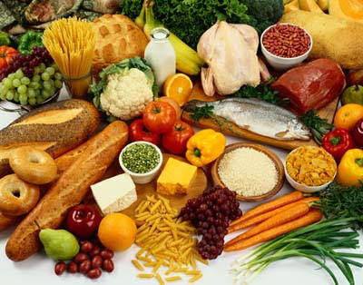
EATING FOR DIABETES

Slide 2
ONLINE CLASS ETIQUETTE
Minimize distractions
Turn off the TV, radio, cell phone ringer
Privacy & security
Asking questions
Chat box
Zoom tips
Group introductions
Notes:
1) Minimize distractions on the participants’ end. Presenter: Ensure your background is appropriate/not distracting.
2) Privacy & security sample script:
-Just like online shopping or email, Virtual Care has some inherent privacy and security risks that your health information may be intercepted or unintentionally disclosed.
-Feel free to share your personal experiences or questions during our group discussion time, but please be aware that your personal information will be shared with anyone accessing this webinar.
3) Participant questions.
-Please let me know when you have a question by typing it into the chat box (explain where to find the chat box). I will be monitoring the chat throughout the session.
-Or you can un-mute your microphone and ask your question out loud, if you prefer.
4) Zoom tips. Turning off participants’ webcams saves bandwidth and reduces freezing/glitches.
-On the next slide, show clients how to turn their microphone and webcam on & off.
5) Icebreaker/Introductions. Allow participants to introduce themselves. In the interest of time, you may want to encourage participants to introduce themselves before the class starts (while waiting for participants to log in 15 minutes before the class).
Does anyone have any questions before we get started?

Slide 3
Notes:
1st animation: Arrows pointing to chat icon in taskbar and the chat box on the right side of the screen.
2nd animation: Arrows pointing to mute and stop video in the taskbar.

Slide 4
OUTLINE
Nutrition
Carbohydrates, Sugar & Other nutrients
Balanced meals
Alcohol
Reading labels
Portion sizes

Slide 5
TRUE OR FALSE?
Now that I have diabetes, I have to eat a perfect diet. No carbs, no fat, no salt and especially no sugar. Food will never be fun again.
Notes:
POLL QUESTION in Zoom: Now that I have diabetes, I have to eat a perfect diet.
True
False

Slide 6
FALSE!
Truth: Carbohydrate (sugar) is part of a healthy diet.
Choose healthy sources of carbohydrate most of the time
It is okay (and healthy) to eat sweet treats sometimes
Avoid “all or nothing” thinking
Notes:
Ask for participants’ suggestions on how to include sweet treats in a moderate way.
For some people, they might choose to have some ice cream or cookies once per week. Others choose to have a small treat, like a bite of chocolate, every day. Others try to limit their excess sugar intake to special occasions only. There is no “right way” for everyone, only a right way for each individual.
TIP: “All or nothing” attitudes about sugar (or food in general) tend to make healthy eating and managing diabetes much more difficult.

Slide 7
WHAT CAN I EAT?
DIABETES NUTRITION

Slide 8
DIABETES NUTRITION
Healthy eating for diabetes is simply that: healthy eating!
No foods are “off limits”
How much of a difference can healthy eating make? A LOT!
Decreases 10 year risk of diabetes complications by at least 30%
Can lower A1c by 1-2%
Balanced eating is more powerful than any medication

Slide 9
TAKE HOME POINT: YOUR OVERALL DIET PATTERN IS WHAT MATTERS MOST

Slide 10
Nutrients
Carbohydrate
Protein
Fat
Increases blood glucose
No increase in blood glucose
Notes:
There are 3 different types of nutrients (also called macronutrients) that provide calories to our body: carbohydrates, protein, and fat.
Carbohydrates are foods that increase blood glucose. Protein and fat do not increase blood glucose (in the simplest explanation).

Slide 11
Carbohydrates
Sugar
(Naturally-Occurring and Added Sugars)
Starch
Fibre
Increase blood glucose
No increase in blood glucose
Notes:
Within the “family” of carbohydrates, there are 3 different types: sugar, starch, and fibre.

Slide 12
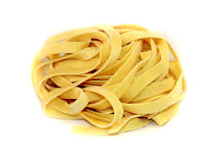
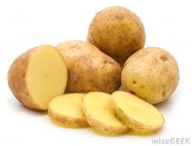
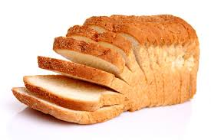
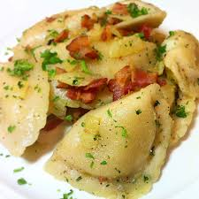
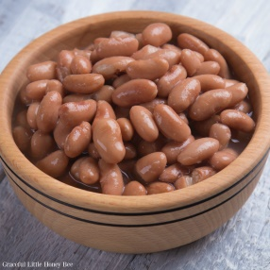
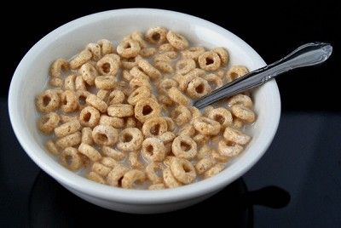
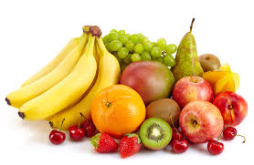
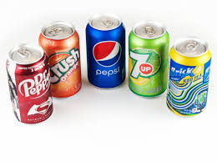
CARBOHYDRATES (CARBS)
Provide energy for the body
Carbohydrate = sugar
Notes:
Carbohydrates = sugar, starch & fibre.
-Carbohydrates provide an essential source of energy (fuel) for the body.​
-Carbohydrates are found in grain products (e.g. bread, cereal, pasta, rice, crackers) and starchy vegetables (e.g. potatoes and corn). These are starchy foods.​
-Carbohydrates also include foods such as fruit, milk and yogurt, candy, cakes, cookies, donuts, and ice cream.​
-The carbohydrates that you eat are converted to glucose, a sugar (fuel) that your body uses for energy.​
-Many of these are healthy foods, and you can eat all of these foods in moderation. For now, just be aware that these foods contain carbohydrate.
-The quality of carbohydrates that you eat can help you to manage diabetes and cholesterol.

Slide 13
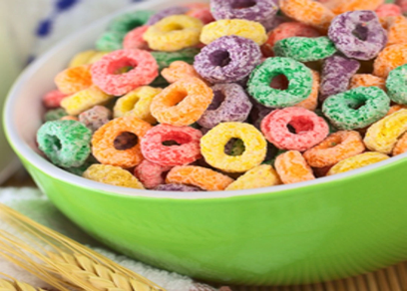
QUALITY OF SUGAR
Naturally Occurring
Added Sugars
↑ Nutrients (usually)
↑ Fibre
↑ Vitamins & Minerals
↓ Nutrients
↑ Calories
Notes:
-Natural sugars are found in fruit, some vegetables including potatoes, squash and corn, milk and unsweetened milk products such as yogurt.
-Added sugars are found predominately in processed foods like sodas, sweetened coffee and tea, chocolates and candies, breakfast cereal, sweetened baked products, flavoured yogurts, condiments and sauces. Sugar is also commonly added to foods that already have natural sugars, like jams or jellies.
-Our body treats sugar the same way, regardless of the source – whether naturally occurring or added sugar. However, most foods with naturally occurring sugars tend to have higher nutritional value than foods with added sugars.

Slide 14
LIMIT SIMPLE SUGARS (EVEN NATURALLY-OCCURRING)
Honey, maple syrup, raw sugar = the same as white sugar
Fresh or frozen fruit = healthy but fruit juice = high sugar
Notes:
-However, foods made of “simple sugars” often have a very high sugar content. Foods like honey, maple syrup, agave, and sugar in the raw should all be limited, even though they are naturally occurring sugars and are not highly processed.
-These foods still raise blood sugar and need to be limited. In fact, honey and maple syrup contain the same amount of sugar (per teaspoon) as “regular” white sugar.
-Fresh and frozen fruit contain naturally occurring sugar, but they also contain high amounts of fibre, vitamins and minerals, as we just discussed. Whole fruits like apples, bananas and berries are very nutritious, even though they contain sugar. You can still eat fruit, even if you have diabetes.
-​However, fruit juice is a very concentrated source of sugar and should be limited. Even unsweetened, “no sugar added” fruit juice often contains almost as much sugar as soda!

Slide 15
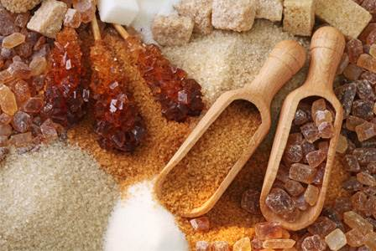
HOW MUCH SUGAR CAN I EAT?
For “added” or “simple” sugars
20-40 g per day
Consider the nutritional quality = fibre + natural or added sugars?
Small amounts of sugar throughout the day are better than all at once
Discuss with a Registered Dietitian
Notes:
This is a complicated topic. Everyone wants to know the “right answer” about sugar, but this is not a “one size fits all” topic.
((World Health Organization guideline: Added sugars = maximum 5-10% total calories, based on 2000 calorie diet = 20-40 g added sugars.))
5-10 tsp of added sugar sounds like a lot, until you realize that: ¾ cup of sweetened yogurt contains almost 4 tsp added sugar. The average granola bar contains 3 tsp added sugar. If you put 1-2 tsp sugar in your coffee, you reached your limit for the day – without eating cookies, ice cream, or any of the other sweet treats we often enjoy.
Ultimately, the lowest level of added sugar that you can happily live with is probably the best, since depriving yourself of sweet foods can make it difficult to sustain healthy eating habits in the long term.

Slide 16
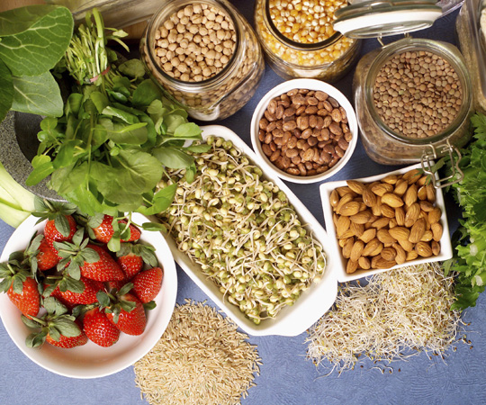
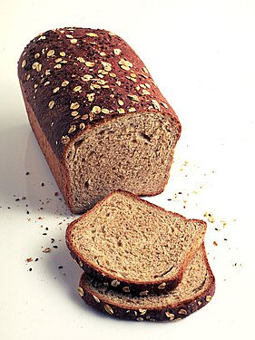
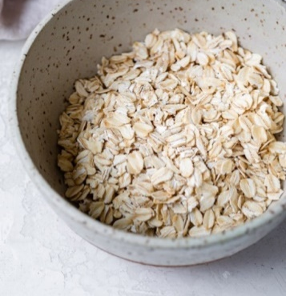
FIBRE
Not digested = no sugar
Stabilizes blood glucose
Lowers blood cholesterol
Makes you feel full
Need = 25-35 grams/day
Notes:
-High quality carbohydrate foods are a good source of fibre. Fibre is not digested by our body, therefore it does not turn to sugar and it helps to prevent blood sugar spikes.
-Fibre also helps to lower blood cholesterol, protect against some cancers, promotes regular bowel movements, and promotes satiety (fullness).​
​
-What foods are a source of fibre: whole grain bread, whole grain pasta, oats or other cereals made from whole grains, brown rice, wild rice, quinoa, barley, vegetables, fruit, beans and lentils, bran, flaxseed, chia seeds, psyllium and bran.​ Most of the grains that we eat should be whole grains.​
-Reminder: Increase your dietary fibre intake slowly and drink plenty of fluids to avoid gastrointestinal discomfort.

Slide 17
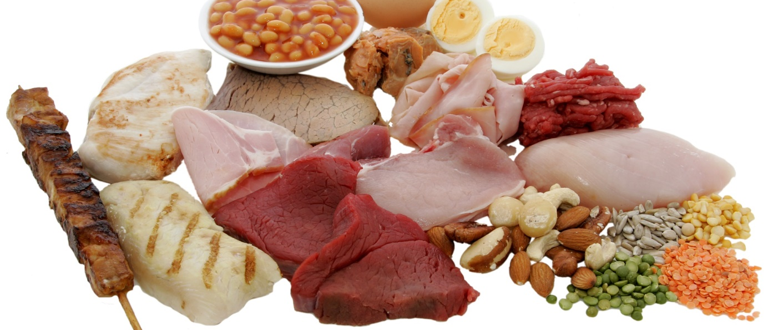
PROTEIN
Does not turn to sugar
Keeps muscles & tissues healthy
Stabilizes blood glucose
Makes you feel full
Quality matters!
Notes:
-Healthiest protein sources are low in saturated fat: skinless chicken, lean beef, fish, lean pork, tofu, nuts, seeds, beans, lentils. Extra saturated fat in meats should be limited because it raises cholesterol.
-Including a source of protein with meals and snacks can improve satiety (keep you feeling full longer) and slow the rise in blood glucose levels.​

Slide 18
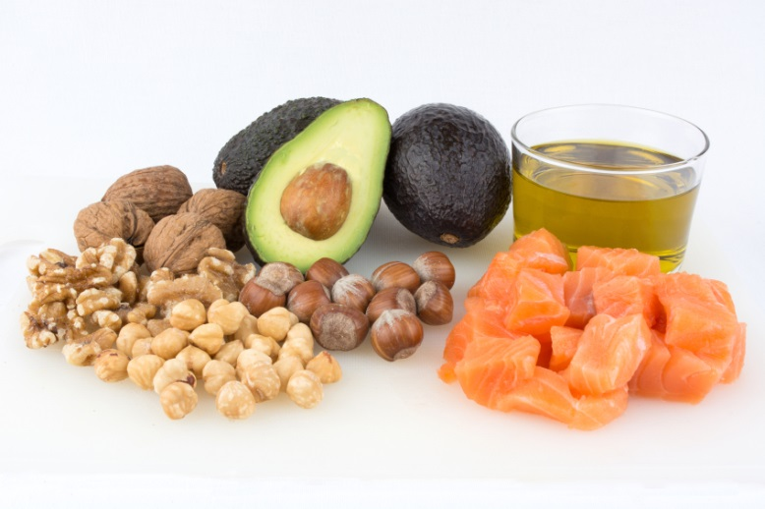
FAT
Does not turn to sugar
Helps absorb nutrients from food
Stabilizes blood glucose
Makes you feel full
Quality matters!
Attend Eating For Heart Health class for more detail
Notes:
-Dietary fats and oils provide energy to the body and help your body absorb certain vitamins. Fat also gives flavour to foods.​
​-The type of fat consumed is more important for health than the total amount of fat consumed.​ The quality and type of fat we eat is important because it can affect the cholesterol levels in your body.
-Direct participants to attend the Heart Health class series if they are interested in more information about fats.

Slide 19
POLL QUESTION
Is it better to eat real sugar – or – artificial sweetener?
Notes:
POLL QUESTION: Which is better to eat?
Real sugar
Artificial sweetener
Both are ok
Neither are healthy for me

Slide 20
SUGAR VS. ARTIFICIAL SWEETENER
Truth: The choice is yours
Safe and approved by Health Canada for use in foods
Artificial sweeteners do not raise blood glucose
Many options available
Notes:
Using artificial sweeteners (diet pop, Splenda, Sugar Twin, stevia, monkfruit) is a personal choice. Many people prefer to avoid artificial sweeteners and try to get used to eating foods that are less sweet. Others prefer to use artificial sweetener so they can continue to have sweet-tasting food often without raising their blood glucose level. The choice is individual.
Refer clients to the “Sugars and Sweeteners” handout. This will be sent as part of the email package after the class.
---Presenter notes—
Sweeteners that do not raise glucose: aspartame (Equal, NutraSweet); sucralose (Splenda); cyclamate (Sugar Twin, Sweet N Low); sugar alcohols (end in -ol = erythritol, xylitol, sorbitol); acesulfame potassium (found in diet pop); stevia (Truvia, Pure Via); monkfruit.
Sweeteners that do contain sugar but are lower glycemic index: agave nectar/syrup (glycemic index 10-20).
Full-sugar sweeteners: white sugar (glycemic index 60); brown sugar; honey; maple syrup; coconut palm sugar; date (palm) sugar; raw sugar/cane sugar; beet sugar; corn syrup; molasses; brown rice syrup.

Slide 21
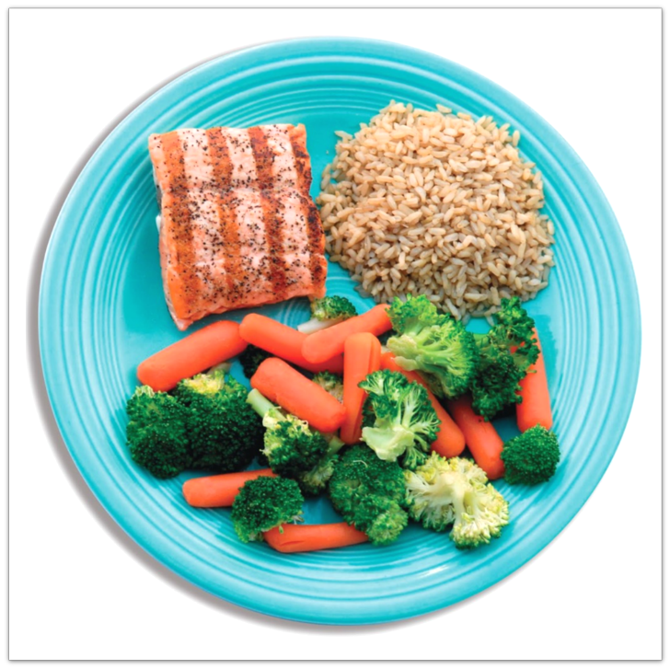
BALANCED MEALS: HEALTHY PLATE METHOD
Notes:
This is a great method to ensure that your meals are balanced. Notice that this meal has lots of vegetables and also includes brown rice. Can anybody identify which nutrients would be beneficial for diabetes in this meal?
Fibre
Healthy carbohydrate (brown rice)
Protein
Healthy fat (salmon)

Slide 22
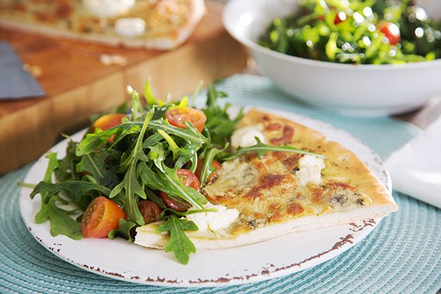
Notes:
Examples of the plate method.
Using our pizza example: ½ plate pizza (carbohydrates + protein) with ½ plate salad or other vegetables.

Slide 23
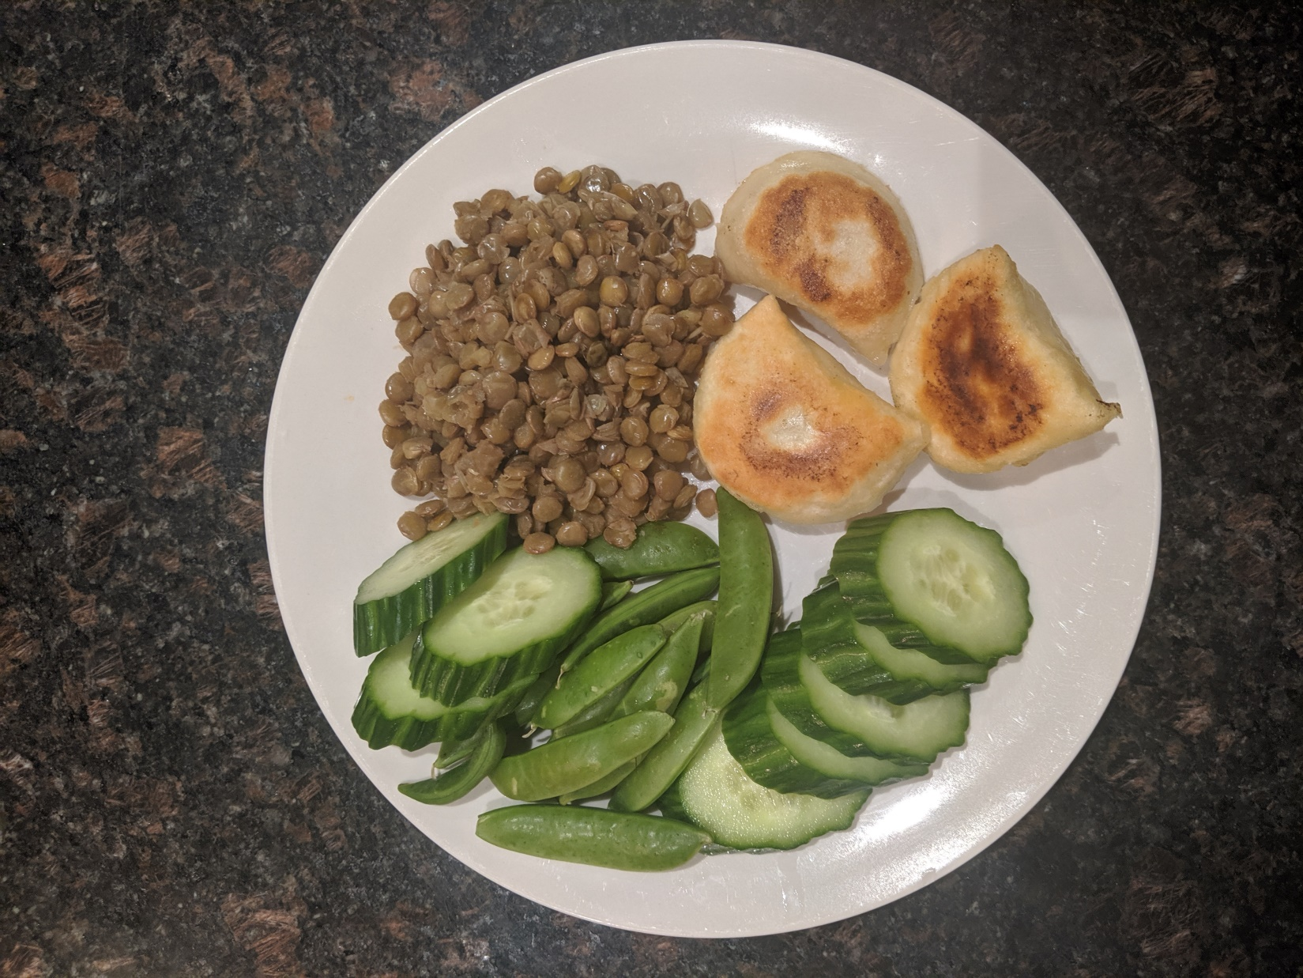

Slide 24
Notes:
Examples of balanced meals.

Slide 27
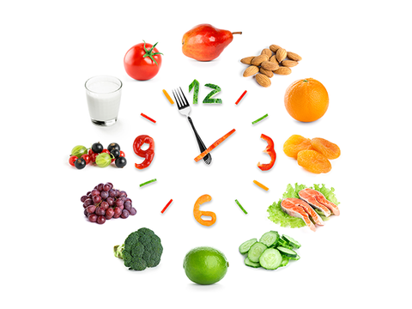
MEAL TIMING AND FREQUENCY
3 meals per day
Snacks are optional
Eating regularly:
Keeps blood glucose stable
Helps portion control
Notes:
Skipping meals:
-Makes blood glucose go UP
-INCREASES chance of overeating or making poor nutrition choices.
You do not have to eat snacks just because you have diabetes, unless instructed by your doctor or dietitian. If you choose to eat snacks, remember to adjust your meal portions. (Don’t eat your standard-sized 3 meals per day and just add 2 snacks). Be mindful of total carb intake and calorie intake.

Slide 28
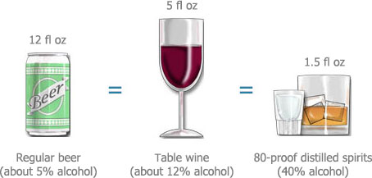
ALCOHOL: MAXIMUM RECOMMENDED INTAKE
Men: 2-3 drinks per day (total 15 per week)
Women: 1-2 drinks per day (total 10 per week)
When moderation may be too much
Avoid alcohol most of the time if you have fatty liver or high triglycerides
CAUTION
Alcohol can cause delayed low blood sugar (hypoglycemia)
Notes:
Drinking too much of any type of alcohol can increase your blood pressure and contribute to the development of heart disease and stroke.
If you drink alcohol, limit yourself to no more than:
-Men = maximum 2-3 drinks per day, to a weekly maximum of 15.
-Women = maximum 1-2 drinks per day, to a weekly maximum of 10.
-If you have high blood triglycerides or fatty liver disease, it is recommended to abstain from alcohol most of the time, even further below these guidelines.
If you take gliclazide (Diamicron) or insulin, talk to your health care provider about your alcohol consumption (due to the risk of hypoglycemia/delayed hypoglycemia).
Presenter notes:
-In moderation, alcohol may actually modestly increase HDL. However, alcohol raises triglycerides and provides extra calories.
-Excessive alcohol intake can also damage the liver, pancreas, sex organs, brain, veins/arteries/heart, and nervous system.
-If you don’t drink, don’t start (even for the HDL increase).
A standard alcoholic drink means:
• 341 mL / 12 oz (1 bottle) of regular strength beer (5% alcohol).
• 142 mL / 5 oz wine (12% alcohol).
• 43 mL / 1-½ oz spirits (40% alcohol).

Slide 29
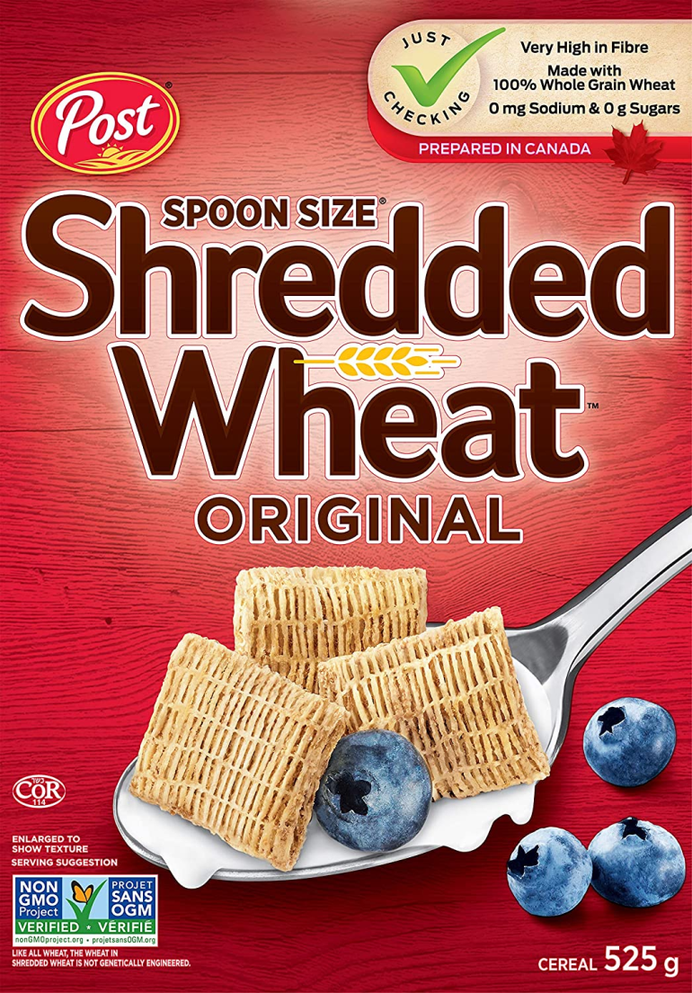
LABEL READING

Slide 30
Carbohydrates
Sugar
(Naturally-Occurring and Added Sugars)
Starch
Fibre
Increase blood glucose
No increase in blood glucose
Notes:
Reminder about the different types of carbohydrates and their effect on blood glucose.

Slide 31
LABEL READING
1) Look at the serving size Compare to your actual intake
2) Look at the total grams of carbohydrate per serving
Includes:
Fibre,
Sugar, and
Starch (but starch is not always displayed on the label)
Notes:
Look at the serving size and compare to your actual intake. The serving size on this label is for 1 cup of cereal. The typical cereal bowl holds 2-3 cups of cereal. To get an accurate picture of the nutrition you are actually eating, you may need to double or triple the amounts listed on the nutrition label. I suggest that you measure the portions of food you eat and compare it to the serving size on the nutrition facts table.
Look at the grams of carbohydrate per serving. In this case, 1 cup of cereal contains 38 grams of carbohydrate. This is the total amount of fibre plus sugar plus starch. (i.e. The 6g fibre and 0g sugar are included in the 38g carbohydrate. You do not add 38 + 6 + 0).

Slide 32
Label reading
3) Subtract the fibre
(Does not raise blood sugar)
38 g carbohydrate per serving
- 6 g fibre
32 g net carbohydrate
(sugar + starch)
Notes:
3) Fibre does not raise blood sugars. Thus, we can subtract the amount of fibre from the total amount of carbohydrates.
This cereal contains 38g of carbohydrate and 6g of fibre per serving. 38 grams carbohydrate minus 6 grams fibre = 32 g carbohydrate per serving.
Therefore, you would count 32 grams of carbohydrate for this food. This is sometimes referred to as “net carbohydrates”. The 32g of net carbohydrates is the total content of both sugar and starch.

Slide 33
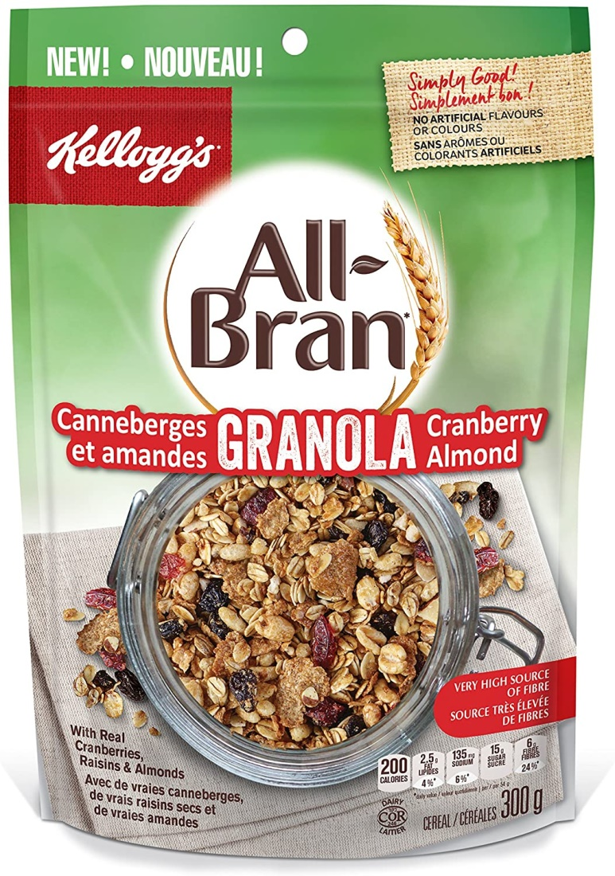
COMPARING FOODS

Slide 34
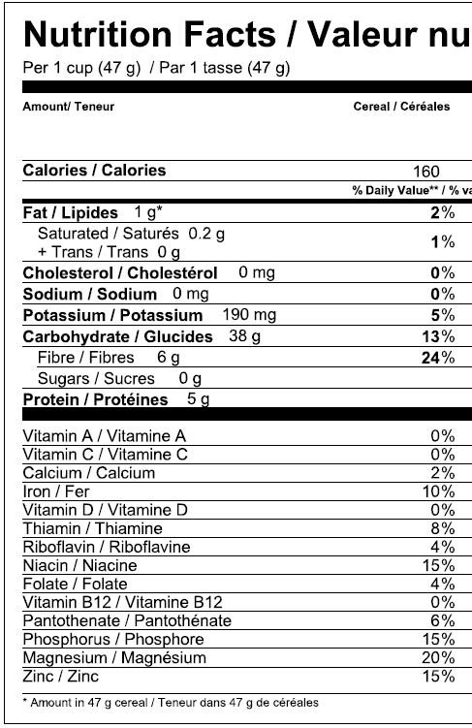
COMPARING FOODS
1) Serving size
2) Total grams of carb
37 g net carb per 2/3 cup
3) Subtract fibre
32 g net carb per 1 cup
Notes:
Look at the serving size. The portion size on the box of Shredded Wheat is 1 cup, but the portion size on the granola is 2/3 cup. Also remember to compare the serving size on the nutrition label versus the portion size that you actually eat. (Presenter note: You may wish to discuss the weight of the cereal [47g per 1 cup Shredded Wheat vs. 54g per 2/3 cup granola])
Next, look at the total grams of carbohydrate. Shredded Wheat contains 38g carb, whereas the granola contains 43g carb.
Finally, subtract the fibre. Shredded Wheat contains 38g carb minus 6g fibre = 32g net carb per 1 cup of cereal. All Bran Granola contains 43g carb minus 6g fibre = 37g net carb per 2/3 cup of granola. (Note = 56g net carb per 1 cup of granola).
Note: If participants want more information on reading labels (e.g. for fat and sodium) please direct them to attend the “Eating for Heart Health” class.

Slide 35
DIABETES NUTRITION
How much carbohydrate should I eat?
Notes:
Next we will review carbohydrate counting. Some participants may not be interested in this level of detail.
Carb counting is NOT REQUIRED to manage your diabetes. However, for people who are looking for guidelines about portion sizes, this is a good starting point.
Remind participants who choose not to carb count: If they follow the healthy plate method that we discussed earlier, that method provides an appropriate intake of carbohydrates. In essence, the plate method “does the thinking for you” in terms of appropriate portion sizes.

Slide 36
HOW MUCH CARB SHOULD I EAT?
Women
30-45 grams of carbohydrate per meal (x 3 meals/day)
Maximum 15-20 grams of carbohydrate per snack
Maximum 150-200 grams total carb per day
Men
30-60 grams of carbohydrate per meal (x 3 meals/day)
Maximum 15-30 grams of carbohydrate per snack
Maximum 200-250 grams total carb per day
Notes:
These are guidelines only! Individual carb needs will be different depending on many factors:
1. Physical activity level
2. Other treatment modalities (medication, physical activity, stress levels, sleep)
3. Age
4. Personal goals for diabetes management - are you open to using medication? Are you hoping to control blood sugars with diet alone? If so, targeting a lower carb intake will be a major component of your treatment plan, versus a person who is okay with taking metformin and being more physically active (to allow them to eat a higher carb intake).

Slide 37
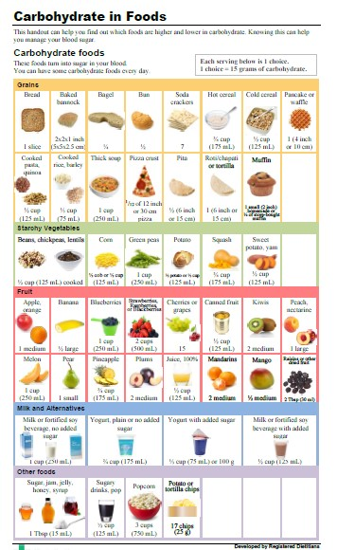
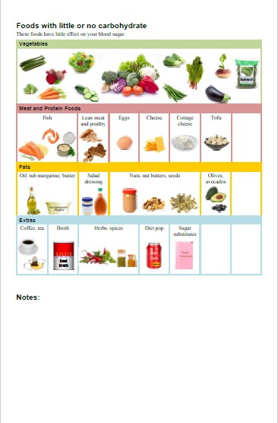
15 g carbohydrate
per serving
Notes:
This handout will be emailed to participants after the class.
-For foods that don’t provide a Nutrition Facts label, we will show you how to easily estimate the carbohydrate content.
-Looking at page 1 (Carbohydrate Foods) or the left side of your screen: All of the foods on this page contain carbohydrate and will turn to sugar in the body.
-When we talk about counting carbohydrates, the standard reference amount is 15 grams of carbohydrate. For all of these foods, the portion size noted will provide approximately 15 grams of carbohydrate.

Slide 38
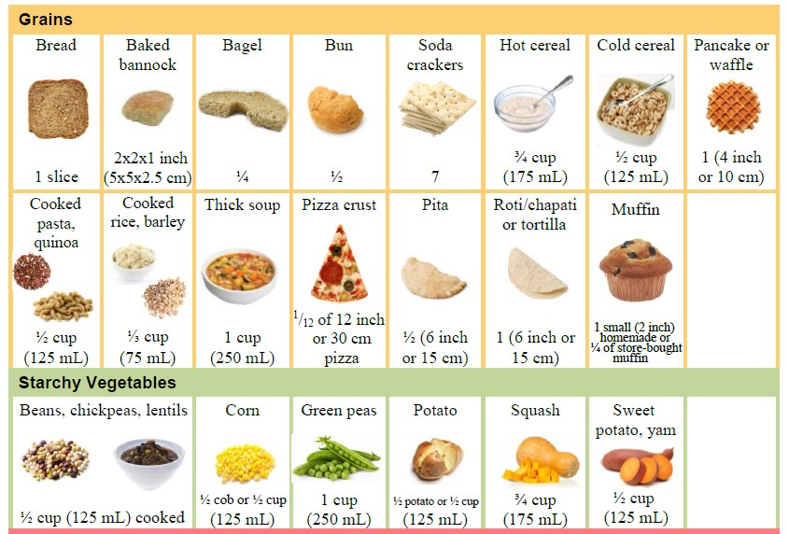
15 g carbohydrate
per 1 slice bread
15 g carbohydrate
per ⅓ cup rice
15 g carbohydrate
per ½ potato
Notes:
Example: 1 slice of bread contains 15 grams of carbohydrate. ½ medium potato (or ½ cup) also contains 15g carb. 1/3 cup of rice also contains 15g carb.

Slide 39
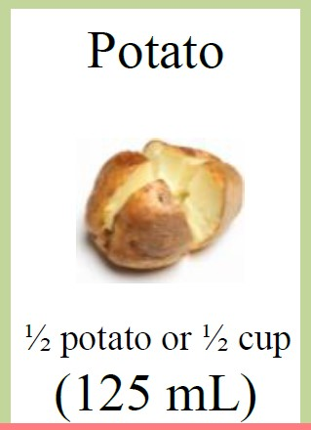
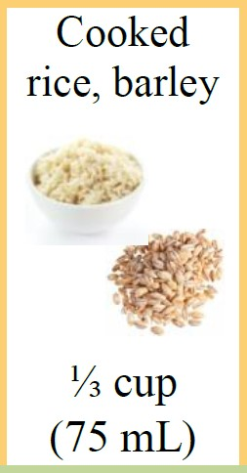
1 whole potato (½ potato x 2)
2 carbohydrate servings
x 15 g carb
30 g carbohydrate
per 1 whole potato (1 cup)
1 cup rice (⅓ cup x 3)
3 carbohydrate servings
x 15 g carb
45 g carbohydrate
per 1 cup rice
Notes:
You may be wondering… can I eat more than 1 serving of a food at a meal? Yes, but I recommend that your total carbohydrate intake for the meal or snack is within the recommendations we just discussed. Women = 30-45g carb per meal, Men = 30-60g carb per meal.
If you eat a whole baked potato, that equals 2 servings of carbohydrate. 2 servings x 15g carb = total 30g carb consumed.
If you eat 1 cup of rice, that equals 3 servings of carbohydrate. 3 servings x 15g carb = total 45g carb consumed.

Slide 40
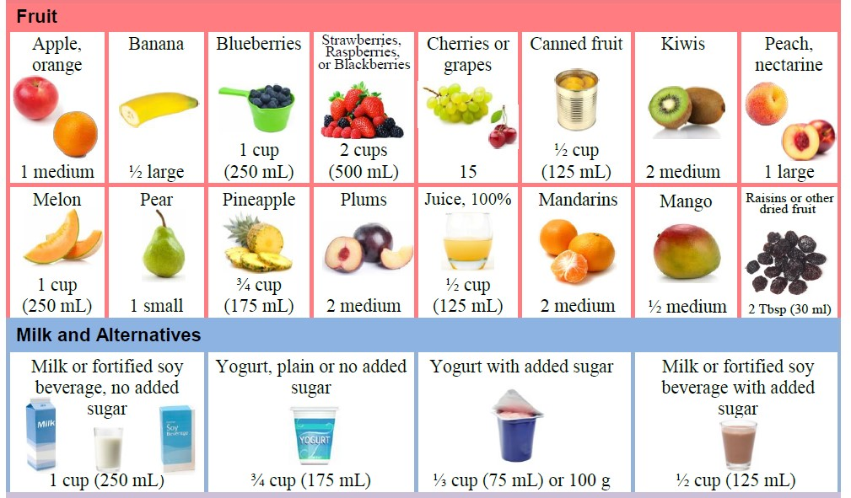
15 g carbohydrate
per ½ banana
15 g carbohydrate per
2 cups of strawberries,
raspberries or blackberries
15 g carbohydrate per
1 apple or 1 orange
Notes:
Similarly, 1 medium apple or orange contains 15 grams of carbohydrate. ½ banana also contains 15g carb. Or you can eat 2 cups of strawberries, raspberries or blackberries and only consume 15g carb.
You can also use this guide to compare foods from different food groups. Example: 1 slice of bread and 1 apple both contain 15g carb and will have a similar effect on blood glucose.

Slide 41
No carbohydrate
Notes:
Now, looking at page 2 (Foods with little or no carbohydrate) on the right side of your screen: All of the foods on this page do not contain much carbohydrate, therefore these foods will not raise your blood sugar.

Slide 42
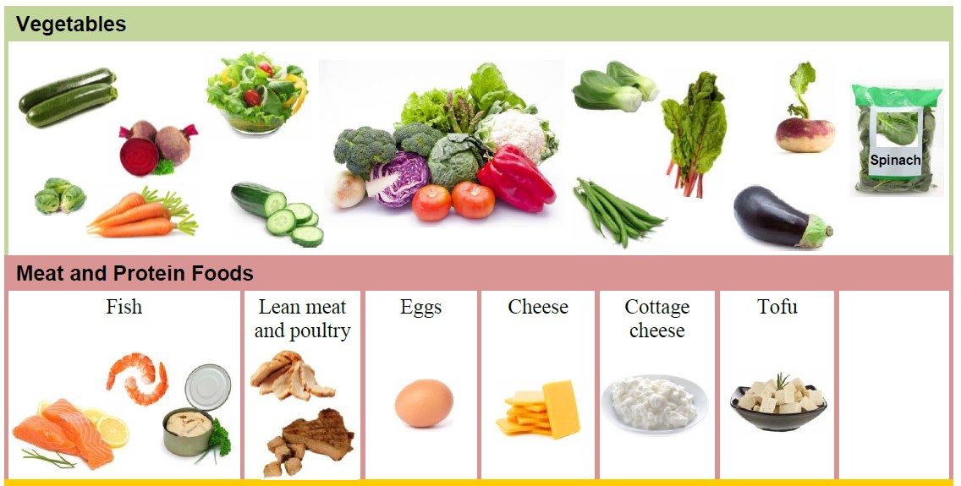
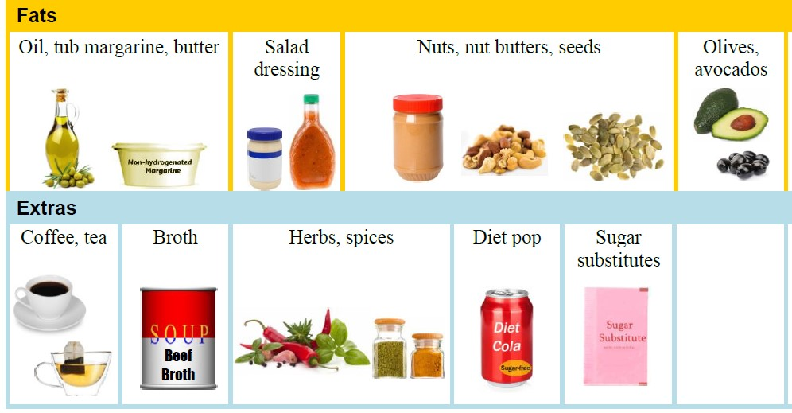
Notes:
Larger view of this section.

Slide 43
BREAKFAST – OPTION 1
2 cups cereal with milk
+ 1 banana
Notes:
Let’s put together some meals so you can see how carb counting works.

Slide 44
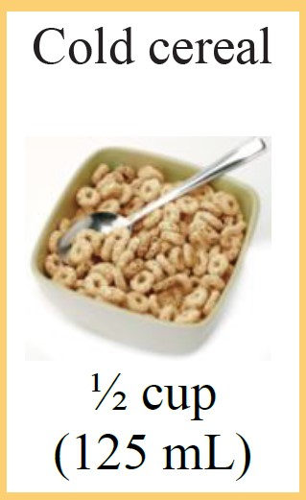
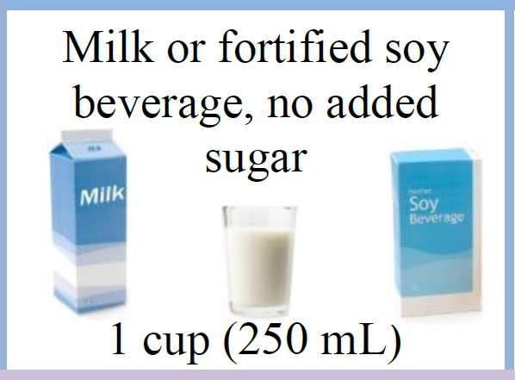
BREAKFAST – OPTION 1
2 cups cereal (½ cup x 4 servings)
4 carbohydrate servings
x 15 g carb
60 g carb per 2 cups cereal
1 cup skim milk (1 serving)
= 15 g carb

Slide 45
1 whole banana (½ x 2 servings)
2 carbohydrate servings
x 15 g carb
30 g carb per 1 banana

Slide 46
BREAKFAST – OPTION 1
105 g total
carbohydrate
60 g carb
15 g carb
30 g carb
Notes:
Cereal + milk + banana = 105 grams carb per meal. This is 2-3 times the recommended carb intake at a single meal.

Slide 47
BREAKFAST – OPTION 2
2 eggs + 2 slices whole grain toast
with margarine or peanut butter
+ 2 cups strawberries
Notes:
This is a large breakfast, and a greater volume of food than Breakfast #1, however the carb content is significantly lower.

Slide 48
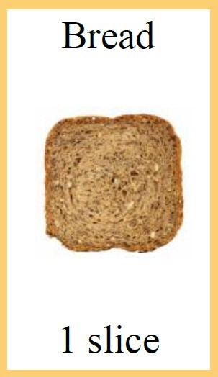
BREAKFAST – OPTION 1
2 slices toast (1 slice x 2 servings)
2 carbohydrate servings
x 15 g carb
30 g carb per 2 slices toast
2 cups strawberries (1 serving)
= 15 g carb

Slide 49
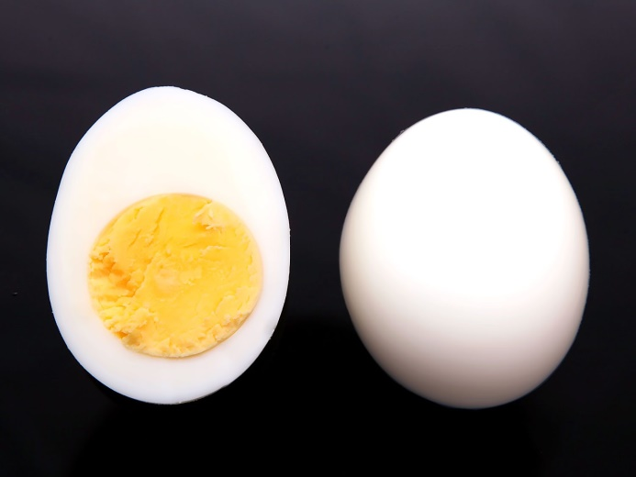
BREAKFAST – OPTION 1
Eggs = no carbohydrate
Margarine = no carbohydrate
Peanut butter = no carbohydrate
= 0 g carbohydrate

Slide 50
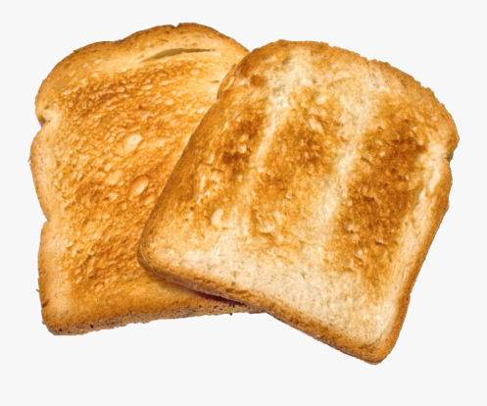
BREAKFAST – OPTION 2
30 g carb
No carb
15 g carb
45 g total
carbohydrate
No carb
Notes:
Toast + peanut butter + eggs + strawberries = 45 grams carb per meal. If you eat only the eggs and toast (no fruit) then this meal is only 30g carb.
By comparison, the meal of cereal with milk + a banana = 105g carb.

Slide 51
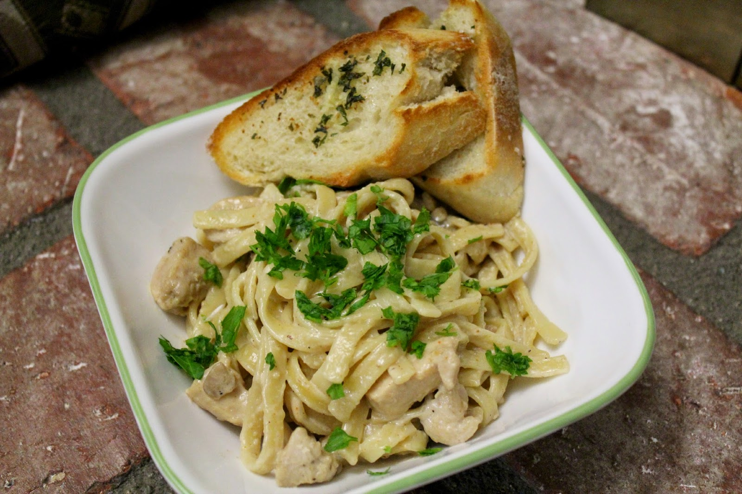
supper – OPTION 1
2 cups fettuccine alfredo with chicken
+ 2 slices garlic bread
Notes:
If you don’t have enough time to review this example, just point out the change in portion sizes and thus reduced carb intake.
Half the original-sized portions of pasta and bread + added Caesar salad.

Slide 52
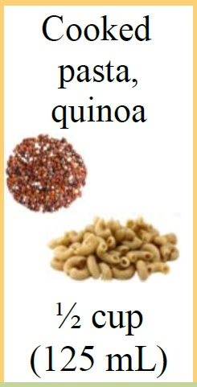
BREAKFAST – OPTION 1
2 cups pasta (½ cup x 4 servings)
4 carbohydrate servings
x 15 g carb
60 g carb per 2 cups pasta
2 slices garlic bread (1 slice x 2 servings)
2 carbohydrate servings
x 15 g carb
30 g carb per 2 slices garlic bread

Slide 53
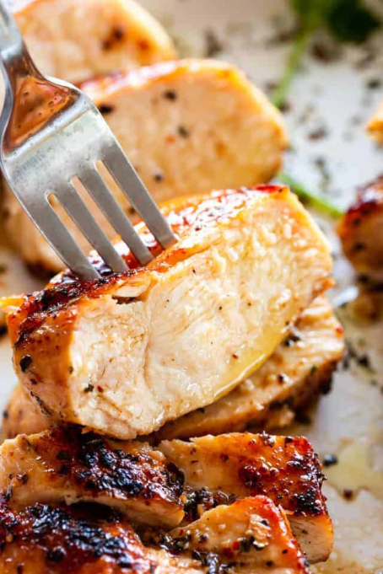
BREAKFAST – OPTION 1
Chicken = no carbohydrate
Alfredo sauce = low/no carbohydrate (check the label)
= 0 g carbohydrate

Slide 54
SUPPER – OPTION 1
60 g carb
No carb
Low/no carb
90 g total
carbohydrate
30 g carb
Notes:
Pasta + garlic bread + chicken = 90 grams carb per meal. Again, this is 2-3 times the recommended carb intake at a single meal.

Slide 55
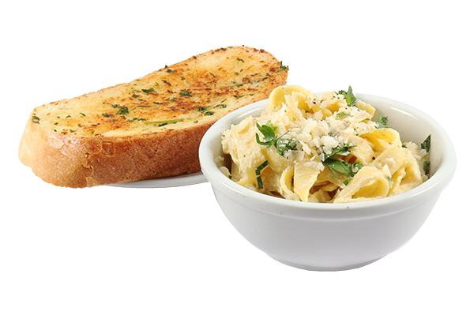
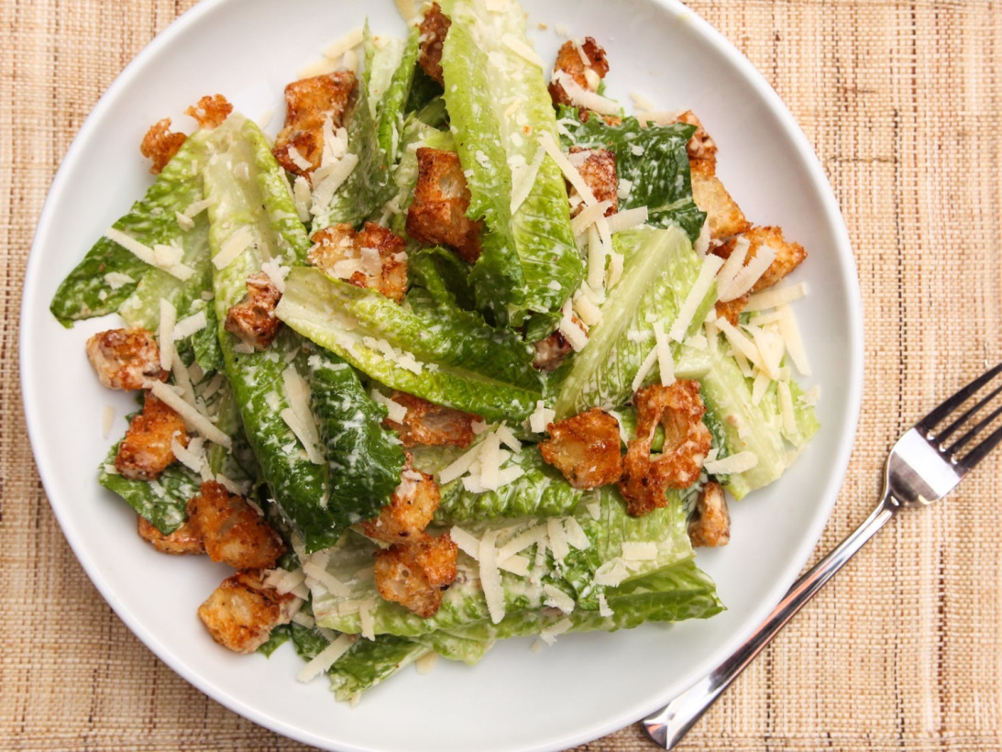
SUPPER – OPTION 2
1 cup fettuccine alfredo with chicken
+ 1 slice garlic bread + 3 cups Caesar salad
Notes:
The changes in option 2:
-1 cup pasta (instead of 2 cups)
-1 slice garlic bread (instead of 2 slices)
-Add Caesar salad (previously no vegetables)

Slide 56
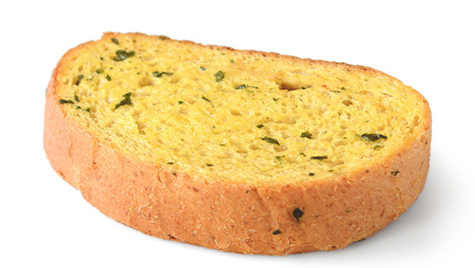
SUPPER – OPTION 2
45 g total
carbohydrate
30 g carb
Low/no carb
15 g carb
Low/no carb
No carb
Notes:
By eating the same foods but in smaller portions, and adding a large portion of salad, we reduced the carb content of this meal from 90g to 45g.

Slide 57
BALANCED MEALS: HEALTHY PLATE METHOD
Notes:
Another reminder for participants who are feeling overwhelmed with carb counting, want a simpler approach, or just choose not to carb count:
If you follow the healthy plate method, this method provides an appropriate intake of carbohydrates. In essence, the plate method “does the thinking for you” in terms of appropriate portion sizes.

Slide 58
HEALTHY EATING RESOURCES
Diabetes Canada
www.diabetes.ca
Unlock Food
Dietitian-approved meal plans & nutrition information
www.unlockfood.ca
Other health education groups,
including Heart Health Essentials
www.wrha.mb.ca/groups

Slide 59
For General Nutrition Information and Questions

Slide 60
NEED MORE SUPPORT? Meet with a Registered Dietitian (optional)
Do you have private health insurance? Find a private practice dietitian here: www.CollegeOfDietitiansMB.ca/find-a-dietitian/private-practice
If you don't have insurance, you may still be able to see a dietitian. Visit www.wrha.mb.ca/nutrition and select Find A Dietitian
Notes:
Encourage participants to attend all of the classes in the diabetes series first. The classes may answer all of their questions, and if clients still want a 1-on-1, they now have the basic knowledge to have an effective visit with a dietitian.

Slide 61
Thank you! Any questions?
Use the chat function or un-mute your microphone
Notes:
Evaluation: To be completed at the end of the series (not after each class).

Slide 62
ACKNOWLEDGMENTS
Development team:
Shauna Doerksen, RD CDE; Dawne Lachapelle, RD CDE; Lorna Shaw-Hoeppner, MPH RD
Reviewer team:
Aimee Bowcott, MPH RD CDE CRE; Cindy Campbell, OT Reg (MB) CRE; Shauna Doerksen, RD CDE; Jenna Hart, RD CDE; Jodis McCaine, RD; Sheila Pelagio, BHEcol BN RN CTE; Colin Reeve, BSP CDE CRE CTE; Cindy Sanchez, RN BN CDE; Cheryl Shaver, BScPharm CTE; Maggie Wallin, BMR-PT CRE

