Slide 1
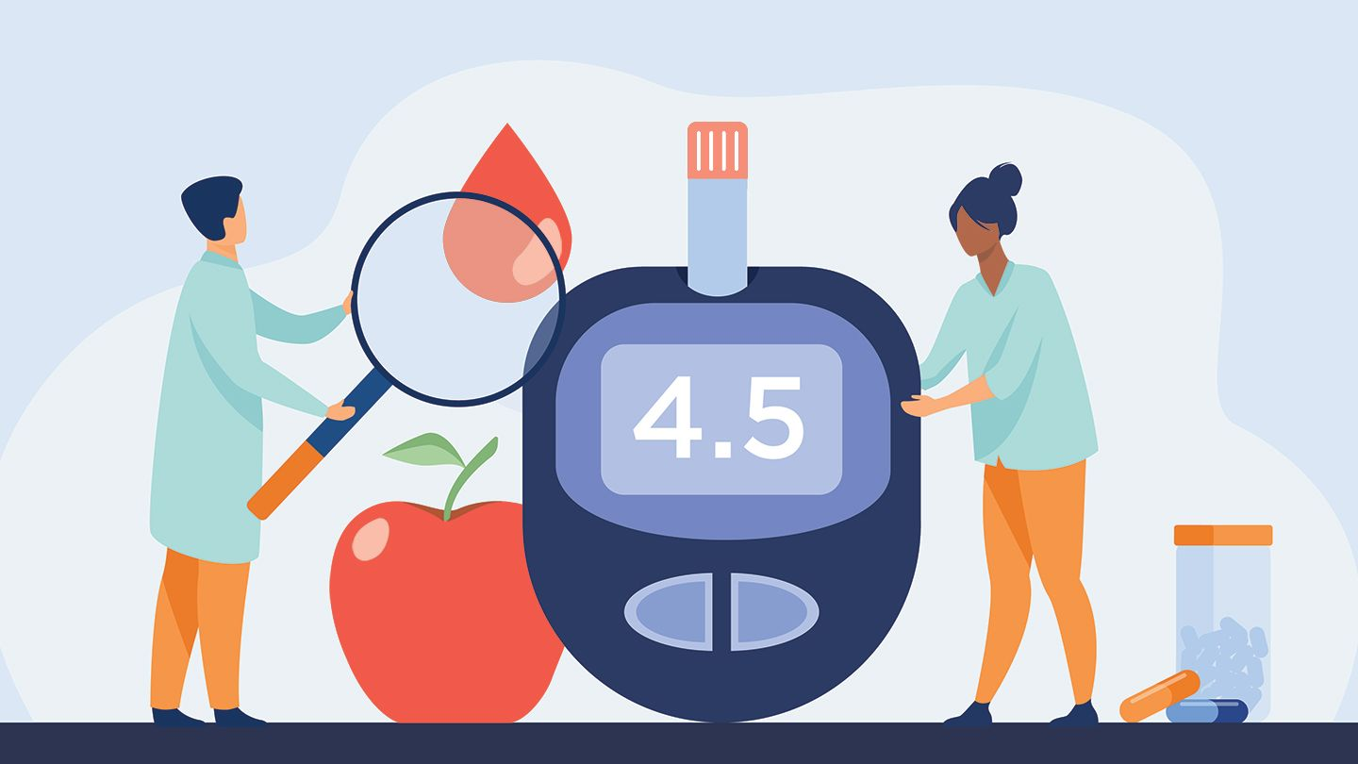
Diabetes essentials

Slide 2
ONLINE CLASS ETIQUETTE
Minimize distractions
Turn off the TV, radio, cell phone ringer
Privacy & security
Asking questions
Chat box
Zoom tips
Notes:
1) Minimize distractions on the participants’ end. Presenter: Ensure your background is appropriate/not distracting.​
​
2) Privacy & security sample script:​
-Just like online shopping or email, Virtual Care has some inherent privacy and security risks that your health information may be intercepted or unintentionally disclosed.​
-Feel free to share your personal experiences or questions during our group discussion time, but please be aware that your personal information will be shared with anyone accessing this webinar.​
​
3) Participant questions.​
-Please let me know when you have a question by typing it into the chat box (explain where to find the chat box). I will be monitoring the chat throughout the session.​
-Or you can un-mute your microphone and ask your question out loud, if you prefer.​
​
4) Zoom tips. Turning off participants’ webcams saves bandwidth and reduces freezing/glitches.​
-On the next slide, show clients how to turn their microphone and webcam on & off.​
​
5) Icebreaker/Introductions. Allow participants to introduce themselves. In the interest of time, you may want to encourage participants to introduce themselves before the class starts (while waiting for participants to log in 15 minutes before the class).​
​
Does anyone have any questions before we get started?​

Slide 3
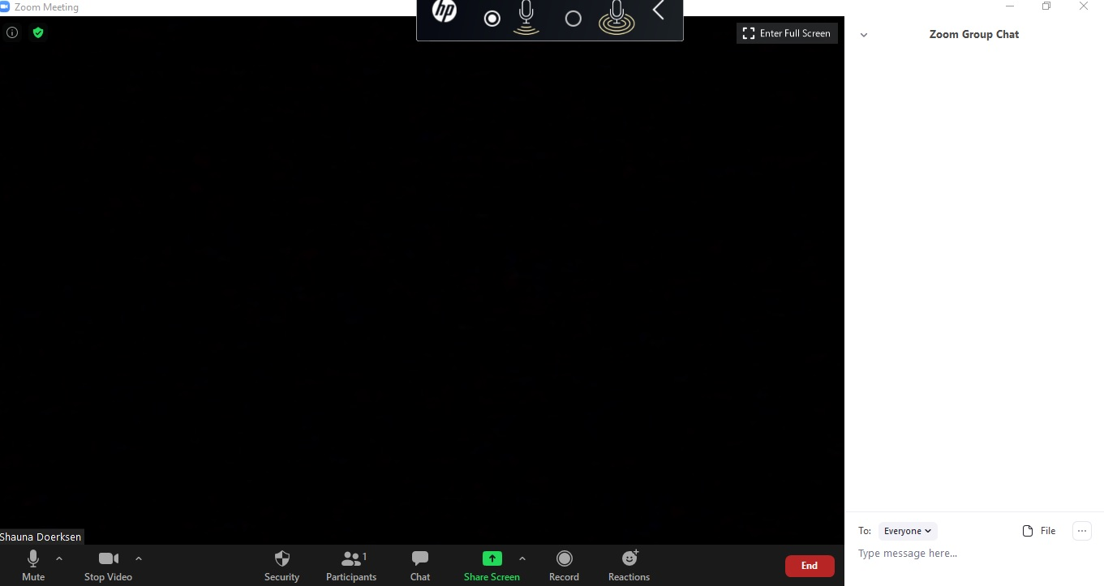
Notes:
1st animation: Arrows pointing to chat icon in taskbar and the chat box on the right side of the screen.
2nd animation: Arrows pointing to mute and stop video in the taskbar.

Slide 4
ICEBREAKER
Please share with the group if you feel comfortable:
How long you’ve lived with diabetes (or prediabetes)
One thing you’d like to learn today
Notes:
Presenter note: In the interest of time, you may want to use this icebreaker while waiting for the class to start (for participants who logged in early).

Slide 5
OUTLINE
The Basics
What is diabetes?
Risk factors
Symptoms
The numbers
Monitoring & Staying Healthy
Complications
Blood sugar monitoring
Medications
How do they work?
Things to consider

Slide 6
DID YOU KNOW?
Approximately 400,000 people live with diabetes in Manitoba
About 30% of our population
Good news: Diabetes is manageable!
Notes:
Statistic from June 2016

Slide 7
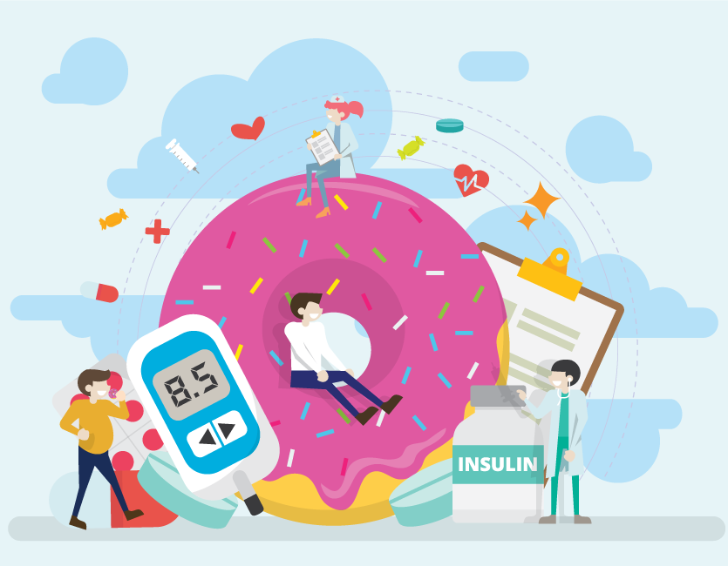
WHAT IS DIABETES?

Slide 8
GLUCOSE = SUGAR
CARBOHYDRATES AND SUGARS GET CONVERTED TO GLUCOSE BY THE BODY
GLUCOSE IS THE TYPE OF SUGAR THAT THE BODY USES FOR ENERGY
Notes:
You will hear the word “glucose” often when we talk about diabetes. Glucose is a type of sugar, and it is also the main source of energy that is used by the body.
When we eat, our body digests food into its basic nutrients. The main nutrient found in carbohydrate foods is glucose. In our next class, we will discuss what foods contain carbohydrates. For now, just know that “carbohydrate” or “glucose” equals “sugar”.

Slide 9
INSULIN
A hormone produced by the pancreas
Insulin moves glucose from the blood into the body’s cells (where glucose is used as energy)

Slide 10
INSULIN
Insulin is like a key
It unlocks the door to a cell to let glucose in

Slide 11
UNDERSTANDING BLOOD GLUCOSE
Food moves through:
Mouth
Stomach
Intestines
Intestines absorb nutrients like glucose by moving them into the blood

Slide 12
UNDERSTANDING BLOOD GLUCOSE
1. Glucose enters the bloodstream
2. Pancreas releases insulin
3. Insulin moves glucose from the blood into cells

Slide 13
UNDERSTANDING BLOOD GLUCOSE
The body balances the right amount of insulin for the amount of sugar in the blood
Diabetes = something goes wrong in this process

Slide 14
DEFINITION OF DIABETES
1. Pancreas cannot make enough insulin
AND 2. Your body cannot properly use insulin
↓
Glucose (sugar) builds up in the blood
(instead of being used as energy)

Slide 15
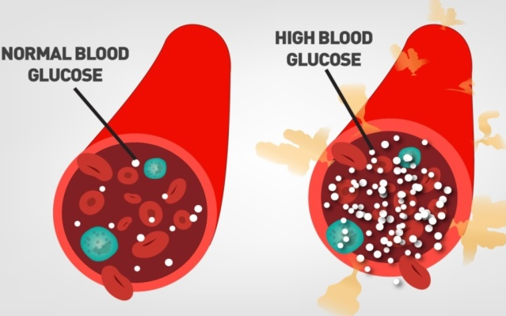
UNDERSTANDING BLOOD GLUCOSE
Type 1 Diabetes:
The pancreas stops making insulin
The person must take insulin injections to survive
Type 2 Diabetes:
The pancreas may not make insulin properly
AND
The cells don’t use insulin properly
Too much glucose
ends up in the blood!
Cells don’t get
enough energy!
Notes:
In both cases – whether type 1 or type 2 diabetes – the end result is the same. a) Too much glucose remains in the blood, and b) The body’s cells don’t receive enough energy (because glucose is trapped in the blood, instead of into the cells to be used for energy).

Slide 16
WHAT ELSE RAISES BLOOD GLUCOSE?
The LIVER
The liver stores glucose and releases it when needed
In type 2 diabetes, the liver can leak glucose into the blood at any time (even when not needed)
Notes:
The liver is especially active in releasing glucose during times of fasting or at night. If you have ever gone many hours without eating and your blood sugar went UP when you expected it to go down, or if you woke up in the morning and your blood sugar was HIGHER than when you went to bed – your liver could be to blame.
How can we manage the liver’s output of glucose?
Take metformin. Metformin helps to reduce the production and release of glucose from the liver.
Eat smaller, more frequent meals and snacks. The liver releases glucose in times of fasting, so don’t skip meals. For some people, eating a SMALL snack before bed can actually reduce the next morning’s fasting glucose level. A small amount of carbohydrate in the bloodstream can signal to the liver that it does not need to release more glucose. (e.g. 1 slice of toast with peanut butter -or- an apple and a small piece of cheese).

Slide 17
WHAT ELSE AFFECTS BLOOD GLUCOSE?
ILLNESS
Infection or fever, Physical trauma, Some cancers
Emotional and physical STRESS
Some medications for other conditions
Pregnancy-related (Gestational Diabetes)
Notes:
Illness: When we are sick, our body requires extra energy to fight off an infection or to heal from an injury. This energy comes in the form of glucose, which is used as the body’s fuel. You may notice that your blood sugar is higher when you are sick, even if you are eating less.
Stress: Whether emotional stress, or physical stress like an injury, this can raise blood sugar levels. When we are stressed, our body goes into “fight or flight mode”. Stress hormones like cortisol and adrenaline tell our body to release glucose into the bloodstream and also increase our insulin resistance.
Medications: Corticosteroids like prednisone can cause high blood sugars.

Slide 18
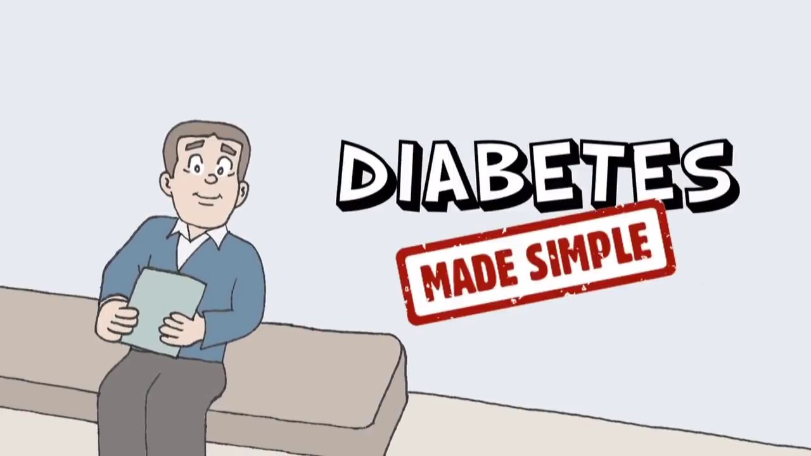
Video
https://www.youtube.com/watch?v=t0hc6zhcQy0
Notes:
Let’s watch a 4 minute video to understand what happens in our body when we have diabetes. https://www.youtube.com/watch?v=t0hc6zhcQy0
​Remind participants they can also view this video at home after the class (YouTube link is provided as part of the class handout slides).
Prior to class: Preload this YouTube link so that it is ready to go when you want to watch it.​
-Click Share Screen.​
-Choose the YouTube video, then at bottom of the window, check off “USE COMPUTER AUDIO” then press OK.​
-Be sure to mute your microphone or at least don't speak over the audio while the video is playing, because participants can hear both you and the video.​

Slide 19
TRUE OR FALSE? Diabetes is caused by eating too much sugar
FALSE
Notes:
Create a poll question in Zoom: Diabetes is caused by eating too much sugar.
a) True b) False

Slide 20
THE FACTS
NO LINK between sugar consumption and diabetes onset
Diabetes = insulin and sugar are out of balance
Eating sugar or “white” carbs can UPSET the balance, but does not cause it
There are many factors that might cause or trigger diabetes
Notes:
“White” carbs (aka refined carbohydrates) = white bread, white rice, white pasta, etc.

Slide 21
RISK FACTORS
Age 40+
Family history
Ethnicity
Diabetes during pregnancy
High cholesterol
High blood pressure
Sleep apnea
Being physically inactive
Excess weight (abdominal area)
Remember:
These are not the causes of diabetes

Slide 22
SYMPTOMS
↓ energy
↑ thirst
↑ urination
Blurry vision
Have you felt any of these symptoms?
Infections
Tingling / numbness
Difficulties with sexual function

Slide 23
TRUE OR FALSE? I would know if I had diabetes because I would feel it
FALSE
Notes:
Zoom poll question: I would know if I had diabetes because I would feel it.
a) True b) False

Slide 24
THE FACTS
Many people don’t have any symptoms!
Sometimes symptoms are vague and we don’t realize they are from diabetes

Slide 25
TRUE OR FALSE? I’m only slightly diabetic
FALSE
Notes:
Zoom poll question: I’m only slightly diabetic.
a) True b) False

Slide 26
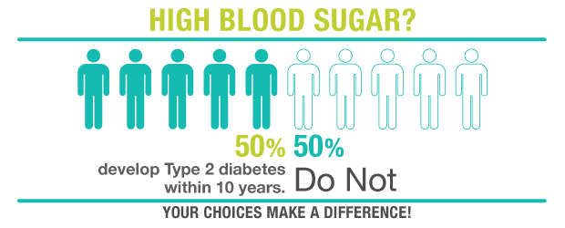
THE FACTS
Prediabetes
When blood sugar is high (elevated) but not high enough to be diagnosed with diabetes
BUT – Prediabetes is reversible!
Notes:
You cannot be slightly diabetic or have “only” mild diabetes. Either you have the disease, or you don’t. That would be the same idea as being slightly pregnant – it doesn’t exist!
However, there is a condition called prediabetes. Prediabetes is not a disease itself – it is a condition that is considered a “warning sign”. About half of people with prediabetes will develop type 2 diabetes within the next 10 years. But prediabetes is reversible, and if you make some changes to your lifestyle, you can delay or reduce your risk of developing diabetes.

Slide 27
HOW DO WE DIAGNOSE DIABETES?

Slide 28
THE NUMBERS
Fasting Glucose
How much glucose (sugar) is in the blood
Can measure at a lab or at home
Hemoglobin A1c
Average blood glucose from the past 2-3 months
Measured at the lab

Slide 29
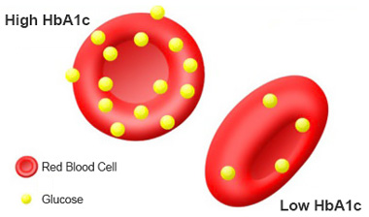
Hemoglobin A1c
How much glucose is “stuck to” red blood cells
The higher the blood sugar over time → the more glucose gets stuck
→ higher A1c

Slide 30
DIAGNOSING DIABETES
 | A1c | Fasting Glucose
No diabetes | 5.9% or lower | 6.0 mmol/L or lower
Prediabetes | 6.0-6.4% | 6.1–6.9 mmol/L
Type 2 diabetes | 6.5% or higher | 7.0 mmol/L or higher
Note: These are not the same as targets!
Notes:
The blood sugar levels that we use to diagnose diabetes are usually NOT the same level that your doctor/primary care provider will set as your target blood sugars to aim for.

Slide 31
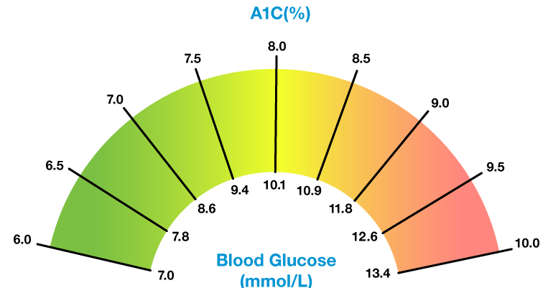
The numbers for A1c and Fasting Glucose are close, but don’t mean the same thing!
Notes:
An A1c of 7.0% corresponds to an average blood glucose of 8.6 mmol/L.

Slide 32
WHAT ELSE SHOULD WE CHECK?

Slide 33
SELF MONITORING BLOOD GLUCOSE
Glucose levels change constantly throughout the day
Eating a meal, exercising, and taking medications all affect blood glucose ( ↑ or ↓ )
Notes:
-Testing your blood glucose at home helps your doctor to monitor how well your diabetes is being managed. Sometimes people need to have their medication adjusted based on the results they are getting on their home blood glucose testing.
-If your eating or physical activity habits change, you will see a change in your blood glucose.

Slide 34
SELF MONITORING BLOOD GLUCOSE
Not everyone needs to test their glucose!
If you test, get curious!
What happens after different meals? After doing exercise?
How do you feel at different glucose levels?
Is there a pattern?
Notes:
However, not everyone needs to test their blood glucose at home - discuss with your health care provider. If you do test your blood glucose, I encourage you to get curious about the numbers that you see when you test. You can learn A LOT about your body by using these readings and then comparing what you ate, how you felt, and your activities for the day, and what your blood glucose levels were.
Bottom line: If you are testing your blood glucose but don’t understand what the numbers mean, then testing is not very helpful. I suggest that you only test if it will help you reflect on what causes your blood sugar to be high or low -OR- if your doctor asks you to monitor your blood sugars at home.

Slide 35
BLOOD SUGAR TARGETS FOR DIABETES
Targets should always be individualized
Note that these are not the “normal” values
A1c
6.5% | Considered for some people
7.0% (or less) | Most adults with type 2 diabetes
7.1% - 8.5% | People with risk factors
Blood Sugar
Before meals | 4.0-7.0 mmol/L
After meals (2 hours) | 5.0-10.0 mmol/L
Notes:
A “normal” (non-diabetic) blood sugar is NOT the same as the target blood sugar level for most people with diabetes.

Slide 36
TRUE OR FALSE? If my blood sugars go back into the normal range , then I no longer have diabetes
FALSE
Notes:
Zoom poll question: If my blood sugars go back into the normal range, then I no longer have diabetes.
a) True b) False

Slide 37
THE FACTS
Once you have been diagnosed with diabetes, you will always have it
However you treat it (diet, exercise, medications) diabetes must be managed for life

Slide 38
DIABETES COMPLICATIONS
WHAT DO YOU KNOW?
WHAT HAVE YOU HEARD?
WHAT ARE YOUR FEARS?

Slide 39
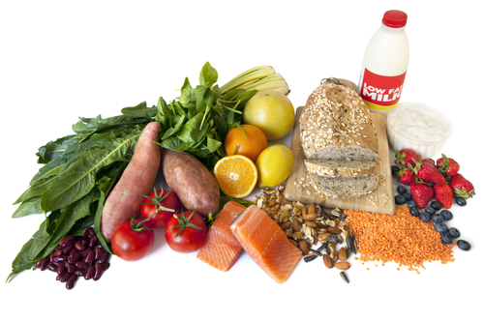
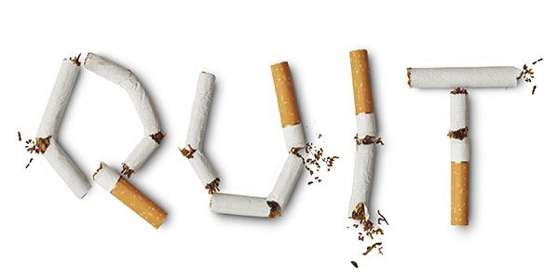
COMPLICATIONS: WHAT CAN I DO?
Healthy eating
Regular physical activity
Take medications as prescribed
Manage stress
Quit smoking
Notes:
You may have heard of the serious effects of diabetes complications. But don’t be discouraged! Almost all complications can be prevented, delayed or minimized by doing the following:
(This slide is repeated at the end of the complications section).

Slide 40
COMPLICATIONS
High blood sugar decreases blood flow and damages blood vessels
Decreased blood flow to organs causes damage
We treat diabetes to prevent complications, even if you feel well
Notes:
Presenter note: The pathophysiology of damage to blood vessels and “sticky” blood is the basis for all complications that will be discussed.

Slide 41
HEART DISEASE
High blood sugar makes blood “sticky”
High sugar also irritates blood vessels
“Sticky” blood gets stuck to irritated vessel walls and can cause a blockage

Slide 42
HEART DISEASE
Heart disease is the most common complication of diabetes
Diabetes increases your risk of heart attack and stroke
Blocked vessel in the heart = heart attack
Blocked vessel in the brain = stroke

Slide 43
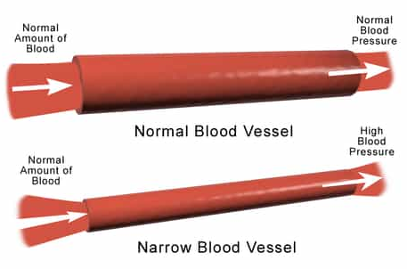
BLOOD PRESSURE
High blood pressure means blood vessels are squeezed tight
Less room for blood flow
Blockages can happen more easily

Slide 44
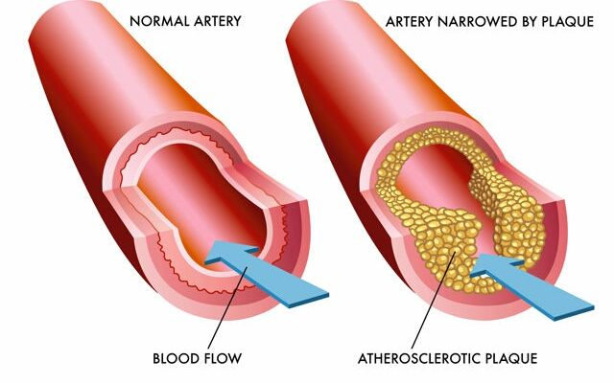
CHOLESTEROL
Cholesterol plaque makes blood vessels narrow
Not all cholesterol is bad!
LDL (bad cholesterol) builds up / worsens plaque
HDL (good cholesterol) removes plaque

Slide 45
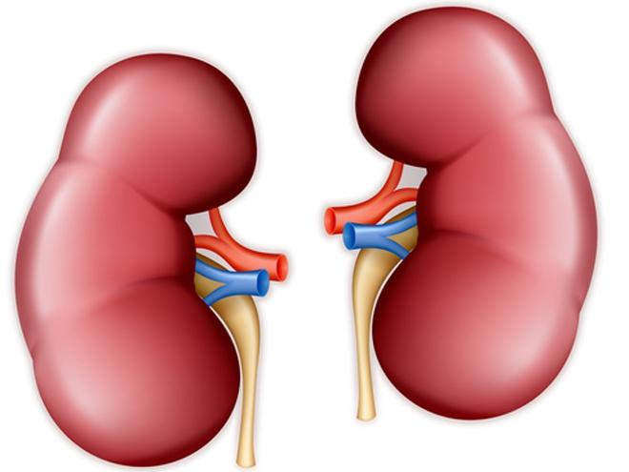
KIDNEYS
Diabetes increases risk of kidney disease and can lead to dialysis
Kidneys filter blood
“Sticky” blood flows slowly and gets stuck (causes kidney damage)
Imagine putting syrup through a coffee filter!

Slide 46
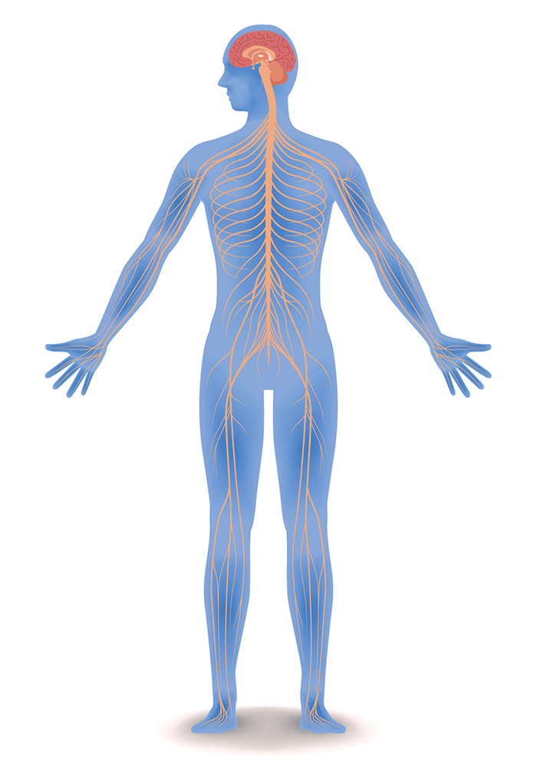
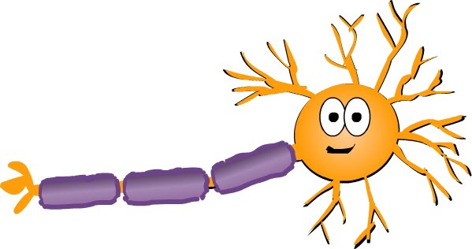
NERVES
Nerves have tiny blood vessels
“Sticky” blood can clog the nerve vessels
Leads to chronic pain or numbness
Dying nerves = pain
Dead nerves = numbness

Slide 47
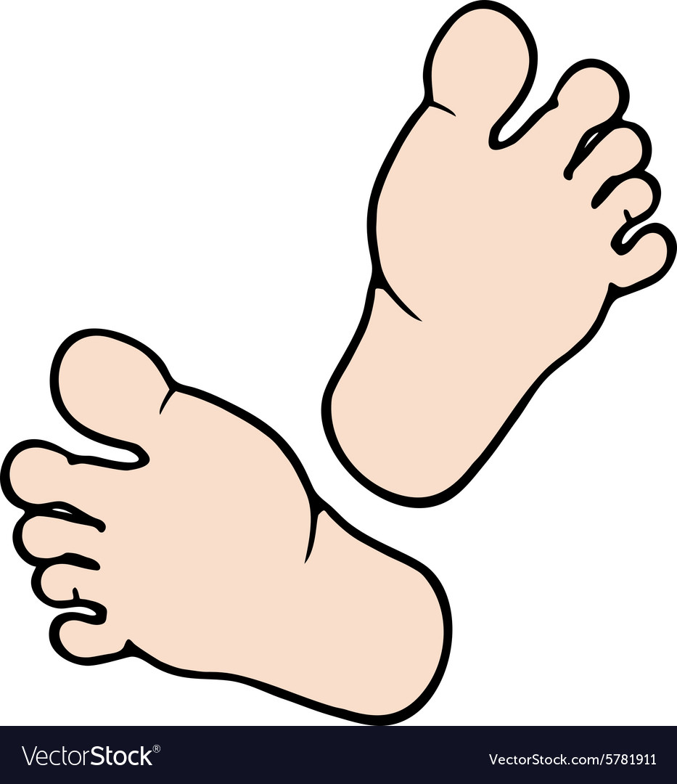
FEET
High sugar in blood feeds bacteria
A small injury that goes unnoticed (nerve damage) can get infected
High blood sugar causes delayed healing of cuts and wounds
Worst case scenario = amputation

Slide 48
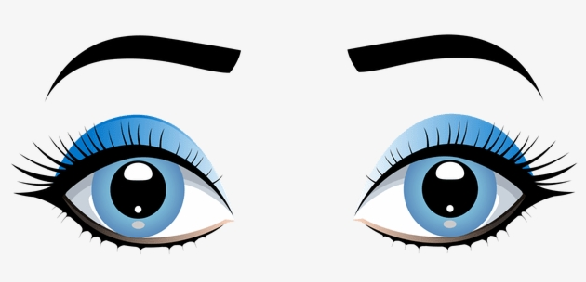
EYES
Diabetes increases risk of eye problems
Cataracts, Glaucoma, Retinopathy
The eye has many tiny nerves and blood vessels
“Sticky” blood can clog the eye vessels and damage nerves
Worst case scenario = blindness

Slide 49
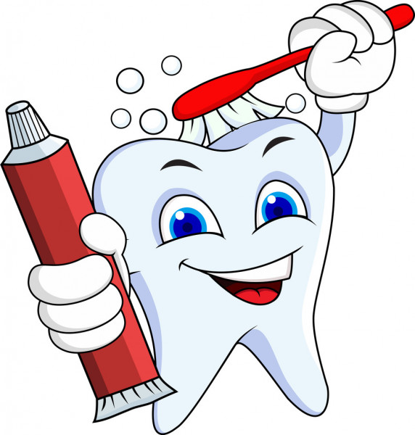
ORAL HEALTH
High sugar feeds germs in the mouth
Diabetes increases risk of:
Dry mouth
Thrush (yeast infection)
Cavities
Dental or gum infections
Gingivitis (gum disease) increases risk of heart disease
Notes:
Gingivitis → heart disease: More bacteria in the bloodstream → More systemic inflammation → Heart disease.
---Background information---
-Poor oral hygiene is associated with gingivitis (a reversible inflammation of the gum tissue – i.e. red, swollen gums). Gingivitis can progress to more severe infection and inflammation, which can lead to periodontal disease (infection of the bones and tissues that support the teeth).
-Infections are more common if blood glucose control is poor. Inflammation is associated with decreased insulin sensitivity, and thus further worsening of blood glucose control.
-Up to 50% of all American people (with & without diabetes) have reversible gingivitis. People with diabetes tend to have the same rates of gingivitis as those without diabetes, but having diabetes was linked with more severe forms of periodontal disease. However, good oral hygiene improves gingival health.

Slide 50
MENTAL HEALTH
Brain cells use glucose for energy (fuel)
Not enough insulin = brain cells can’t use glucose (brain cells “starve”)
Starving brain cells can’t produce neuro-transmitters
Diabetes can cause or worsen depression, anxiety, and dementia

Slide 51
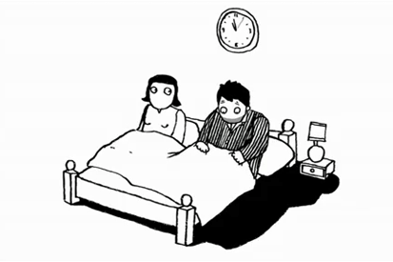
SEXUAL HEALTH
Blood flow and Nerve function are important for sexual function
Erectile dysfunction can be an early warning sign of heart disease

Slide 52
THINGS TO MONITOR
Hemoglobin A1c
Blood test every 3-6 months
Blood pressure
Check at every doctor’s visit
Different target for each person
Cholesterol
Blood test to determine your cardiovascular risk
Some people may benefit from medication (statin)

Slide 53
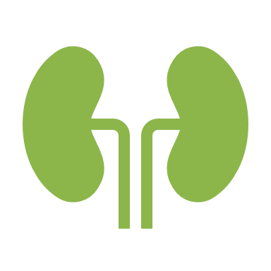
THINGS TO MONITOR
Kidneys
Blood test (measures filtering speed)
Urine test (measures kidney damage)
Feet and Nerves
Yearly monofilament test (checks the sensation of your feet)
Daily foot check at home
Look for cuts, broken nails, or infection
Tips: Use a mirror; Moisturize; Dry well between toes

Slide 54
THINGS TO MONITOR
Eyes
Yearly eye exam
Tell your optometrist that you have diabetes
Oral health
Daily mouth care
Watch for gums that are red, puffy, tender, or bleeding (even a little bit) or persistent bad breath
Dental check-up and cleaning every 6-12 months
Tell your dentist and dental hygienist that you have diabetes
Notes:
Daily mouth care: Brush teeth 2+ times daily and floss once daily.

Slide 55
THINGS TO MONITOR
Mental health
Talk to your doctor if you have concerns
Counseling, medications, and other supports are available
Sexual dysfunction - improve symptoms by
Improving diabetes control (lowering glucose)
Improving mental health
Taking medications if needed

Slide 56
Diabetes Management What else can I do to stay healthy?

Slide 57
THE GOOD NEWS
Every complication that we discussed can be prevented, improved, or delayed by:
Taking medications as prescribed
Healthy eating (Class 2)
Regular physical activity (Class 3)
Managing stress (Class 4)
Quitting smoking
Notes:
As we just saw, there are many things that you and your health care provider can do to delay, minimize, or prevent complications from developing. For the rest of our 4 week series, we will focus mostly on the things that are within your personal control.

Slide 58
MANAGING BLOOD SUGARS AND DIABETES
Physical Activity
Medication
Nutrition
Notes:
There are 3 main approaches to managing diabetes. All of them work in combination with each other. We are going to discuss nutrition and physical activity in more detail in our upcoming classes. For the remainder of today’s class, we will focus on medication.

Slide 59
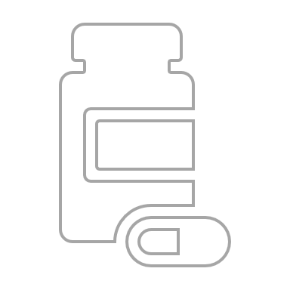
MEDICATIONS

Slide 60
TRUE OR FALSE? Going on a medication for diabetes means that I’ve failed my diet / exercise plans and my diabetes is getting worse
FALSE
Notes:
Zoom poll question: Going on a medication for diabetes means that I’ve failed my diet / exercise plans and my diabetes is getting worse.
a) True b) False

Slide 61
THE FACTS
Diabetes is progressive
What works today may not always be enough in the future
Healthy behaviours are always beneficial
Medications are used in addition to lifestyle changes
The higher your risk, the more benefit medications provide
It’s a combined effort!
Notes:
Combined effort = Combine the effects of diet + physical activity + medications.

Slide 62
WHAT DO MEDICATIONS DO?
Improve symptoms
Decrease HEALTH risks

Slide 63
MEDICATION: THINGS TO CONSIDER
PROS
CONS
Lower cost medications
Possible side effects
Weight loss
Lower risk of complications, heart disease, or death
Frequency (once a day, once a week)
Higher cost medications
Possible side effects
Risk of low blood sugar
Upset stomach
Weight gain
Yeast infections
Injection (insulin or other drugs)
Notes:
Any time your doctor/NP suggests to start a medication, there are many pros and cons to consider. Have a conversation with your doctor or pharmacist about why they recommend a medication for you.
You can also make an appointment with the pharmacist at your drugstore to review your medications, learn about why you are taking them, and any side effects or other benefits they provide.

Slide 64
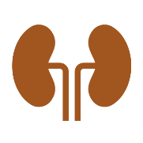
Ways THAT medications lower glucose levels
Help your body’s insulin work better
Make more insulin
Slow glucose release from “leaky liver”
Slow glucose absorption from GI tract (gut)
Increase glucose removal by kidneys
Slow food through gut, decrease appetite
Notes:
Presenter notes: Symbols match the mechanism of medication classes (lock, eye, turtle, hourglass, kidney, plate). Symbols will appear on the slides ahead.
Review these next slides quickly. Highlight the overall message that medications work in many different ways, and that you may be prescribed more than one medication for diabetes because they have different mechanisms of action. Information is provided so that, after the class, participants can review the slides and reflect on the medications that they personally take. Encourage clients to talk to their doctor or pharmacist if they have more questions about medications.

Slide 65
Metformin
Helps insulin work more effectively
Slows down the “leaky liver”
Empagliflozin Dapagliflozin Canagliflozin Jardiance Forxiga Invokana
Increase glucose removal by the kidneys
Notes:
---Information in the speaker notes is provided for background information only. Do not read this as part of the class unless participants have a specific question---
Metformin:
-Often a first choice of medication.
-Reduces insulin resistance, increases glucose uptake by muscle and other tissue, inhibits hepatic gluconeogenesis.
-Pros: a) Low cost (~$10/month), b) Minimal side effects, c) Decreases your risk of dying (cardiac risk decreased by 35% in 10 years).
-Cons: Diarrhea/Upset stomach. (Often gets better with time. Start with a low dose and titrate slowly; Take with food).
Empagliflozin/Dapagliflozin/Canagliflozin (SGLT2 inhibitors):
-Mechanism: Increases urinary excretion of glucose / “pee out sugar” / reduces reabsorption of glucose in the kidneys.
-Pros: a) No hypoglycemia, b) Weight loss (2-3 kg), c) Reduce blood pressure (5/2 mmHg), d) Decrease risk of heart disease (Best evidence with empagliflozin and dapagliflozin).
-Cons: Higher cost (~$100/month), b) Yeast infections possible.

Slide 66
Glyburide Gliclazide Repaglinide Diabeta Diamicron Gluconorm
Increase the amount of insulin produced in the body
Sitagliptin Linagliptin Saxagliptin Januvia Trajenta Onglyza
Increase the amount of insulin produced in the body
Decrease appetite / slows food leaving stomach
Notes:
---Information in the speaker notes is provided for background information only. Do not read this as part of the class unless participants have a specific question---
Glyburide/Gliclazide/Repaglinide (Sulfonylureas):
-Pros: a) Low cost (~$25/month), b) Lowers glucose = helps you feel better (i.e. less symptomatic).
-Cons: a) Risk of low blood sugar, b) Does not decrease heart disease risk.
Sitagliptin/Linagliptin/Saxagliptin (DPP-4 inhibitors):
-Pros: a) No hypoglycemia, b) Lowers glucose = helps you feel better (less symptomatic).
-Cons: a) Higher cost (~$100/month), b) Does not decrease heart disease risk.

Slide 67
Liraglutide Semaglutide Dulaglutide Victoza Ozempic Trulicity
Increase the amount of insulin produced in the body
Decrease appetite / slows food leaving stomach
Pioglitazone Actos
Helps insulin work more effectively
Notes:
---Information in the speaker notes is provided for background information only. Do not read this as part of the class unless participants have a specific question---
Liraglutide/Semaglutide/Dulaglutide (GLP-1 receptor agonists):
-Semaglutide and Dulaglutide are taken once a week. Liraglutide is taken daily.
-Pros: a) Weight loss (1.5-3 kg) b) No hypoglycemia, c) Lowers risk of heart events (e.g. MI, stroke)
-Cons: a) High cost (~$225/month), b) Requires an injectable (but are not insulin). Semaglutide has an oral (pill) option but that version is not covered by MB Health/EDS.
Pioglitazone:
-Rarely used anymore.
-Pro: Lowers glucose = helps you feel better (i.e. less symptomatic).
-Cons: a) Causes fluid gain (edema) which can worsen heart failure, b) Does not decrease heart disease risk.

Slide 68
Insulin
Increases the amount of insulin in the body
Used when other medications are not enough
Remember:
Diabetes is progressive
Over time, insulin-making cells in the pancreas wear out
Insulin injections “top up” the body to the insulin level it needs
Notes:
Pros:
a) Lowers glucose = helps you feel better (i.e. less symptomatic).
b) Must be injected, but NOT painful. Much LESS painful than checking blood sugar (by finger poke).
c) Insulin injections are usually given only 1-2 times per day, usually at bedtime or first thing in the morning. (Don’t need to take basal insulin at a restaurant).
d) Low blood sugars are less common with newer types of insulin.
e) May be less costly than newer oral medications (cost depends on insulin dose).
Cons:
a) Risk of low blood sugar (hypoglycemia).
b) Does not decrease heart disease risk.

Slide 69
MEDICATIONS
Medications work in different ways
You may need several medications in combination to lower glucose and reduce your risk of diabetes complications

Slide 70
OTHER MEDICATIONS
Blood pressure pills
Lower heart disease risk (if you have high blood pressure)
Some may help protect your kidneys, regardless of your blood pressure level
Cholesterol pills (statins)
Reduce heart disease risk, regardless of cholesterol level
Notes:
Blood pressure pills (ACE inhibitors/ARBs): Decrease cardiac risk by 35-50% in 10 years (IF you have high blood pressure).
Cholesterol pills (statins): Decrease cardiac risk by 25-35% in 10 years (REGARDLESS of cholesterol level).

Slide 71
POLL QUESTION
How would you prefer to manage your diabetes?
Prescription medications
Vitamins / Natural supplements
Both (prescriptions + natural products)
Neither (diet + exercise only)
Notes:
Zoom poll question: How would you prefer to manage your diabetes?
a) Prescription medications
b) Vitamins / Natural supplements c) Both d) Neither
(There is no correct answer to this question; this is simply used to judge the type(s) of treatment preferred by your participants).

Slide 72
NATURAL HEALTH PRODUCTS
Natural health products can be advertised as treatments, regardless of how safe or effective they are
Natural products are not required to be studied as in-depth as prescription medications
If you are taking a supplement for any reason, tell your health care team, so they can make sure it is safe for you

Slide 73
Notes:
However you decide to manage your diabetes, remember that YOU are at the center of your care. You have the right to ask questions and to determine what type of treatment plan you want to follow. Ultimately, you are in control and your health care team is here to support YOU.

Slide 74
DIABETES RESOURCES
Diabetes Canada
www.diabetes.ca
Heart & Stroke Foundation
www.heartandstroke.ca
Other health education groups
www.wrha.mb.ca/groups
Health Links (204) 788-8200
Your diabetes care team: Doctor/NP, Nurse, Dietitian, Community Pharmacist, Physiotherapist, OT, etc.
Notes:
For participants who request a 1-on-1 appointment with a diabetes educator:
Encourage participants to attend all of the classes in the diabetes series first, as the classes may answer all of their questions.
If clients still want a 1-on-1 after attending all the classes, they now have the basic knowledge to have an effective visit with a CDE/clinician.

Slide 75
SMOKING RESOURCES
Smoker’s Helpline
1-877-513-5333
Manitoba Lung Association www.mb.lung.ca
Peer support online www.facebook.com/groups /ManitobaQuits
Education / support groups, including Commit To Quit and Packing It In classes www.wrha.mb.ca/groups

Slide 76
Thank you!
Any questions?
Use the chat function or un-mute your microphone
Notes:
Evaluation: To be completed at the end of the series (not after each class).

Slide 77
ACKNOWLEDGMENTS
Development team:
Karin Ens, BScPharm EPPh CDE & Jennifer Gibson, BSP ACPR EPPh
Reviewer team:
Aimee Bowcott, MPH RD CDE CRE; Cindy Campbell, OT Reg (MB) CRE; Shauna Doerksen, RD CDE; Jenna Hart, RD CDE; Jodis McCaine, RD; Sheila Pelagio, BHEcol BN RN CTE; Colin Reeve, BSP CDE CRE CTE; Cindy Sanchez, RN BN CDE; Cheryl Shaver, BScPharm CTE; Maggie Wallin, BMR-PT CRE

